Slide 1
Data Quality

Slide 2
95% of this lecture is taken from the NCGIA Core Curriculum in GIScience. https://escholarship.org/uc/spatial_ucsb_ncgia_cc
What follows is my extraction and interpretations on what is most important.

Slide 3
First, a definition. Learn it. Love it.
Data quality can be defined as “accuracy, precision, consistency, and completeness over space, time, and theme relative to the database specifications.”
To start with the last bit, all data is good… and all data is bad. It all depends on what you need it for! What is perfect for one application may be worthless for the next. Always keep this in mind. Afghanistan story.
I’ll now walk through this more or less in order: spatial accuracy, temporal accuracy, thematic accuracy, spatial precision, temporal precision, …..

Slide 4
But first, who cares?
Well, everyone. Because GIGO (if you don’t know this acronym, look it up).
Without good data, your work will be at best worthless, and at worst, it will kill people.
AI is bad at much of this. Especially the “relative to DB specs” part.

Slide 5
How do we assess it?
The most common is metadata standards. In short, the data creator publishes good metadata – and the users are responsible for making sure the data is good for their application. In short, buyer (user) beware.
  Federal data usually has excellent metadata and QA/QC standards.
  Beyond that, it varies a lot.

Slide 6
Accuracy!
Accuracy is the inverse of error. Many people equate accuracy with quality but in fact accuracy is just one component of quality.
An error is a discrepancy between the encoded and actual value of a particular attribute for a given entity. “Actual value” implies the existence of an objective, observable reality. However, reality may be:
  Unobservable (e.g., historical data)
  Impractical to observe (e.g., too costly)
  Perceived rather than real (e.g., subjective entities such as “neighborhoods")

Slide 7
Spatial Accuracy
This can be defined as the distance between a true location and the measured location. Usually measured in meters (for example, a standard GPS has an “accuracy” of 10m. Which means that two standard deviations of the data (96%) will fall within 10m of the correct location.
Obviously, this is easy for points. Trickier for lines and polygons. Though I always fall back to those points… as lines and polygons are just connected points.
For rasters, the sptial accuracy is the same as the pixel size (assuming the pixel size is representative of the way in which the data was collected). You can’t decrease pixel size to increase accuracy. Landsat TM data. Thermal resampled from 120 to 30. Multispectral Scanner System (MSS): nominal ground resolution of 80 meters (specifically, a ground sampling interval or pixel size of roughly 57 meters by 79 meters) across four spectral bands

Slide 8
Temporal accuracy
Temporal accuracy is the agreement between the encoded and “actual” temporal coordinates for an entity.
Temporal coordinates are often only implicit in geographical data, e.g., a time stamp indicating that the entity was valid at some time. Often this is applied to the entire database (e.g., a map dated “1995”).
More realistically, temporal coordinates are the temporal limits within which the entity is valid (e.g., Pothole Q54D-35-021 existed between 2/12/96 and 8/9/96).
Temporal accuracy is NOT the same as “currentness” (or up-to-dateness) which is actually an assessment of how well the database specification meets the needs of a particular application. A database can be temporal accurate but still out of date; historical applications depend on such data.
  Data can be 100% accurate, but not current. This is why dates are an important part of metadata.

Slide 9
Thematic Accuracy
the accuracy of the attribute values encoded in a database
For example, you are mapping roads. If you label the interstate as an interstate, you are accurate. If you label it as a state highway, it’s not accurate.

Slide 10
Precision (or resolution, in the GIS world)
Resolution (or precision) refers to the amount of detail that can be discerned in space, time or theme. Resolution is always finite because no measurement system is infinitely precise, and because databases are intentionally generalized to reduce detail
Resolution is an aspect of the database specification that determines how useful a given database may be for a particular application. High resolution is not always better; low resolution may be desirable when one wishes to formulate general models.

Slide 11
Spatial Precision
For rasters, it’s the cell size. In fact, for rasters, spatial precision and accuracy are the same. What you see is what you get.
  Not really true for vector – consider that GPS point. It’s really a 10m fuzzy area, not a point defined down to the nearest mm. But! Spatial precision in vector typically appears higher than it really is.
For lines, you might consider both the precision of the points and how frequently those points are collected. For example, for a road, do you take a point every meter (usually along the center line) – or every 10? Or 100?
For polygons, we use something called the minimum mapping unit. How big does something have to be before I bother to map it.
  Take the example of a forest – how many trees does it take to call it forest?

Slide 12
Temporal Resolution
Basically, how long it took to collect the data.
  For example, for photos, it’s the shutter speed of the camera. It’s capturing that data over a very small time period.
  If I were mapping, say, roads. And it took me a year to complete my map of Kittitas county, the temporal res of that dataset would be a year.

Slide 13
Thematic resolution
This has to do with the number of categories I am dividing my data into.
  As an example, again, roads. If my categories are interstates, state highways, and other – that’s a pretty low resolution.
  If I went with interstates, state highways, county roads (paved), county roads (unpaved), city roads, forest service roads, private roads, etc – that would be a pretty high thematic resolution.

Slide 14
Consistency
Consistency refers to the absence of apparent contradictions in a database. Consistency is a measure of the internal validity of a database
Consistency can be defined with reference to the three dimensions of geographical data.
  Spatial consistency includes topological consistency, or conformance to topological rules, e.g., all one-dimensional objects must intersect at a zero-dimensional object (Kainz, 1995).
  Temporal consistency is related to temporal topology, e.g., the constraint that only one event can occur at a given location at a given time (Langran, 1992).
  Thematic consistency refers to a lack of contradictions in redundant thematic attributes. For example, attribute values for population, area, and population density must agree for all entities.

Slide 15
Consistency 2
Mostly, we worry about thematic consistency. For any given dataset, we want everyone involved to collect exactly the same data the same way.
As a side note, this is something we had problems with when sampling mudflats in Australia with a lot of volunteers. For the most part, the volunteers did what they were told and were consistent. It was the scientists that went off on their own and treated that little part of the database more as they would their personal field notes.
  Yeah, we had some serious consistency problems.

Slide 16
Completeness – it’s kinda fun.
And we tend to subdivide it into incomplete and overcomplete.
Incompleteness can be measured in space, time or theme . Consider a database of buildings in Minnesota that have been placed on the National Register of Historic Places as of the end of 1995.
  Spatial incompleteness: The list contains only buildings in Hennepin County (one county in Minnesota, rather than all of Minnesota).
    Over complete would be including buildings in Michigan
  Temporal incompleteness: The list contains only buildings placed on the Register by June 30, 1995.
    Temporally overcomplete would be including more recent buildings.
  Thematic incompleteness: The list contains only residential buildings.
    Overcomplete would be including buildings that aren’t on the historical register.

Slide 17
Summary
Data quality is the degree of excellence in a database. Quality is assessed relative to the database specification, which defines the desired level of generalization and abstraction. The quality of this specification, and its appropriateness for particular applications, can also be assessed.
Quality assessment and reporting is based primarily on metadata standards (truth-in-labeling and fitness-for-use).
Data quality is contains several components, including accuracy, precision, consistency and completeness. Each component can be assessed in space, time and theme (the three basic dimensions of geographical data).
Various assessment methods can be used for each component/dimension combination. Some methods are well-developed and others are not.

Slide 18
That’s nice, Bob. But how do I assess my data?
In an ideal world, you know what’s happening in the real world, so you can then know how your data stacks up. Field knowledge is always, always, always valuable. Get as much as you can.
Be critical. Assume the data is crap and work from there. Look at it from many angles.
Compare it to data you know the standards for. In the US, the best usually available are USGS 1:24000 topo sheets. Downloaded from the USGS so you know someone hasn’t mucked them up. Quad sheets have full, published metadata standards.

Slide 19
https://spatialreserves.wordpress.com/2018/11/26/a-graphical-aid-in-deciding-whether-geospatial-data-can-be-used/
https://www.linkedin.com/pulse/gis-gigo-garbage-out-30-checks-data-errors-nathan-heazlewood/
https://www.linkedin.com/pulse/gis-gigo-garbage-out-30-checks-data-errors-nathan-heazlewood/

Slide 20
Ooohhh.. Let’s see if I have any data quality cartoons.
Any excuse to browse my ‘toons…. I’m sure XKCD did something… A few that are vaguely relevant.

Slide 21
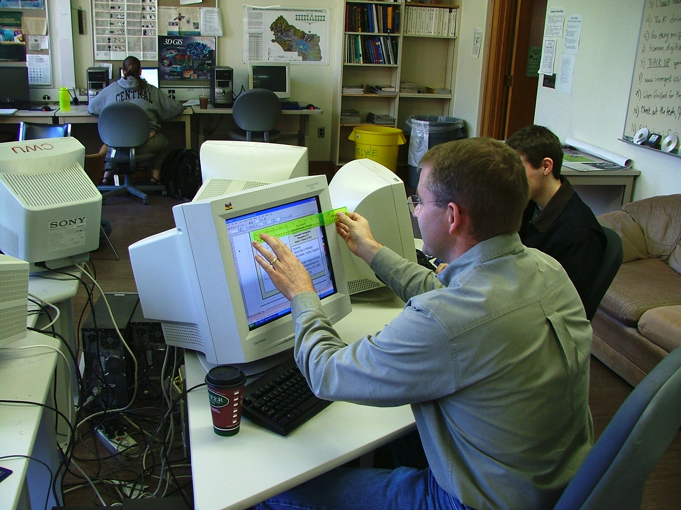
Precision measurements in the old gis lab.

Slide 22
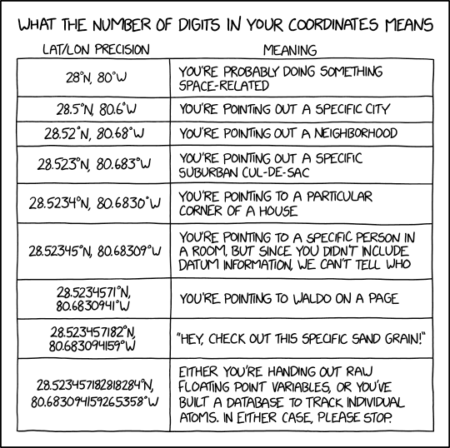

Slide 23
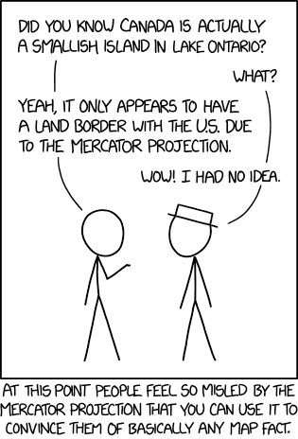
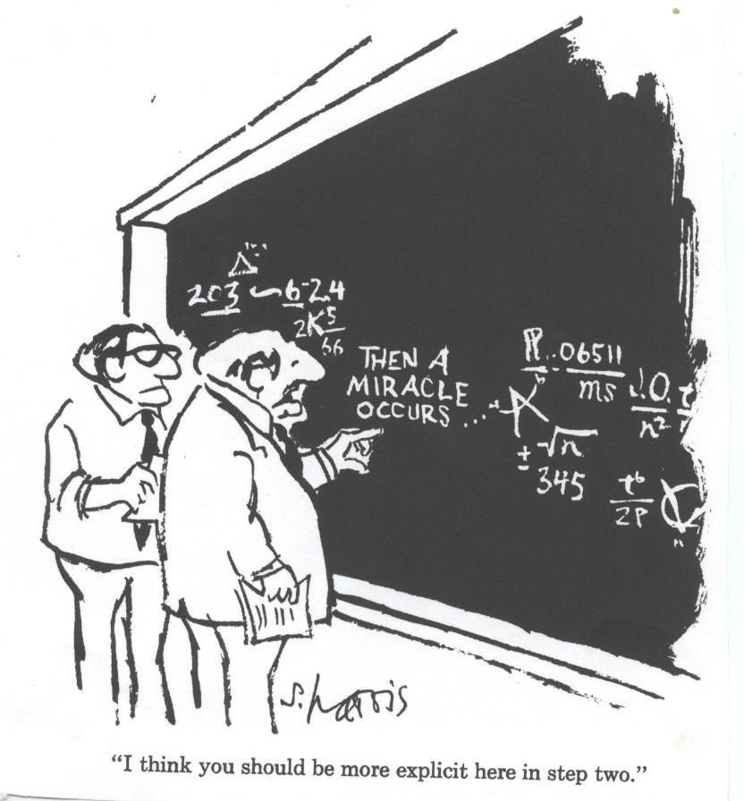

Slide 24

