Slide 1
Where are you?
A guide to coordinate systems, datums, projections, and geoids.

Slide 2
Assigning a number
Coordinate systems. Can be local or global. Which include:
  Latitude/Longitude
  Universal Transverse Mercator (UTM)
  EOV (Egységes Országos Vetületi rendszer, or Uniform National Projection system)
  In the US – include State Plane.

Slide 3
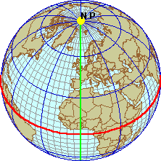
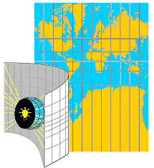
Coordinate Systems
Geographic vs. Projected
Geographic Coordinate Systems (GCS)
    Location measured from curved surface of the earth
    Measurement units latitude and longitude
      Degrees-minutes-seconds (DMS)
      Decimal degrees (DD) or radians (rad)
Projected Coordinate Syst (PCS)
    Flat surface
    Units can be in meters, feet, inches
    Distortions will occur, except for very fine scale maps

Slide 4
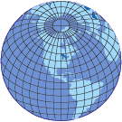

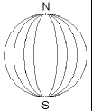
Lat/Long
Latitude/Longitude Lines of latitude Longitude lines
N or S of Equator E or W of Prime Meridian
Also called parallels and meridians

Slide 5
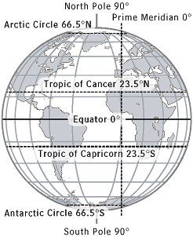

Slide 6
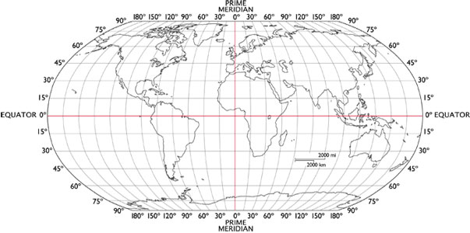
Lat/Long

Slide 7
Solving longitude? http://cudl.lib.cam.ac.uk/collections/longitude
https://www.rmg.co.uk/about-us/board-longitude
Master and Commander books. By Patrick O’Brian. Skip the movie.

Slide 8
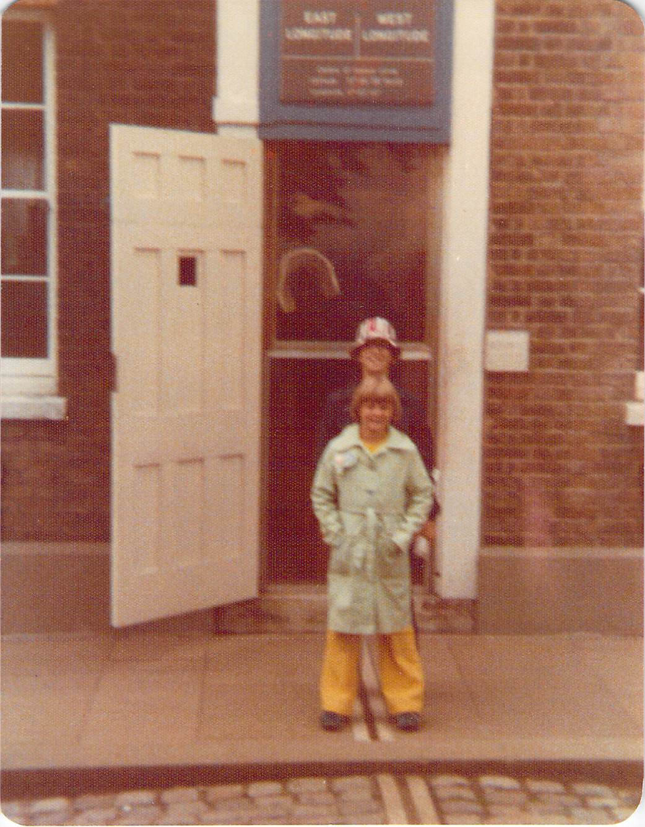

Slide 9
Universal Transverse Mercator
Basically, slicing the globe into a series of vertical “peels”
False easting and false northing set for both hemispheres
Everything becomes a grid in meters.
Basically the same as what the military uses!

Slide 10
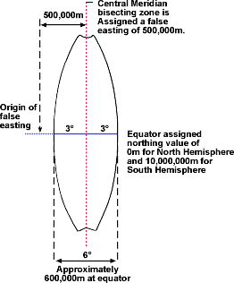

Slide 11
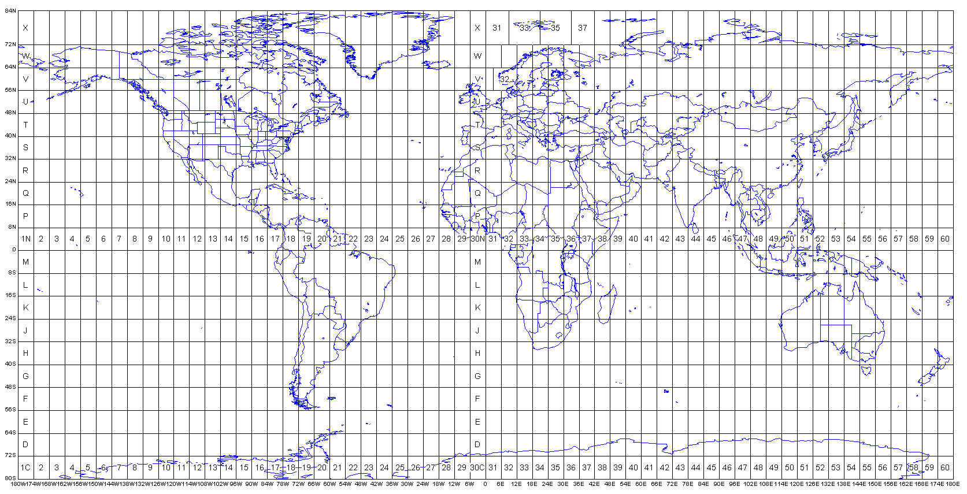

Slide 12
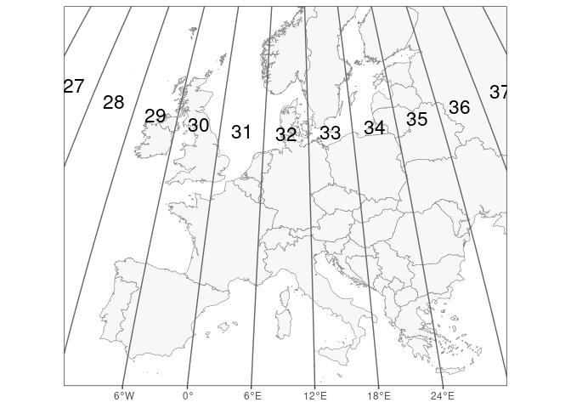
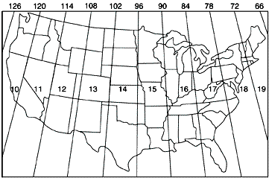

Slide 13
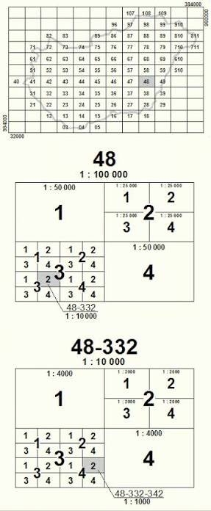

EOV

Slide 14
What about the shape of the earth?
It’s not spherical. Not even close. Which would, however, make the math easy.
It’s not even a spheroid…. (two axes of different length)
It’s considered an oblate spheroid…. In other words, a spheroid with bulges and pits. Think a squashed golf ball.
So, we need a mathematical model of the shape of the earth – a datum.
Picture a transparent ball. Now draw lat/long onto it. Put a lightbulb inside. Light the bulb and look at the reflection of the lat/long on the wall. Now, distort the ball – the location of the lines changes.
So, to have accurate coordinates, we need an accurate model of the earth.

Slide 15
They can be centered at the center of the earth or on the surface
Which, really depends on the technology of the time.
They can also be “local” or global.

Slide 16
Datums – the ones to worry about
Clarke 1866
North American Datum of 1927 (NAD27)
NAD83
WGS84
Hungarian Datum 1972 (HD72)
Note which are earth centered. And the approximate error between them.
Explain why local datums/coordinate systems are important.

Slide 17
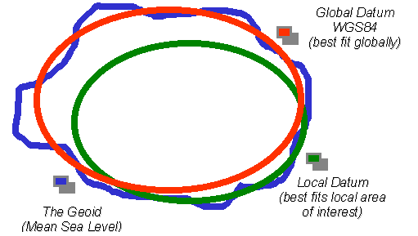

Slide 18
The Geoid
Basically, a high end datum based on gravity.
Needed for crazy accurate measurements – not something most of us will ever need to deal with.
But, gravity isn’t a constant: https://apod.nasa.gov/apod/ap141215.html

Slide 19
What about projections, though???
A projection is just a way of getting a 3D object (the earth) onto a 2D surface (screen or paper map). It has nothing to do with accuracy, coordinates, or datums.
Important point – projections always distort – what they distort and how much is up to the cartographer.

Slide 20
Projection classification
1) By Geometric construction
  Conic
  Cylindrical
  Azimuthal
  Modified by
    Aspect (equatorial, polar, oblique)
    Case (Tangent, secant, polyconic)
or

Slide 21
Classification 2
2) by preserved properties
  Area (equal area or equivalent projections)
  Angle (shapes are correct – conformal projections). Note, angle and area are mutually exclusive. Mercator!
  Distance (equidistant projections) – distances between points are correct. But only to/from a single point! The center
  Azimuth. Great circles are straight lines. Often viewed with the poles at the center. Only applies to/from a single point. The center.
  Compromise. Nothing is preserved. But nothing super distorted, either.
Now, let’s look at some images. Much of the below swiped from Pease.

Slide 22
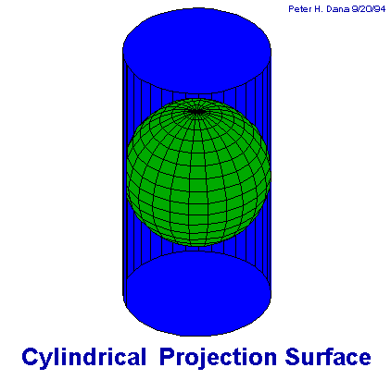

Projections
projecting a spherical surface onto a cylinder. minimize distortion along the equator (in the normal position).

Slide 23
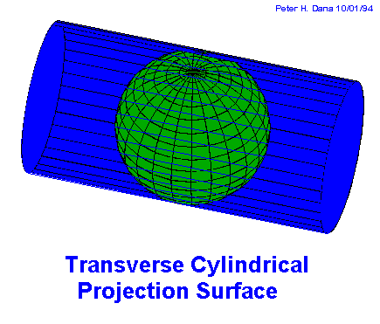
Projections
A transverse projection is rotated 90° from the normal projection.
As the line of tangency is along a meridian instead of a parallel, this reduces distortion along a north-south line while distortion increases on either side in an east-west direction.

Slide 24
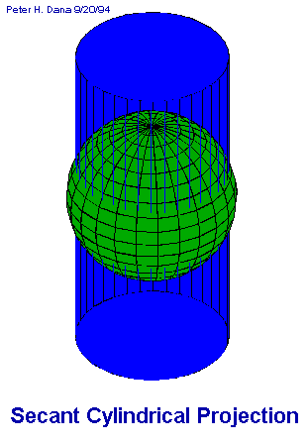

Projections
The secant projection intersects the Earth at two locations creating two standard lines, in this case minimizing distortion along the two standards and reducing the overall distortion away from the standards as compared to a more traditional projection.

Slide 25
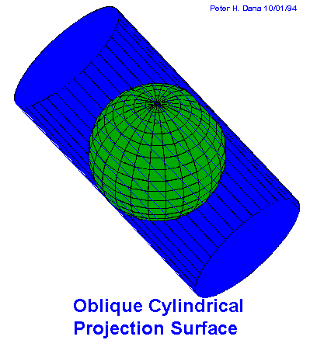
Projections
The oblique projection intersects the Earth at some other angle other than along the meridians or parallels.

Slide 26
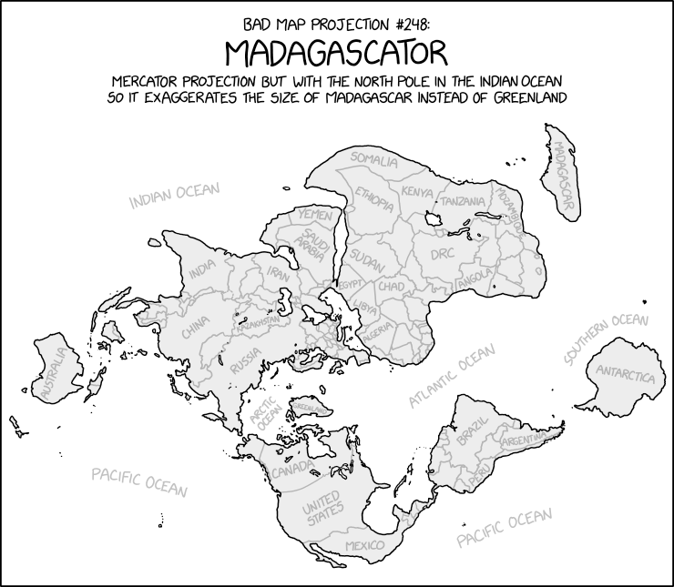

Slide 27
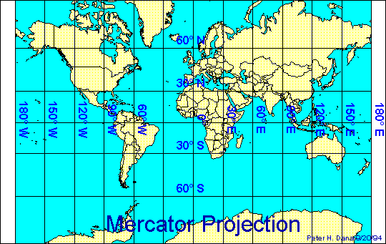
straight meridians and parallels that intersect at right angles.
Scale is true at the equator or at two standard parallels equidistant from the equator.
used for marine navigation because all straight lines on the map are lines of constant azimuth.

Slide 28
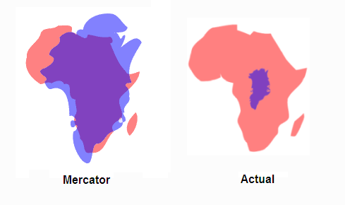

Slide 29
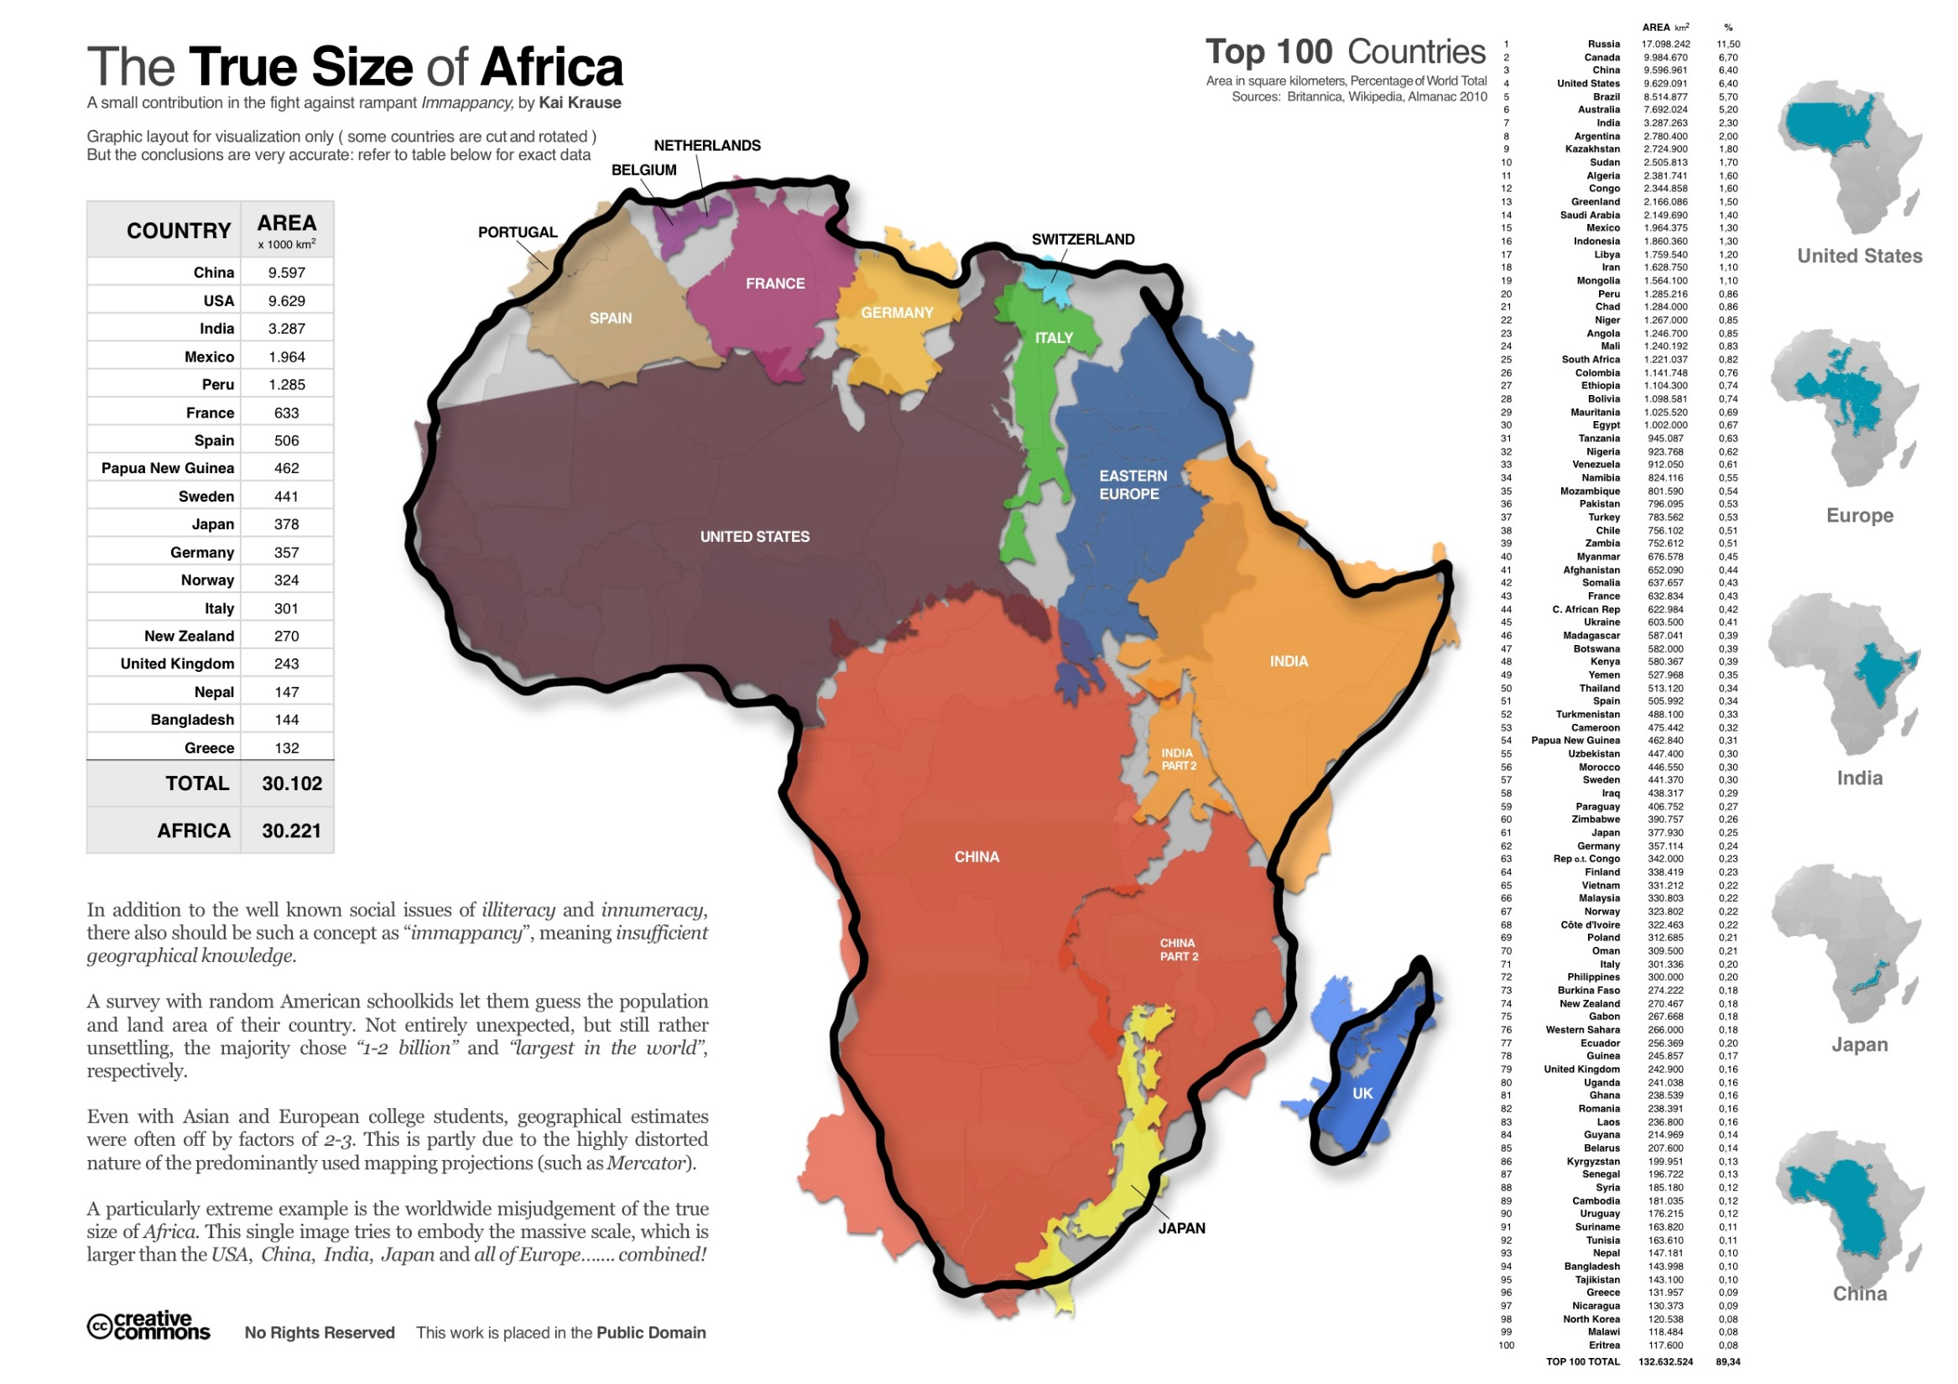

Slide 30
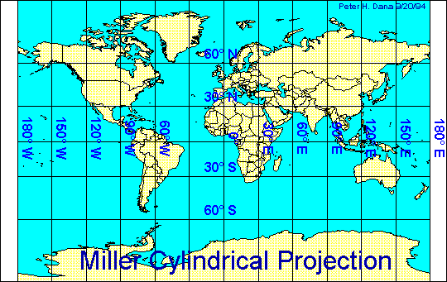
Types of Cylindrical Projections –
These include -
straight meridians and parallels that meet at right angles, but straight lines are not of constant azimuth.
Shapes and areas are distorted. Directions are true only along the equator. The projection avoids the scale exaggerations of the Mercator map.

Slide 31
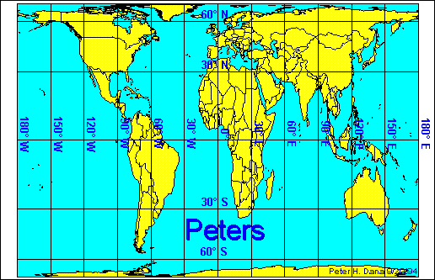
Types of Cylindrical Projections –
These include -
This projection is a cylindrical equal-area projection that de-emphasizes area exaggerations in high latitudes.

Slide 32
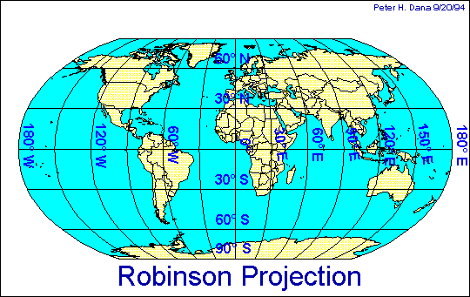
Projections
Types of Cylindrical Projections –
These include -
based on tables of coordinates, not mathematical formulas. The projection distorts shape, area, scale, and distance in an attempt to balance the errors of projection properties.

Slide 33
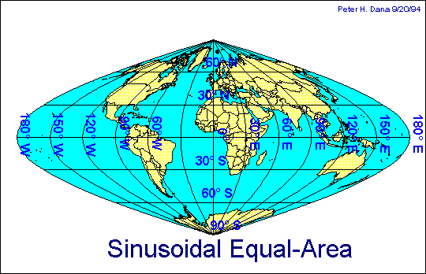
Projections
Types of Cylindrical Projections –
These include -
Equal-Area has straight parallels at right angles to a central meridian.
Scale is true only on the central meridian and the parallels.
Horrible for the globe, but often used in countries with a larger north-south than east-west extent.

Slide 34
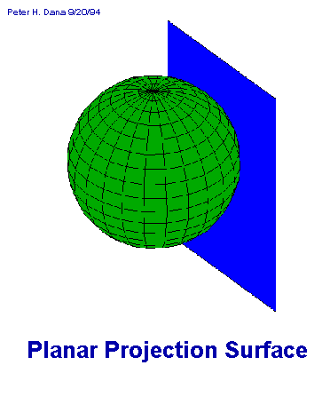
Projections
Planar are are otherwise known as azimuthal.
This type of projection is usually pole-centered because it minimizes distortion in a circle around the pole.

Slide 35
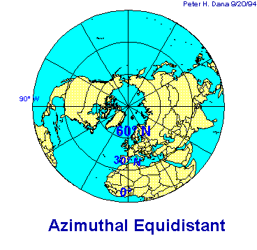
These projections are commonly used to show air-route distances.
Distances measured from the center are true with distortion increasing away from the center point.

Slide 36
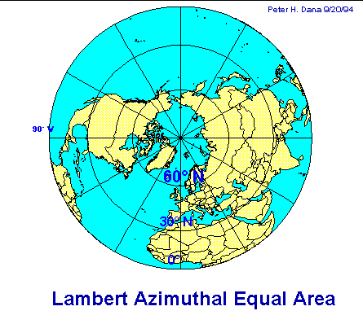
Types of Planar Projections –
These include -
This projection is commonly used to map large ocean areas.
The central meridian is a straight line, others are curved. A straight line drawn through the center point is on a great circle.

Slide 37
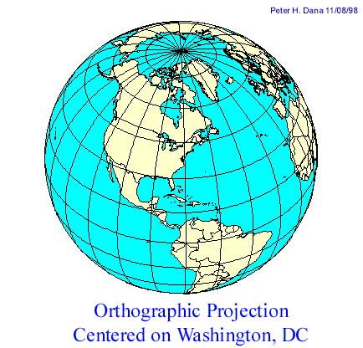
Types of Planar Projections –
These include -
These projections are used for perspective views of hemispheres. Area and shape are distorted. Distances are true along the equator and other parallels.

Slide 38
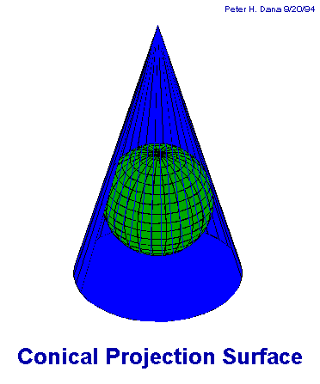
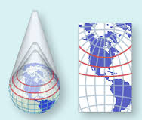
Conic Projections result from projecting a spherical surface onto a cone. These projections tend to minimize distortions in the mid-latitudes.

Slide 39
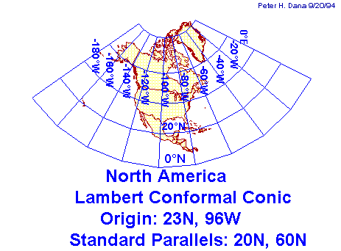

Note: This projection has two standards.
Area, and shape are distorted away from standard parallels. Directions are true in limited areas. Used for maps of North America.

Slide 40
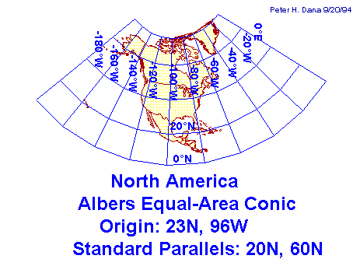
Another secant conic projection.
distorts scale and distance except along standard parallels. Areas are proportional and directions are true in limited areas. Used in the United States and other large countries with a larger east-west than north-south extent.

Slide 41
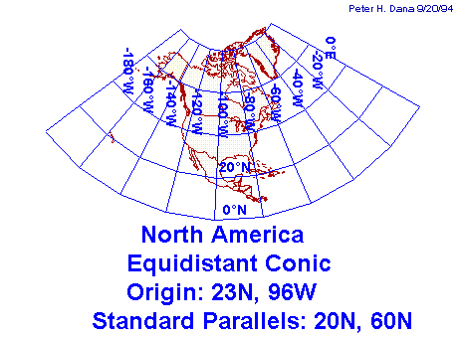
another secant conic projection.
Direction, area, and shape are distorted away from standard parallels. Used for portrayals of areas near to, but on one side of, the equator.

Slide 42
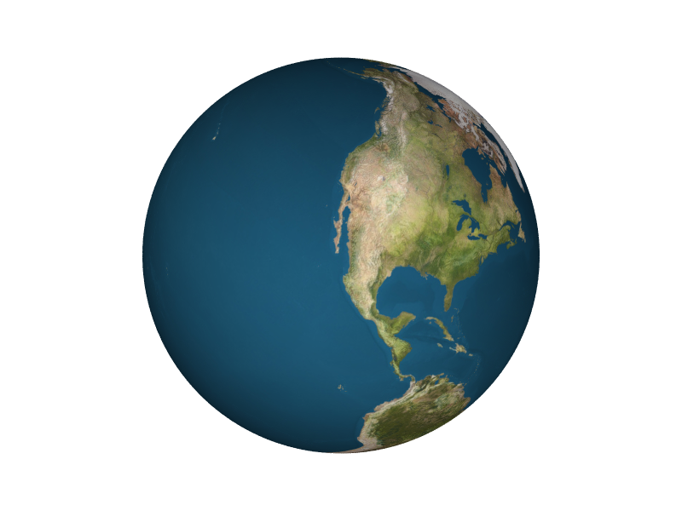
Projections
Other Types of Projections –
Buckminster Fuller’s projection was based on his geodesic globe ideas and projected the sphere on to a icosahedron (20-sided sphere).

Slide 43
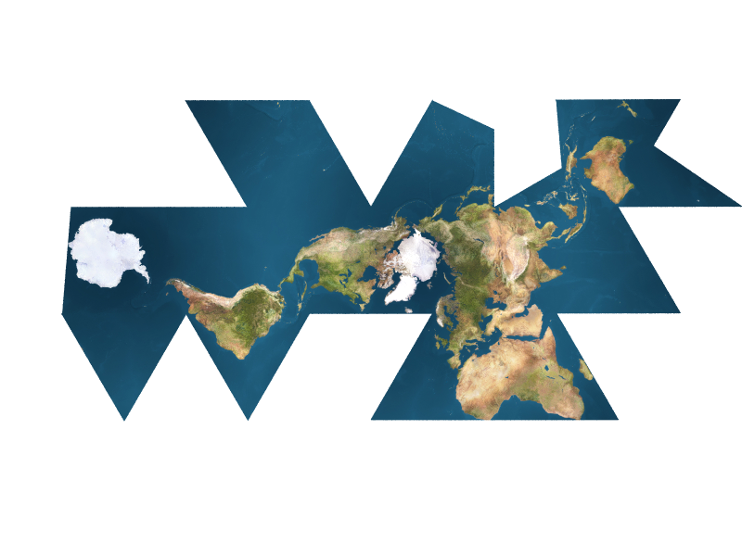
Other Types of Projections –
Buckminster Fuller’s projection was based on his geodesic globe ideas and projected the sphere on to a icosahedron (20-sided sphere).
Then by pulling it apart and flattening it, the result is a map of minimal distortion (each of the axes of the polygons act like a standard).

Slide 44
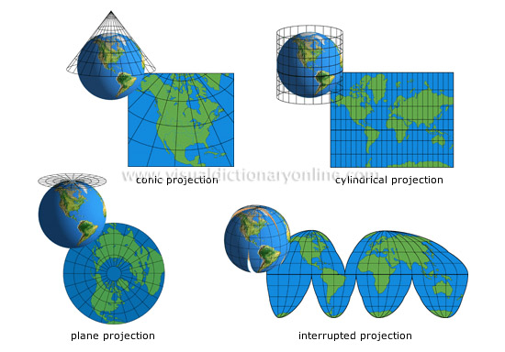

Slide 45
Map Projections and Coordinate Systems
Choosing Map Projections

Slide 46
Cylindrical projections for countries in the tropics
principal scale preserved along the equator

Slide 47
Conical projections for countries in the temperate zones
principal scale preserved along a parallel of latitude

Slide 48
Azimuthal projections for the polar regions
principal scale preserved at the pole

Slide 49
The larger the area mapped, the more projections distort

Slide 50
