Slide 1
US National Parks

Slide 2
Go over syllabus

Slide 3
Question to students
What are your thoughts about this class
What do you know about US National parks?
What do you think of when you hear the words US National Park.

Slide 4
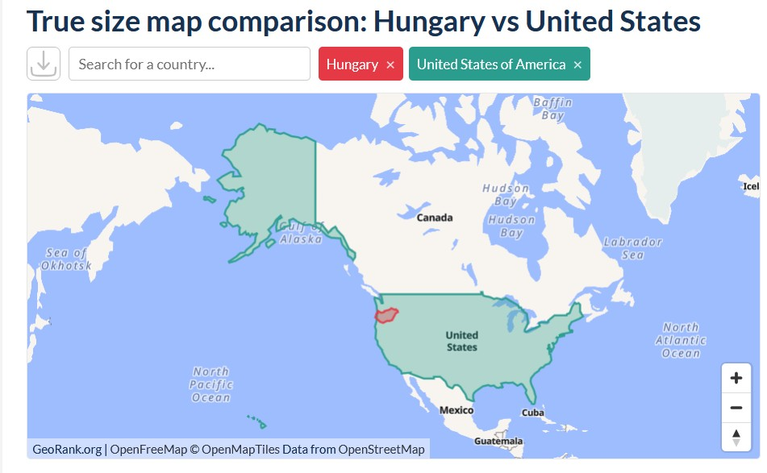
Size differences
The United States is about 106 times larger than Hungary, with the U.S. covering approximately 9,833,517 square kilometers compared to Hungary's 93,030 square kilometers. [1, 2]

Slide 5
The largest U.S. national park is Wrangell–St. Elias National Park and Preserve in Alaska, covering approximately 32,375 square kilometers (12,500 square miles) for the park alone, or 53,320 square kilometers (20,587 square miles) when combined with its adjacent national preserve
Again.. Hungary is ~93,000 sq km.
Math.
The combined size of the eight national parks in Alaska is approximately 131,628 square kilometers

Slide 6
Let’s wander around a bit
https://www.nps.gov/planyourvisit/maps.htm
Be sure to catch those outside the US borders

Slide 7
National Park System
https://www.nps.gov/aboutus/national-park-system.htm
Good lord… what’s the difference?
“National Parks” vs everything else.
Spend some time here looking at all the things.
Don’t forget the related areas, especially the National Trails system.

Slide 8
History of the NPS
https://npshistory.com/publications/brief_history/
1834. artist George Catlin called for preserving areas.
1864. Congress donated Yosemite Valley to California for preservation as a state park. Eight years later, in 1872, Congress reserved the spectacular Yellowstone country in the Wyoming and Montana territories "as a public park or pleasuring-ground for the benefit and enjoyment of the people." With no state government there yet to receive and manage it, Yellowstone remained in the custody of the U.S. Department of the Interior as a national park—the world's first area so designated.

Slide 9
Congress followed the Yellowstone precedent with other national parks in the 1890s and early 1900s, including Sequoia, Yosemite (to which California returned Yosemite Valley), Mount Rainier, Crater Lake, and Glacier. The idealistic impulse to preserve nature was often joined by the pragmatic desire to promote tourism: western railroads lobbied for many of the early parks and built grand rustic hotels in them to boost their passenger business.
The late nineteenth century also saw growing interest in preserving prehistoric Indian ruins and artifacts on the public lands. Congress first moved to protect such a feature, Arizona's Casa Grande Ruin, in 1889. In 1906 it created Mesa Verde National Park, , and passed the Antiquities Act authorizing presidents to set aside "historic and prehistoric structures, and other objects of historic or scientific interest"

Slide 10
By 1916 the Interior Department was responsible for 14 national parks and 21 national monuments but had no organization to manage them. Interior secretaries had asked the Army to detail troops to Yellowstone and the California parks for this purpose. Pretty chaotic with no central organization.
Crusading for a national parks bureau, Mather and Albright effectively blurred the distinction between utilitarian conservation and preservation by emphasizing the economic value of parks as tourist meccas.
Congress responded as desired, and on August 25, 1916, President Woodrow Wilson approved legislation creating the National Park Service within the Interior Department. The act made the bureau responsible for Interior's national parks and monuments, Hot Springs Reservation in Arkansas (made a national park in 1921), and "such other national parks and reservations of like character as may be hereafter created by Congress." In managing these areas, the Park Service was directed "to conserve the scenery and the natural and historic objects and the wild life therein and to provide for the enjoyment of the same in such manner and by such means as will leave them unimpaired for the enjoyment of future generations."

Slide 11
Through the 1920s the national park system was really a western park system. Only Acadia National Park in Maine lay east of the Mississippi.
If the system were to benefit more people and maximize its support in Congress, however, it would have to expand eastward. In 1926 Congress authorized Shenandoah, Great Smoky Mountains, and Mammoth Cave national parks in the Appalachian region but required that their lands be donated. With the aid of John D. Rockefeller, Jr., and other philanthropists, the states involved gradually acquired and turned over most of the land needed for these parks in the next decade.
But the Park Service's greatest opportunity in the East lay in another realm—that of history and historic sites. Congress had directed the War Department to preserve a number of historic battlefields, forts, and memorials there as national military parks and monuments, beginning in 1890 with Chickamauga and Chattanooga National Military Park in Georgia and Tennessee. Happened in the 1930s.

Slide 12
Basically, just grew from there into what we have now.
Only thing cool recently is the alt NPS movement – started during the first Trump administration: https://en.wikipedia.org/wiki/Alt_National_Park_Service
Nowadays, the great orange one is doing his best to hurt the NPS

Slide 13
Next up will be volcanos.

