Slide 1
Data type
Nominal
Ordinal
Interval
ratio

Slide 2
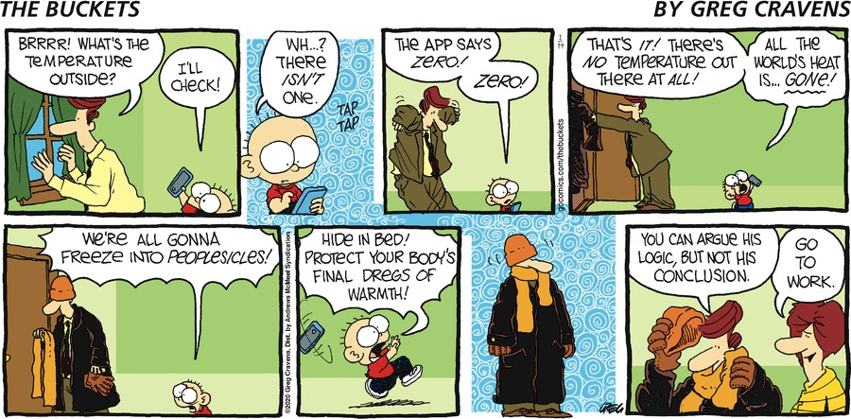

Slide 3
To standardize the data or not to standardize the data
That is the question.
Why? Why not?
Examples.

Slide 4
Classification
Splitting data into groups to make it easier to understand.
equal interval, equal frequency, and natural breaks. How many classes? When to use each? Considering data distribution, ease of understanding concept, ease of understanding legend.

Slide 5
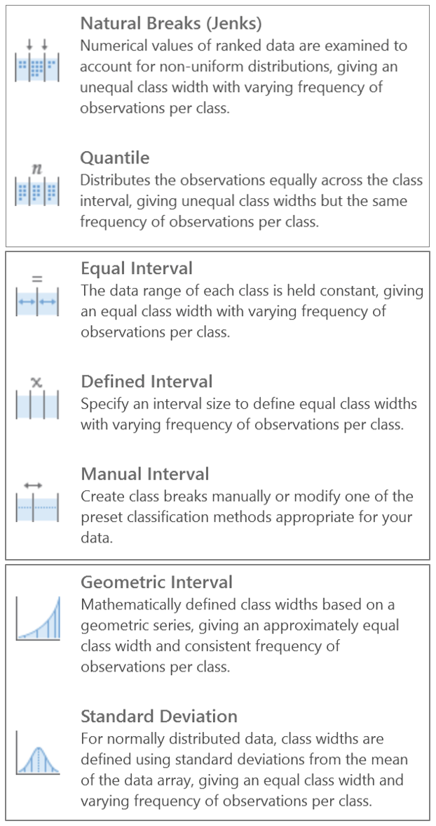

Slide 6
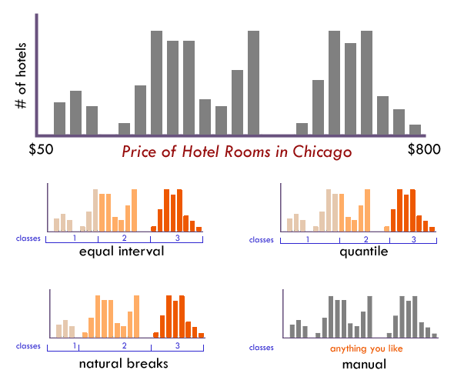

Slide 7
https://www.axismaps.com/guide/data-classification
https://wustl.pressbooks.pub/digitalcartography/chapter/making-chloropleth-maps/
https://community.environicsanalytics.com/hc/en-us/articles/13299751591437-What-are-the-Mapping-Classification-Methods

