Slide 1
Desert Parks

Slide 2
Definition
an area with less than 25 cm (10 inches) of annual precipitation
Deserts may be cold, temperate or hot. All major continents have one type of desert or the other.
Notes:
56

Slide 3
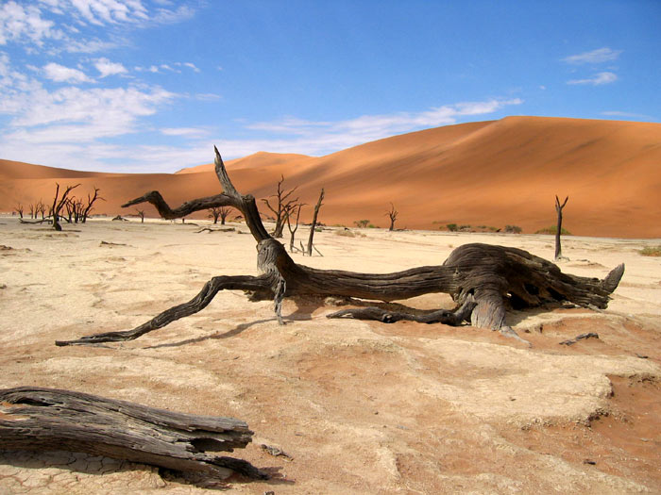
What is a desert?
The desert is a land of extremes: extreme heat and extreme dryness; sudden flash floods and cold nights. Because deserts are such a difficult places to live in they often have names likes "Death Valley“ or "the empty quarter,"

Slide 4
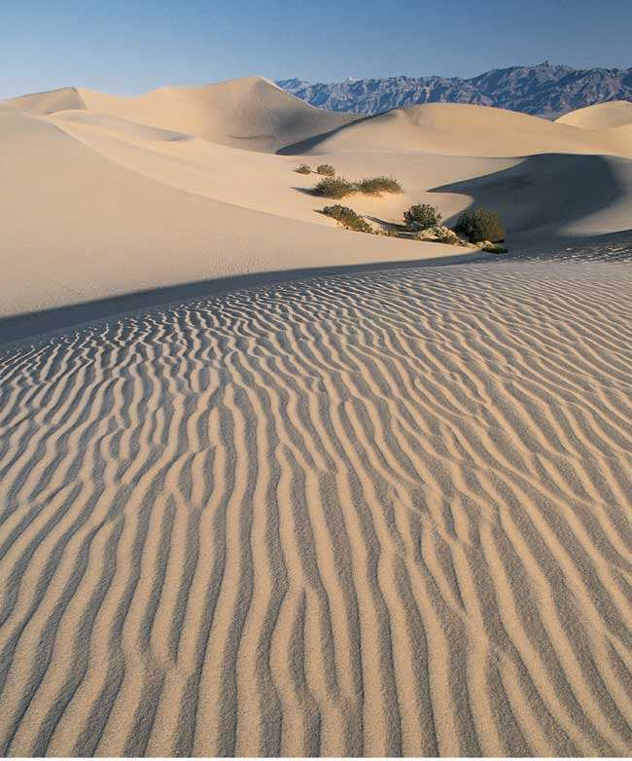
Wind-Swept Sand Dunes
Notes:
56

Slide 5
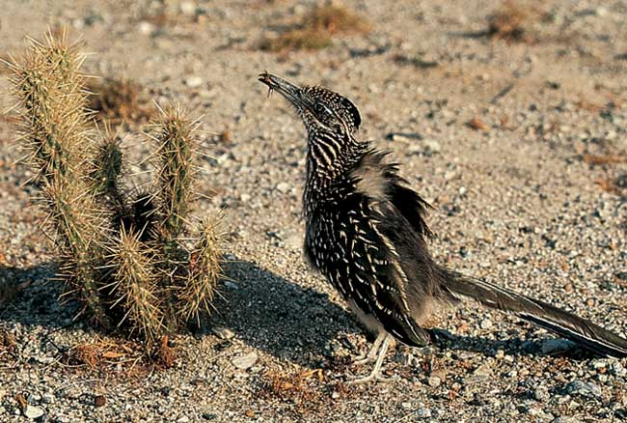
Desert Life Forms (Roadrunner)
Notes:
56

Slide 6
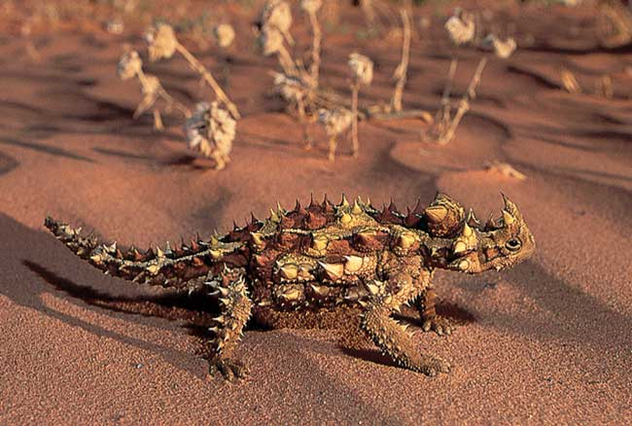
Desert Life Forms (Lizard)
Notes:
56

Slide 7
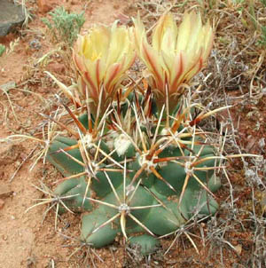
Plants?
Of course, but…..
Plants that grow in a desert have to be especially adapted to the dry conditions. They must be able to: collect and store water and reduce water loss.
Desert plants look quite different to plant that grow in other places.

Slide 8
Types of Deserts
Desert Types
- Subtropical Desert – 30º Latitude
- Deserts on Leeward side of major Mountain ranges
- Interior Deserts- center of continents far from ocean
- Coastal desert- prevailing onshore wind brings cool, damp air to continent. Which then warms, thus, no rain.
  - Polar deserts- extremely cold and dry
Notes:
56

Slide 9
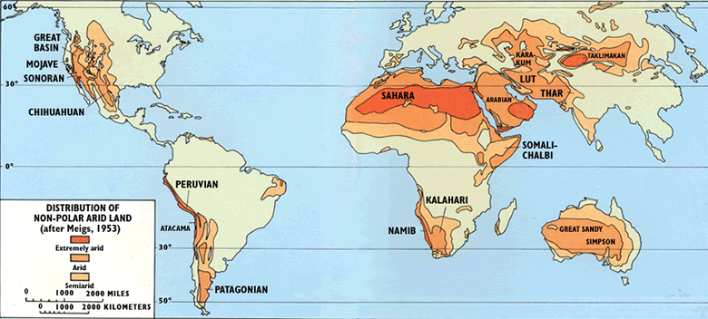

Slide 10
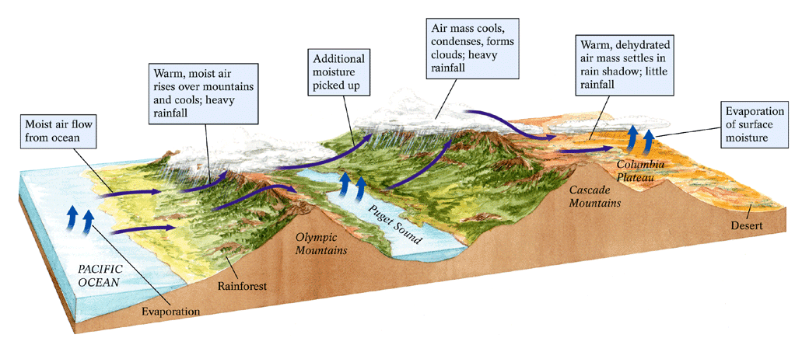
A Rain-Shadow Desert
Notes:
56

Slide 11
Desert landforms
Weathering, wind, and streams create desert landforms
Weathering in Desert is mostly mechanical (physical)
- A little chemical weathering produces manganese and iron-oxide stains, called desert vanish
Stream Erosion
Wind erosion.
Notes:
56

Slide 12
Alluvial fans and bajada
Sediment washed downslope by streams (especially flash floods).
Note, precipitation in deserts is typically as thunderstorms – so a lot of rain all at once, then long periods without any rain at all.

Slide 13
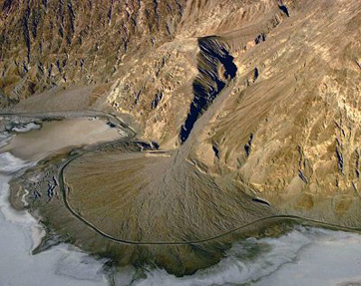
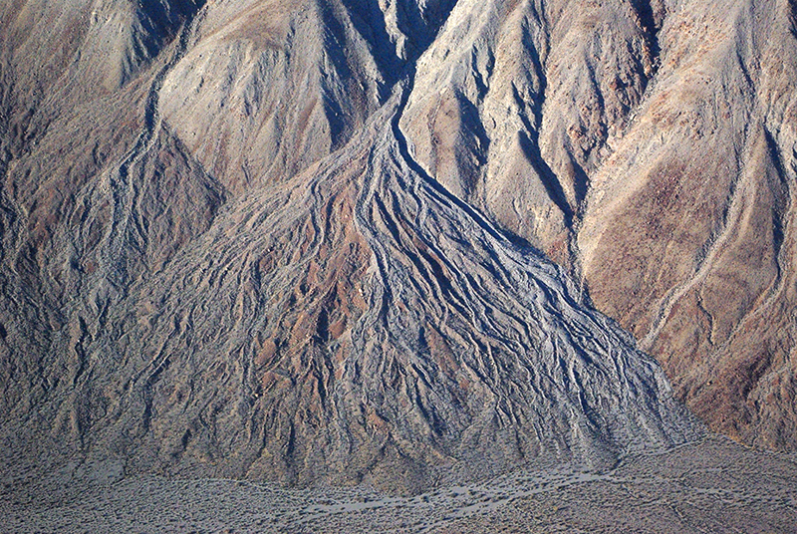

Slide 14
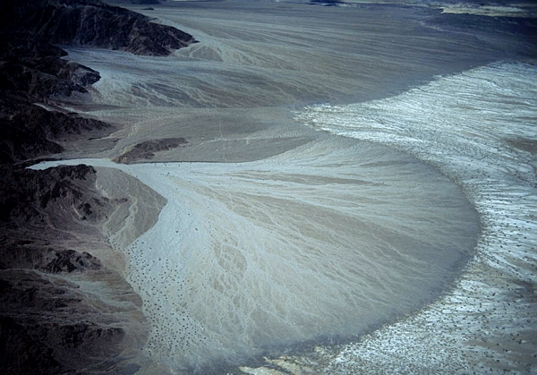

Slide 15
Playa
Desert lake
Very flat and shallow
Often, no water whatsoever
Often, covered in salt
Typically, don’t drain – they evaporate

Slide 16
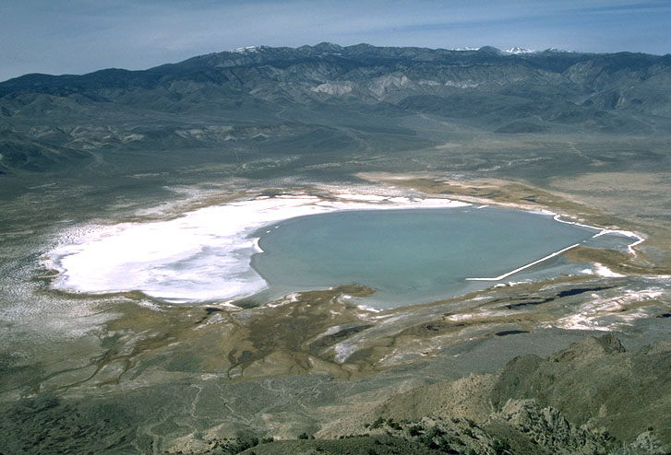

Slide 17
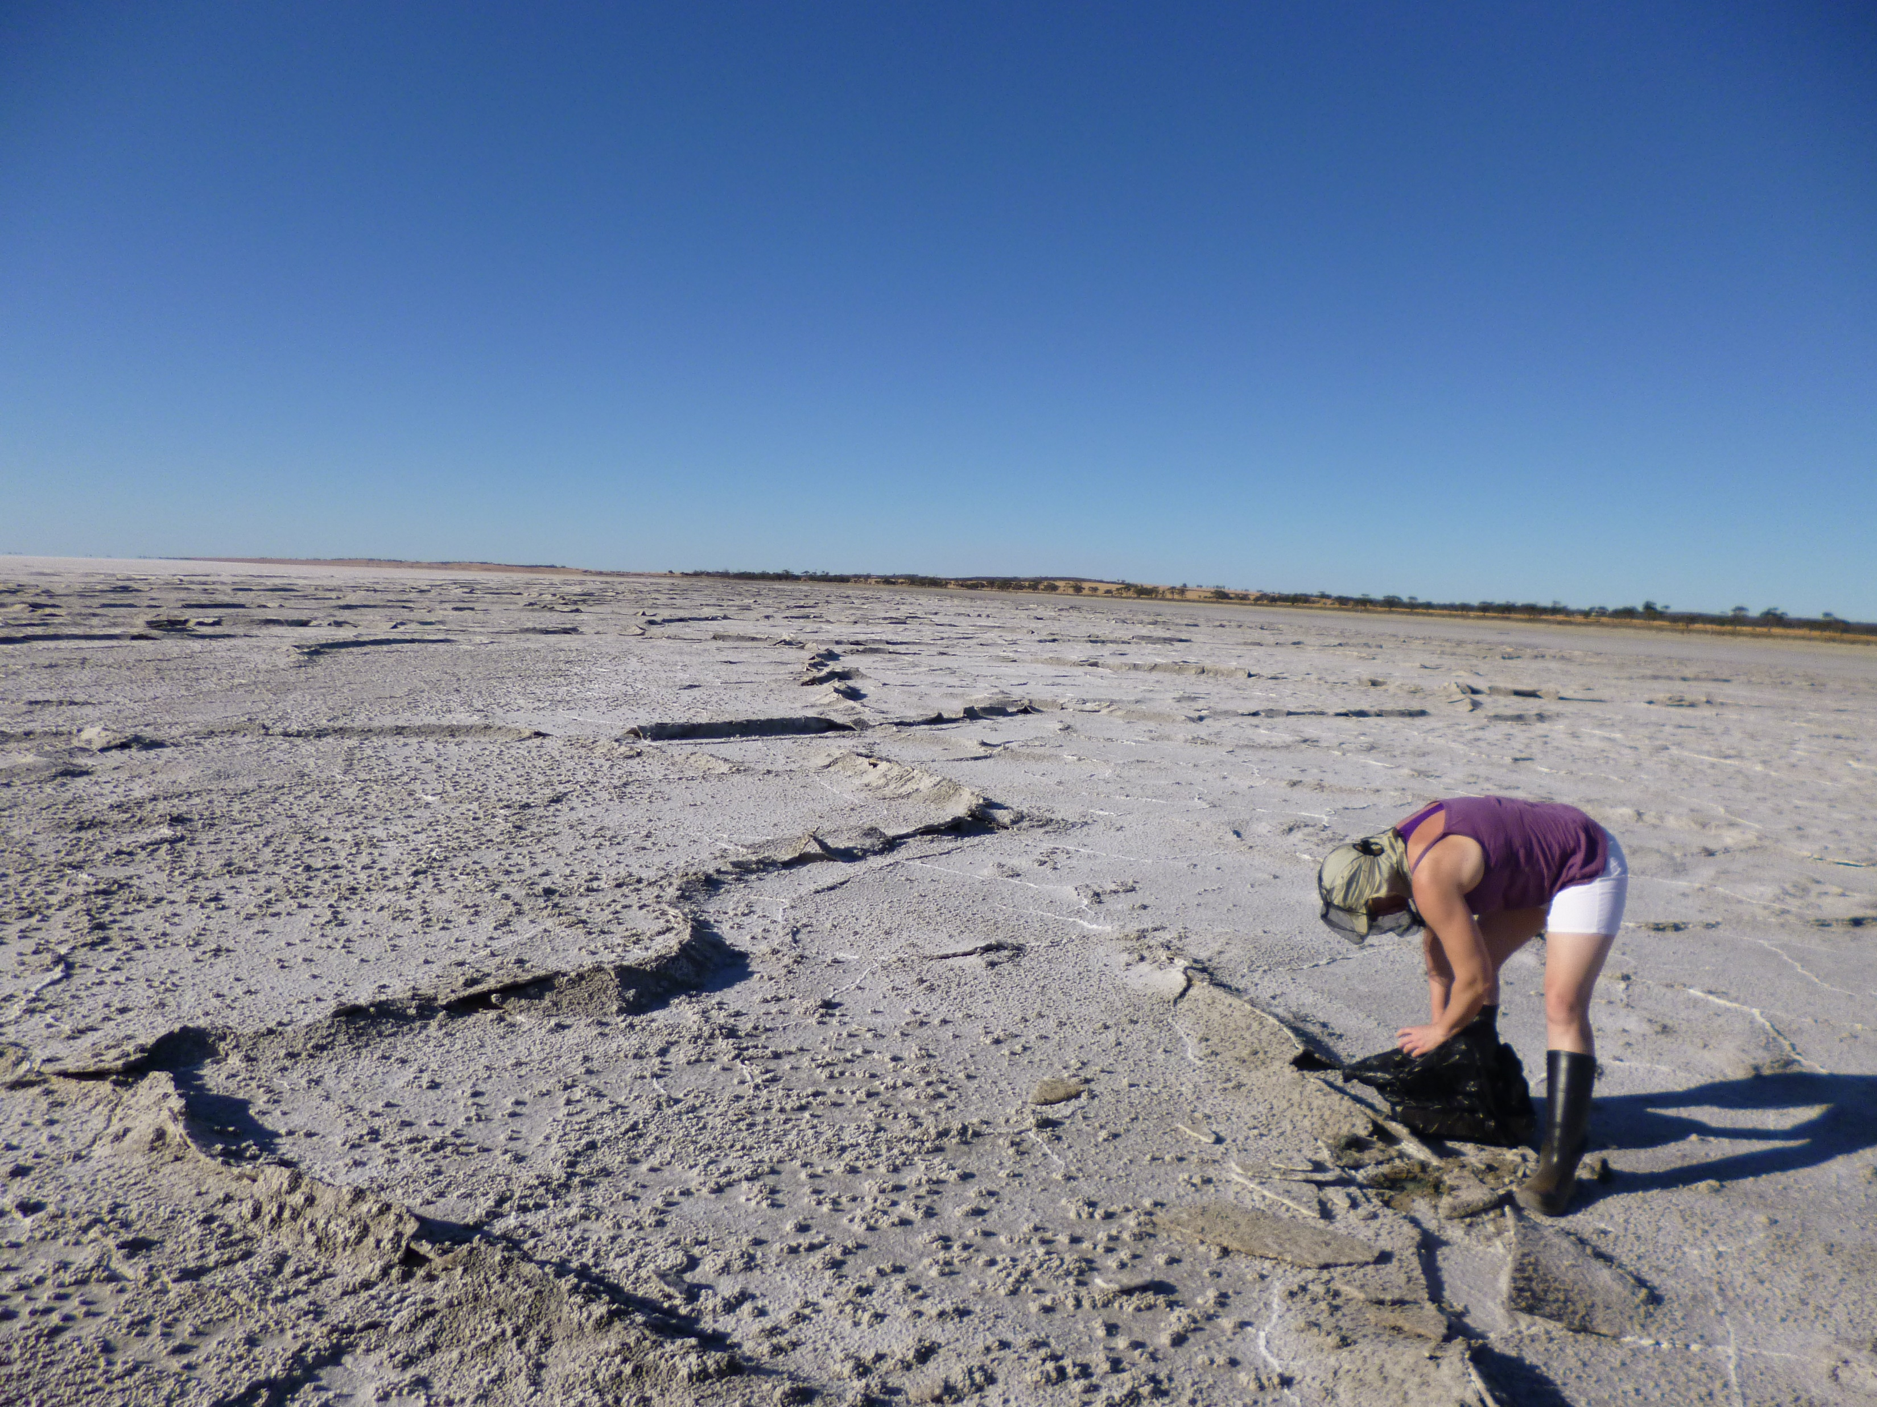

Slide 18
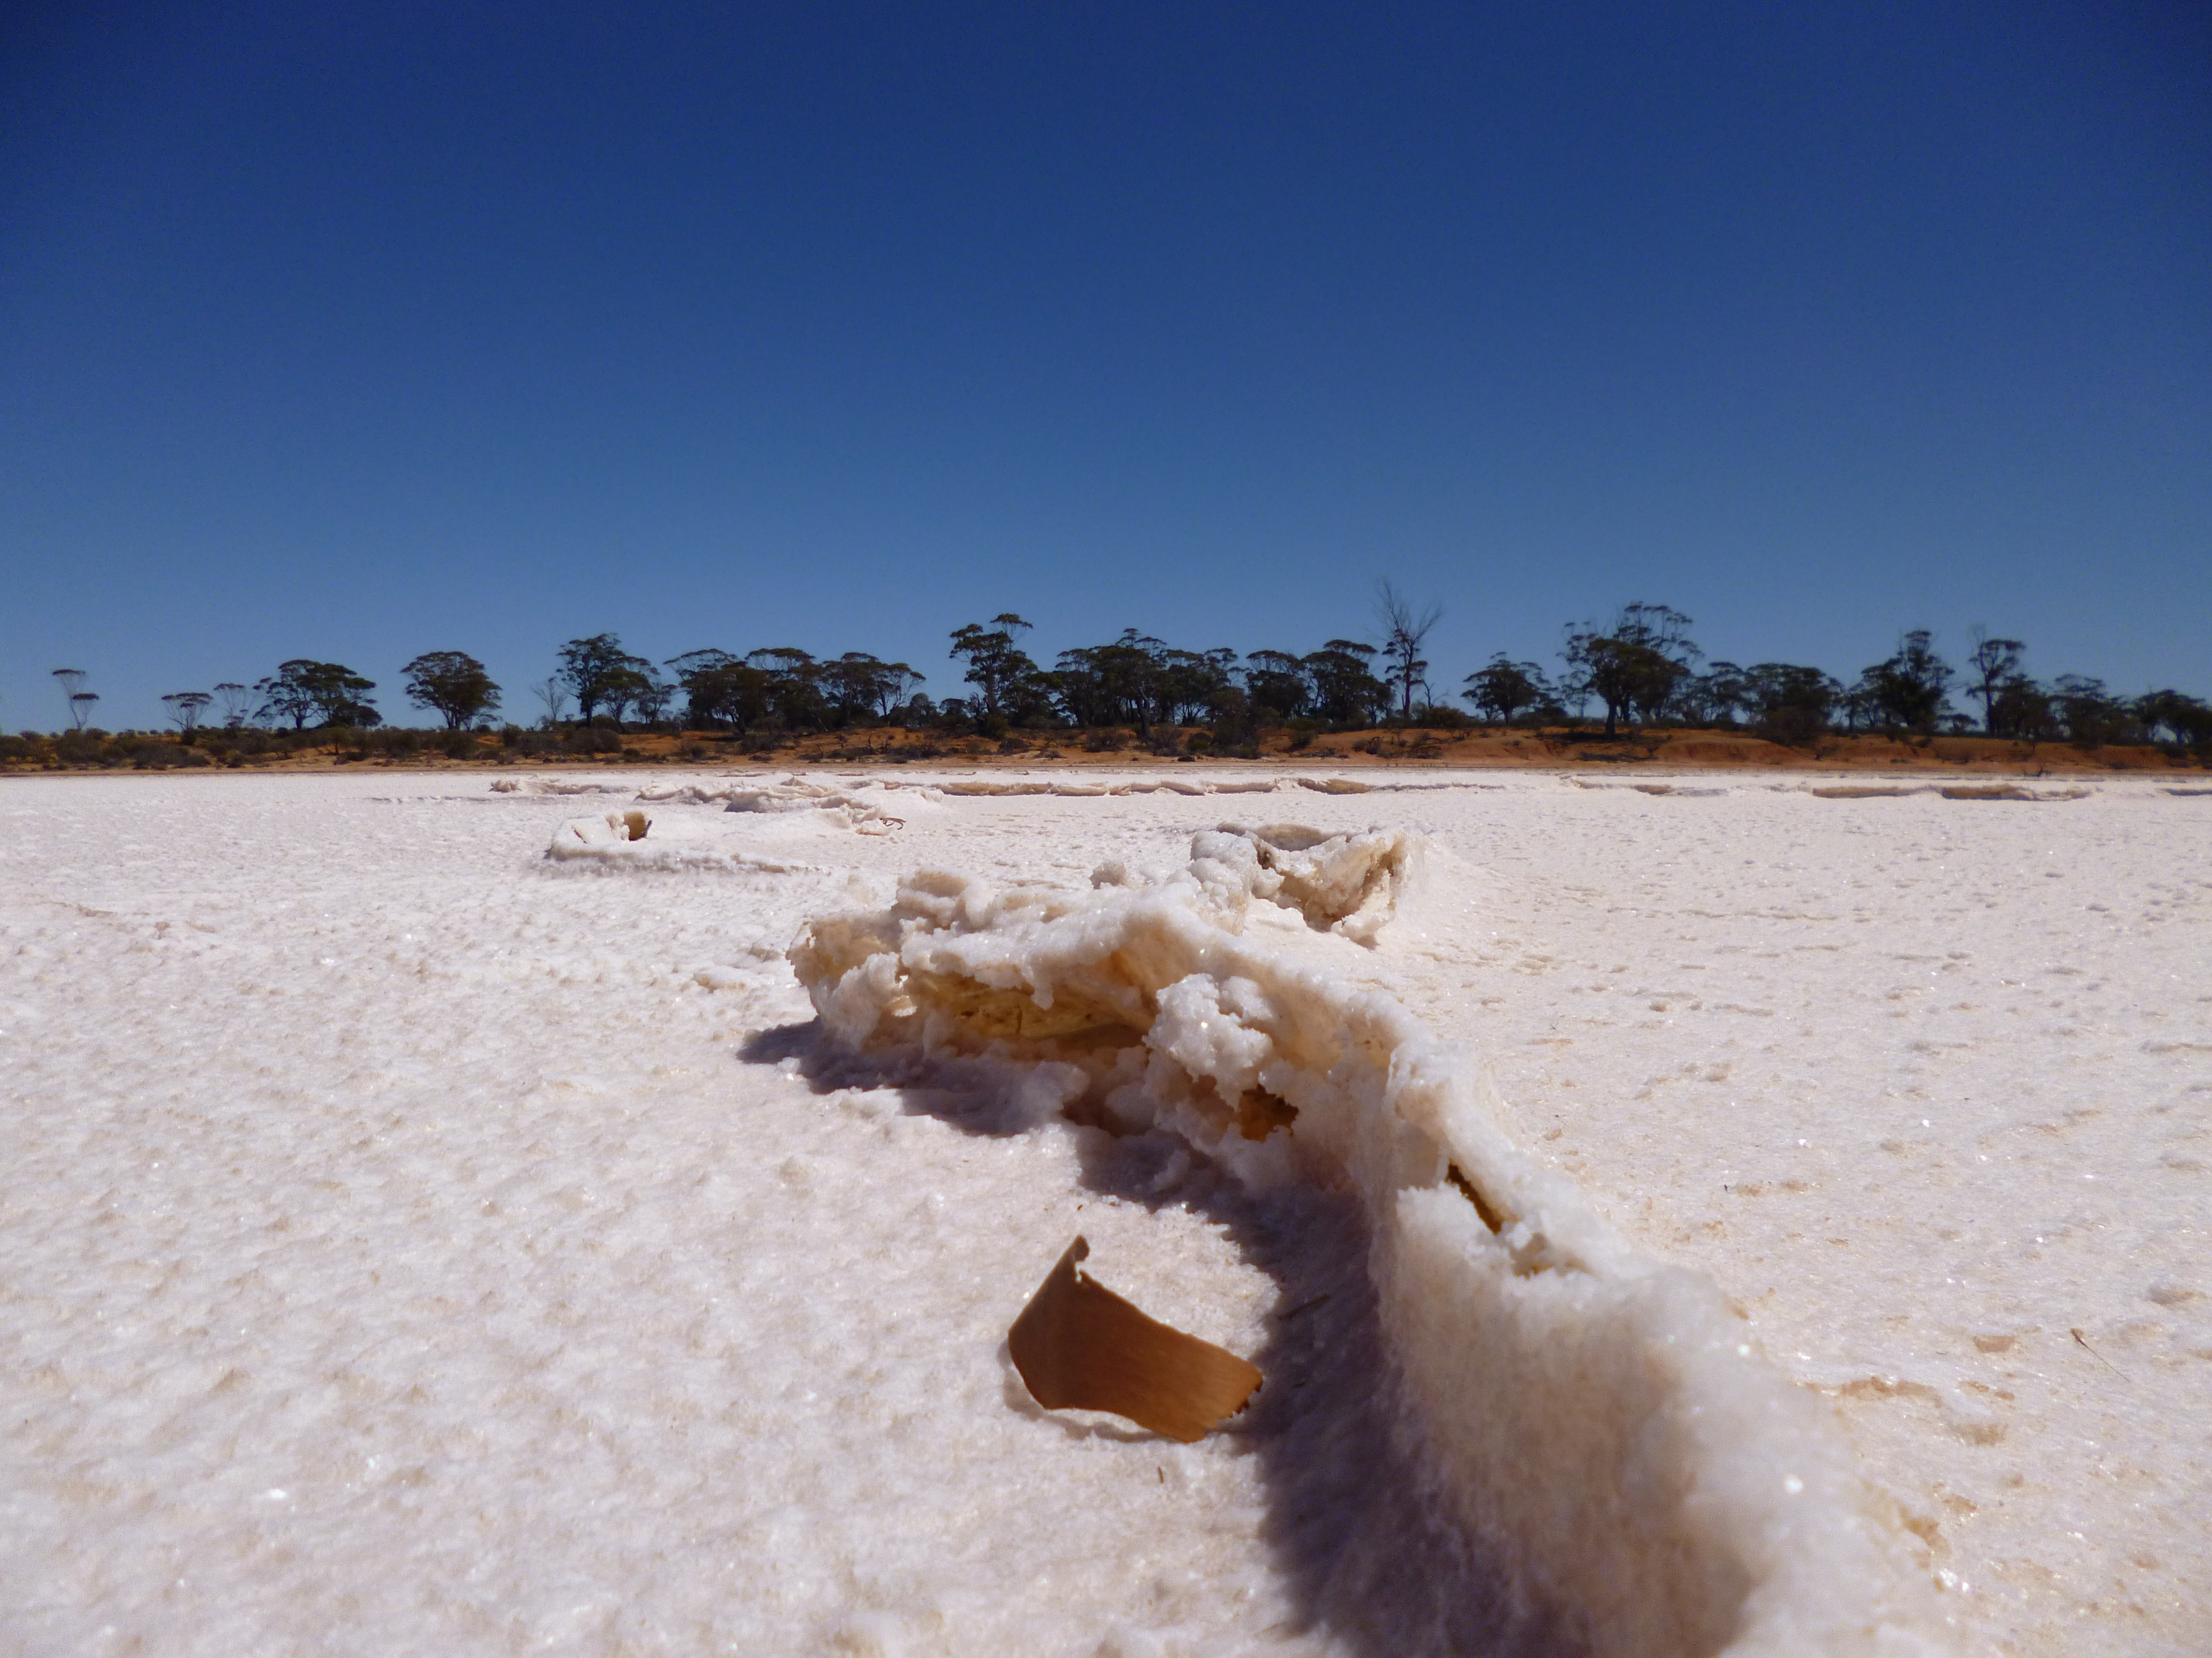

Slide 19
Mesas and Buttes
Flat-topped hills
Mesas much larger

Slide 20
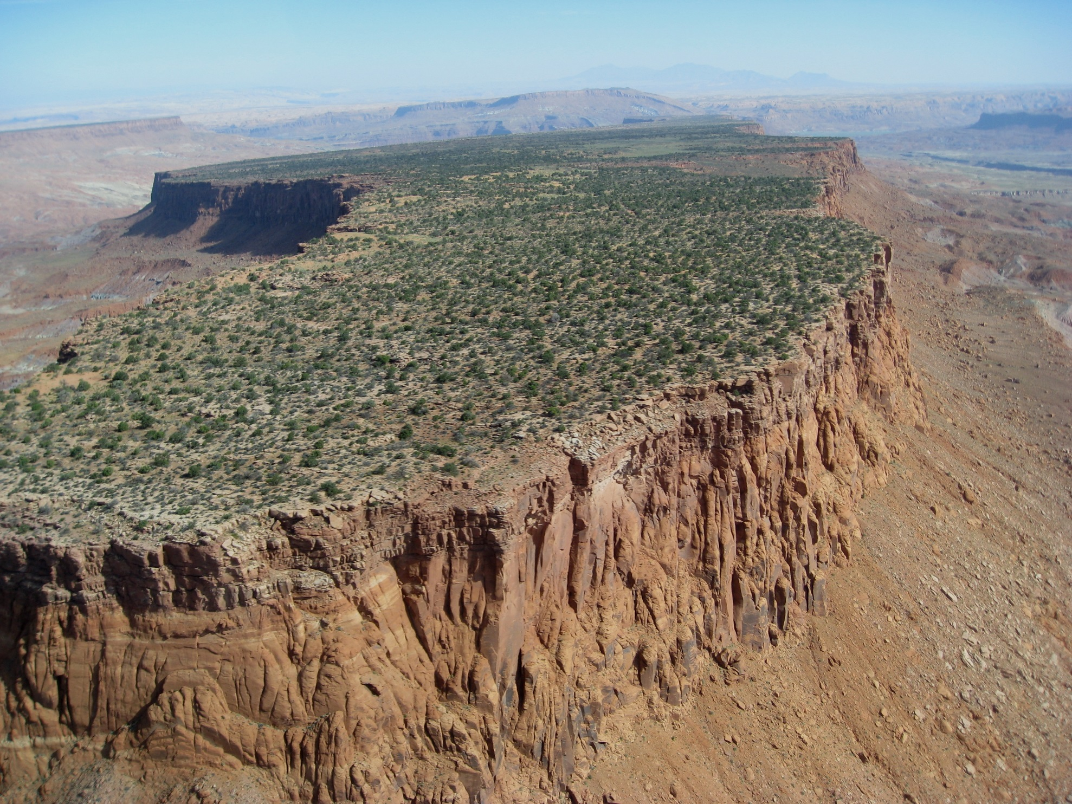

Slide 21
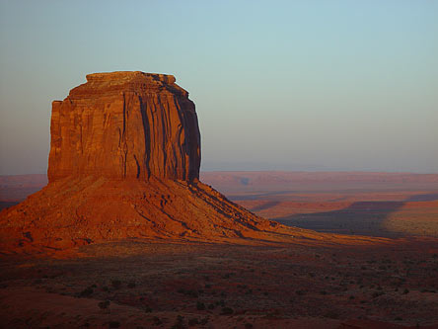
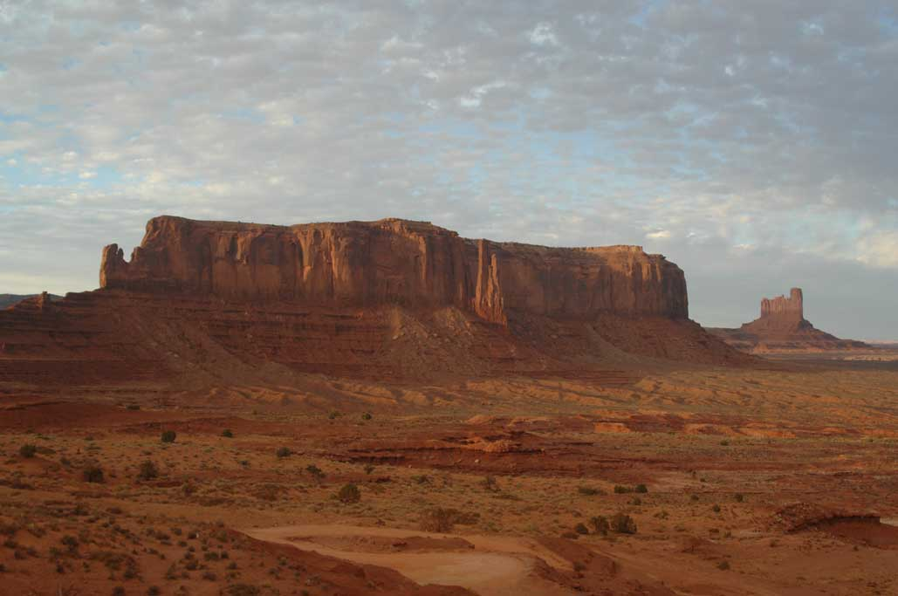
Goto monument valley and wheeler peak in GE

Slide 22
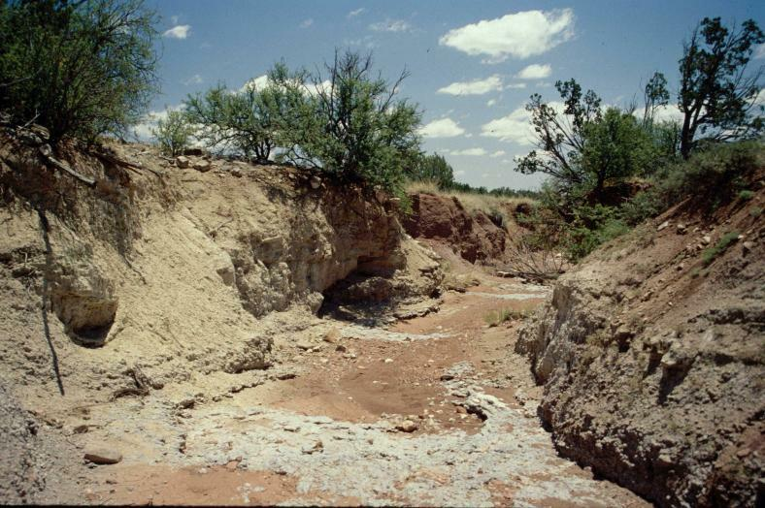
Arroyo

Slide 23
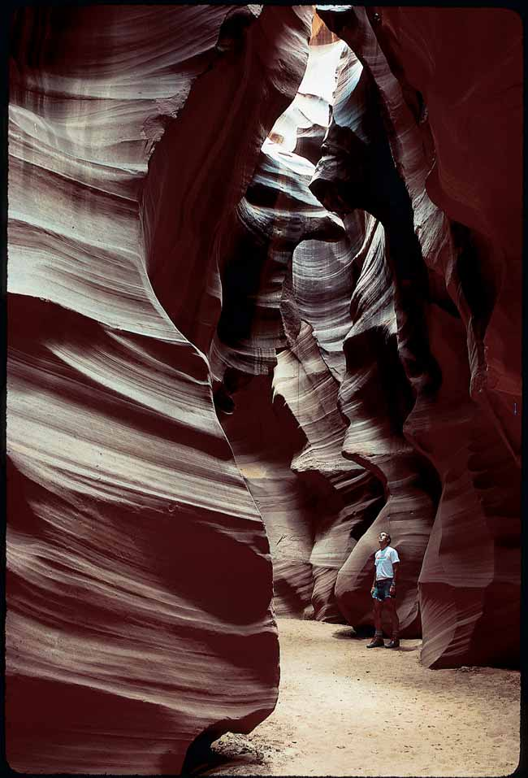
Water-Carved Canyon
Notes:
56

Slide 24
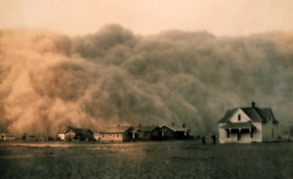
Suspended Load Transport and Deposition
In dry areas very high winds can suspend fine sand particles
Notes:
ESCI 307, Fall 2003, Lecture 14
<number>

Slide 25
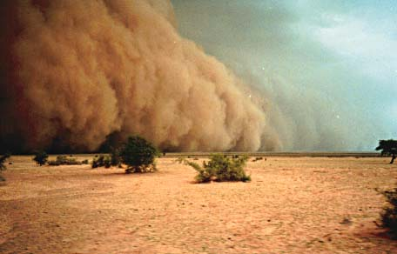
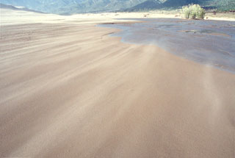
Dust Storm, Senegal
Sand Storm

Slide 26
“Haboob“: https://www.youtube.com/watch?v=IEUyhLP3nyo&feature=share

Slide 27
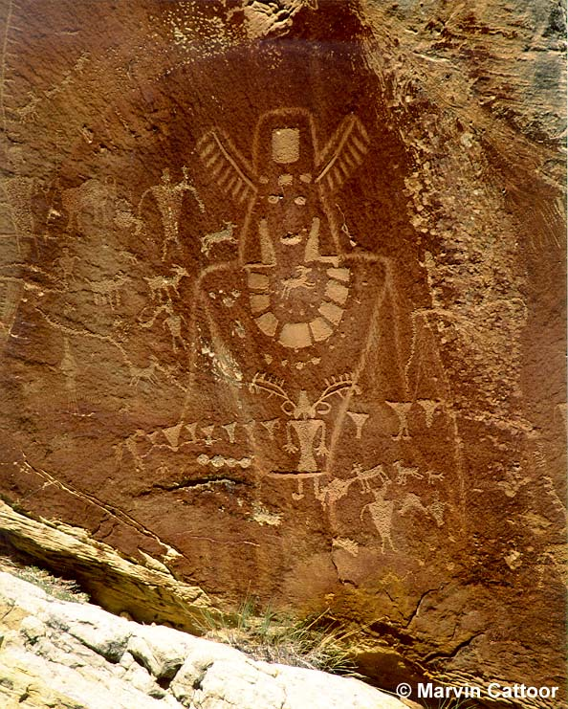
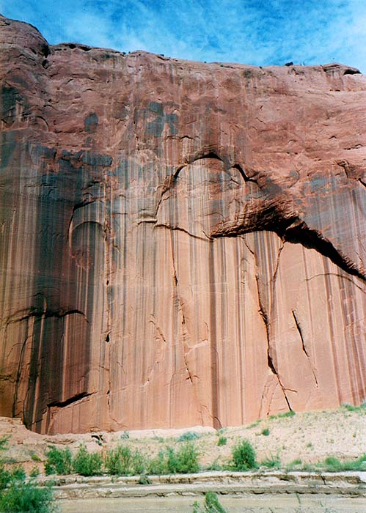
Desert varnish - oxidation of iron and manganese, useful for dating desert surfaces

Slide 28
Deposition of Dunes
Reduced wind velocity results in sediments deposition
Dunes are hills of loose wind-born sand
- Size, shape, and orientation of dune are determined by available sand, vegetation, and wind
Notes:
<number>

Slide 29
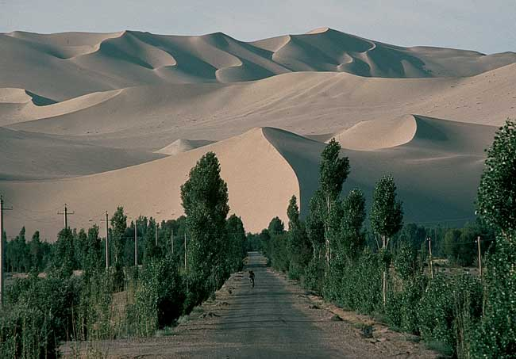
Large Scale Dunes (Gobi Desert)
Notes:
<number>

Slide 30
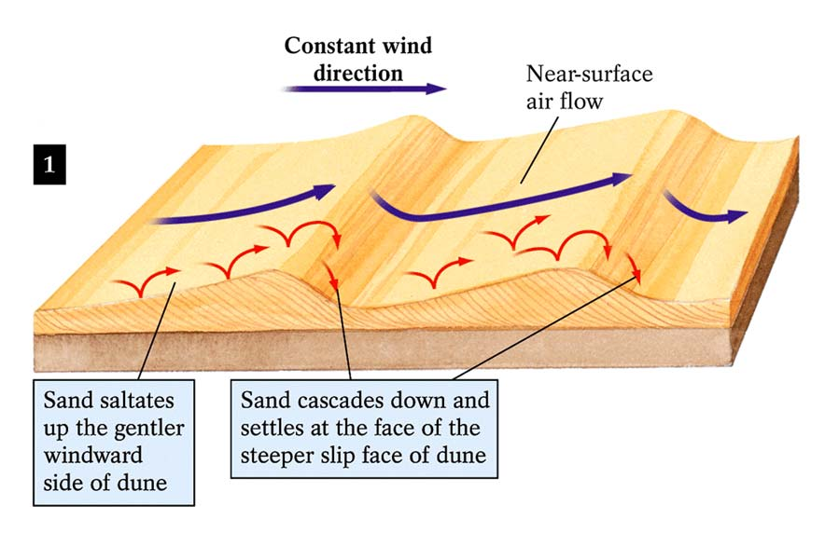
Dune Migration
Just like ripples in a stream
Notes:
<number>

Slide 31
Arches National Park, UT
Red sandstones, lightly folded
https://www.nps.gov/arch/learn/photosmultimedia/photogallery.htm

Slide 32
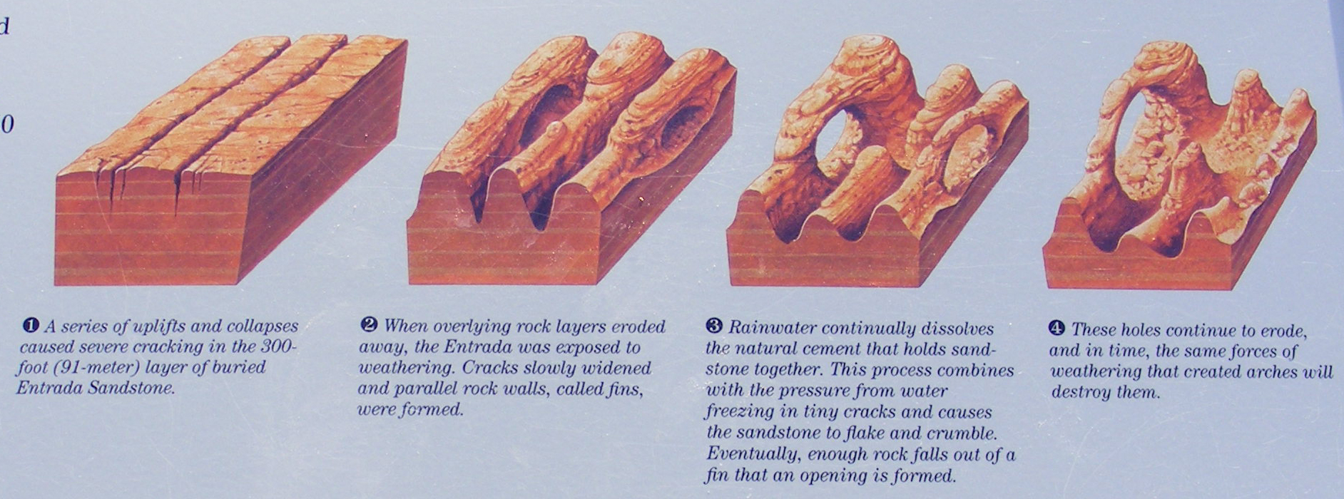
Arches!

Slide 33
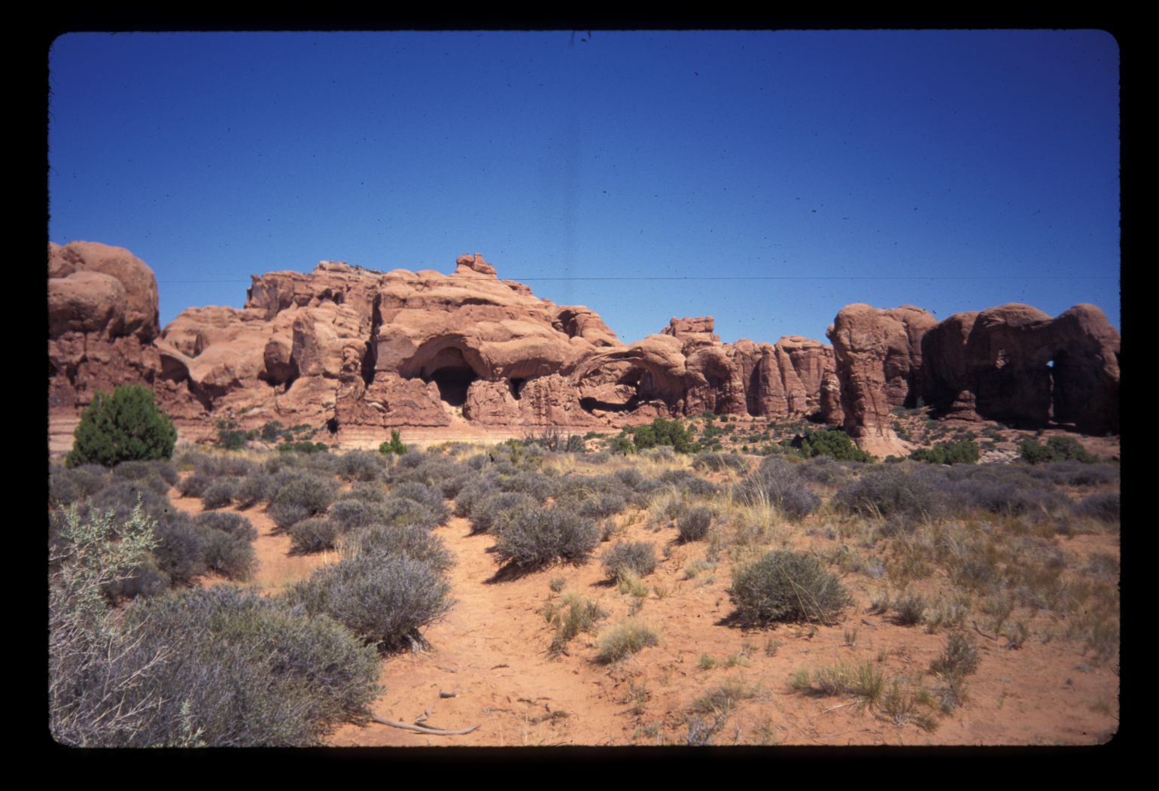

Slide 34
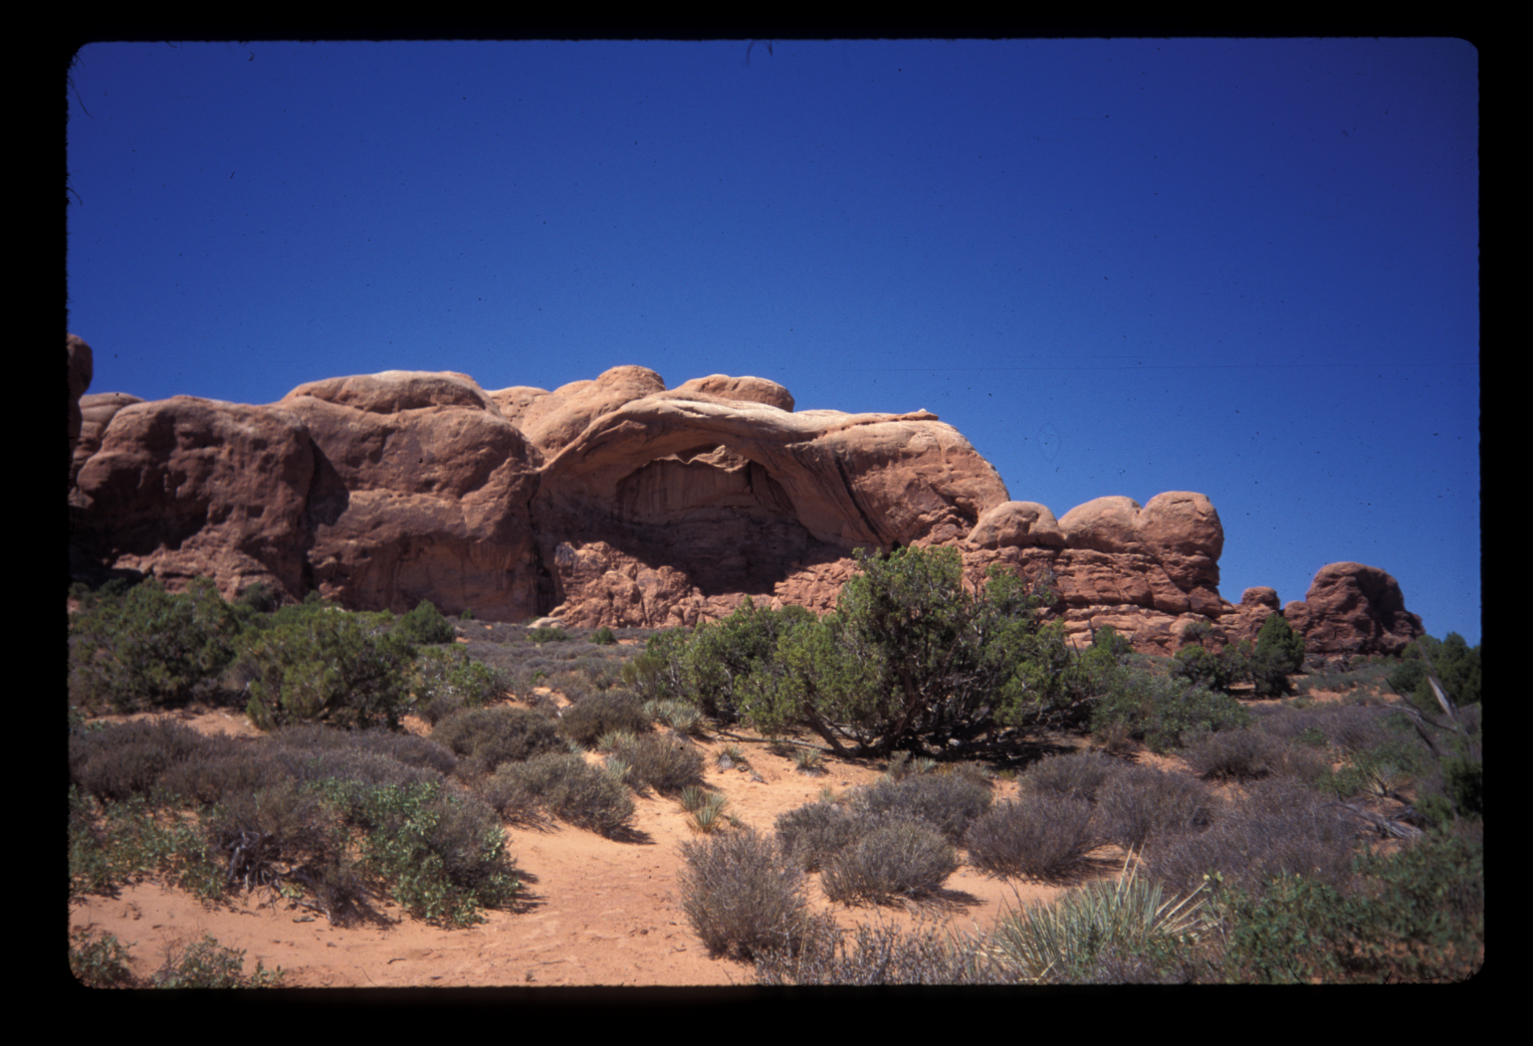

Slide 35
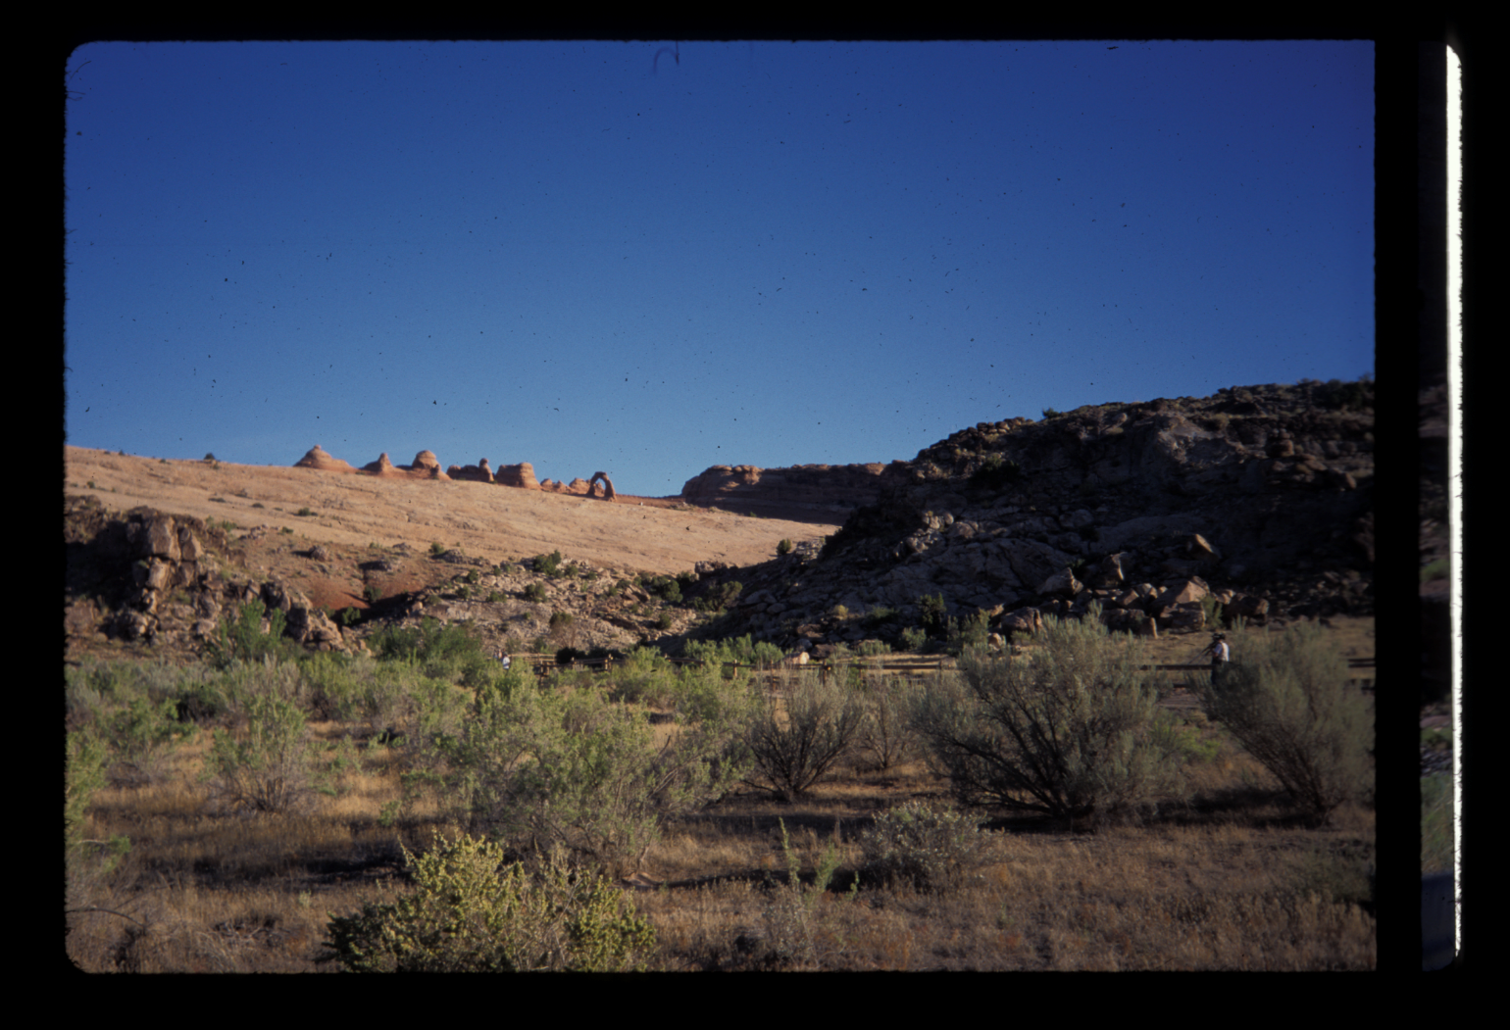

Slide 36
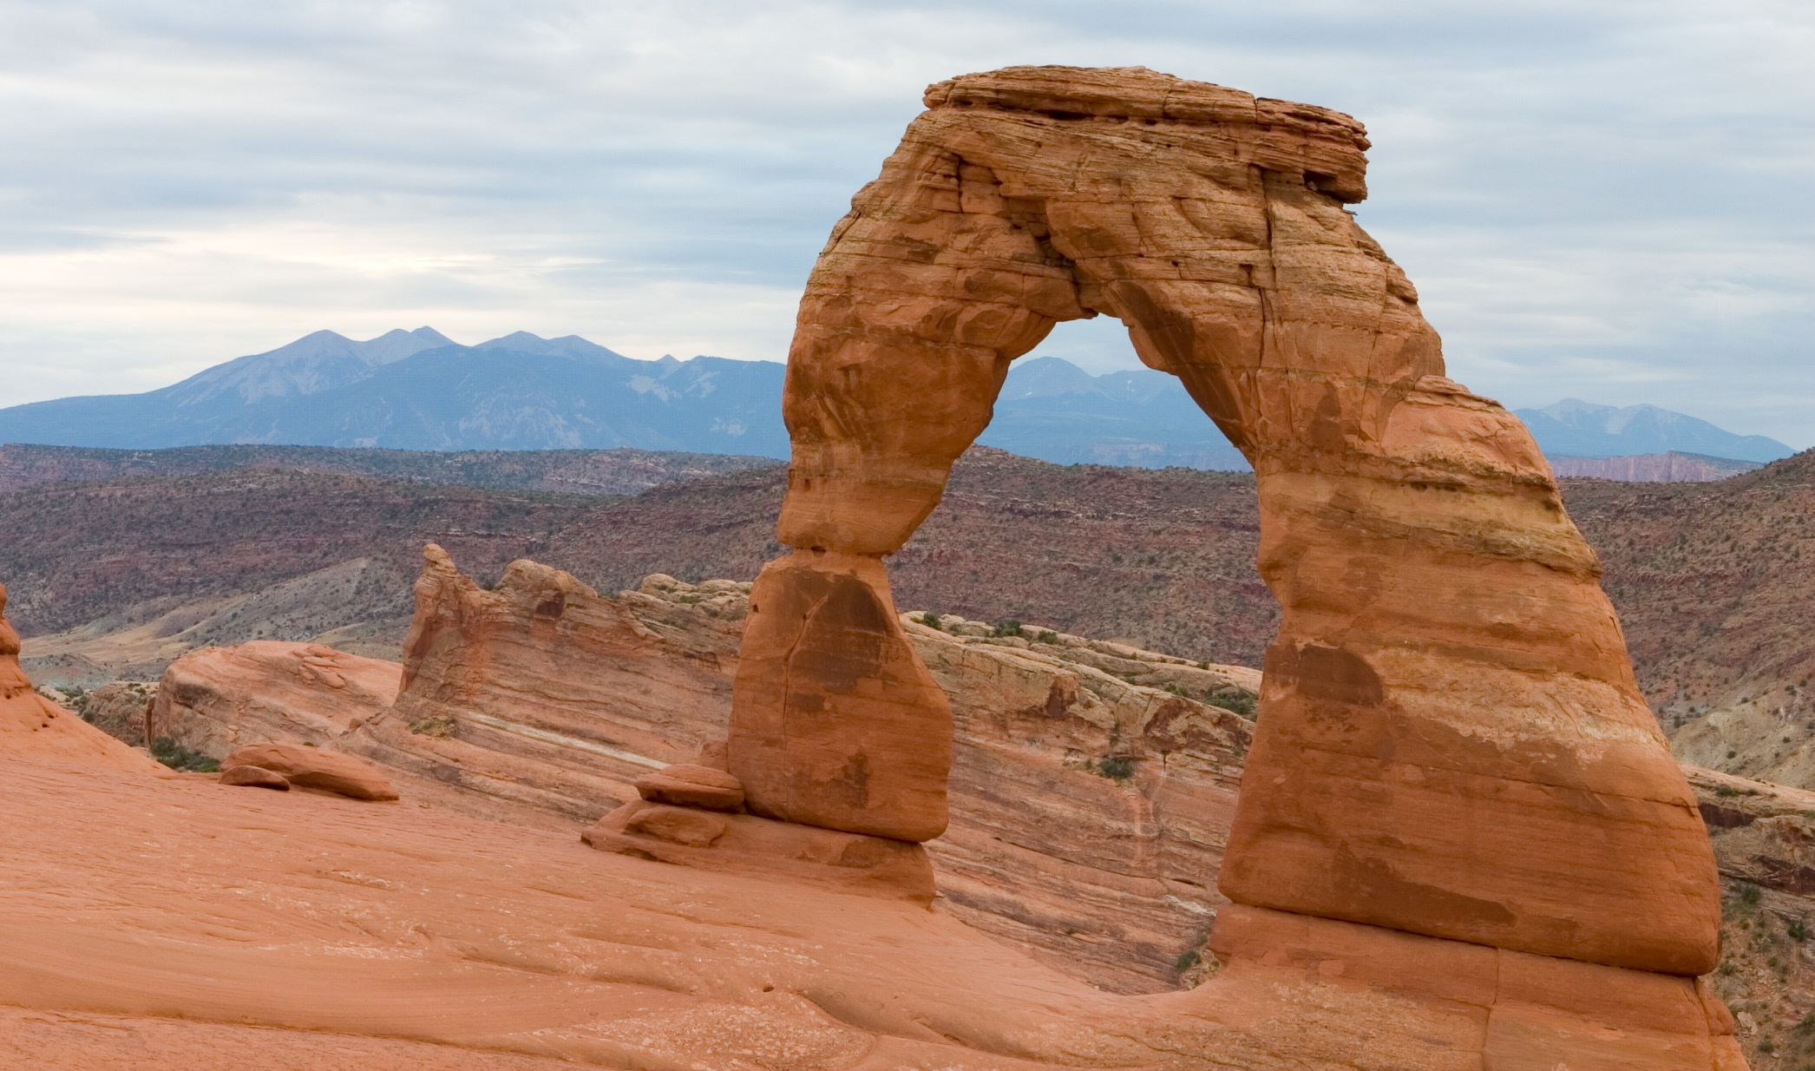

Slide 37
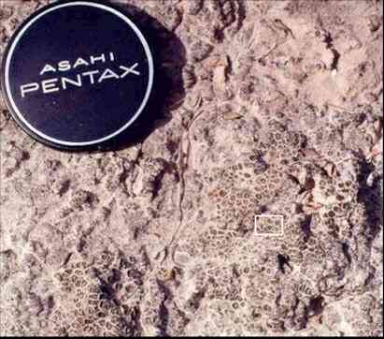
Algae, fungi, and lichens can form a cryptobiotic crust.
If disturbed, such crusts may require 200 years to reestablish.

Slide 38
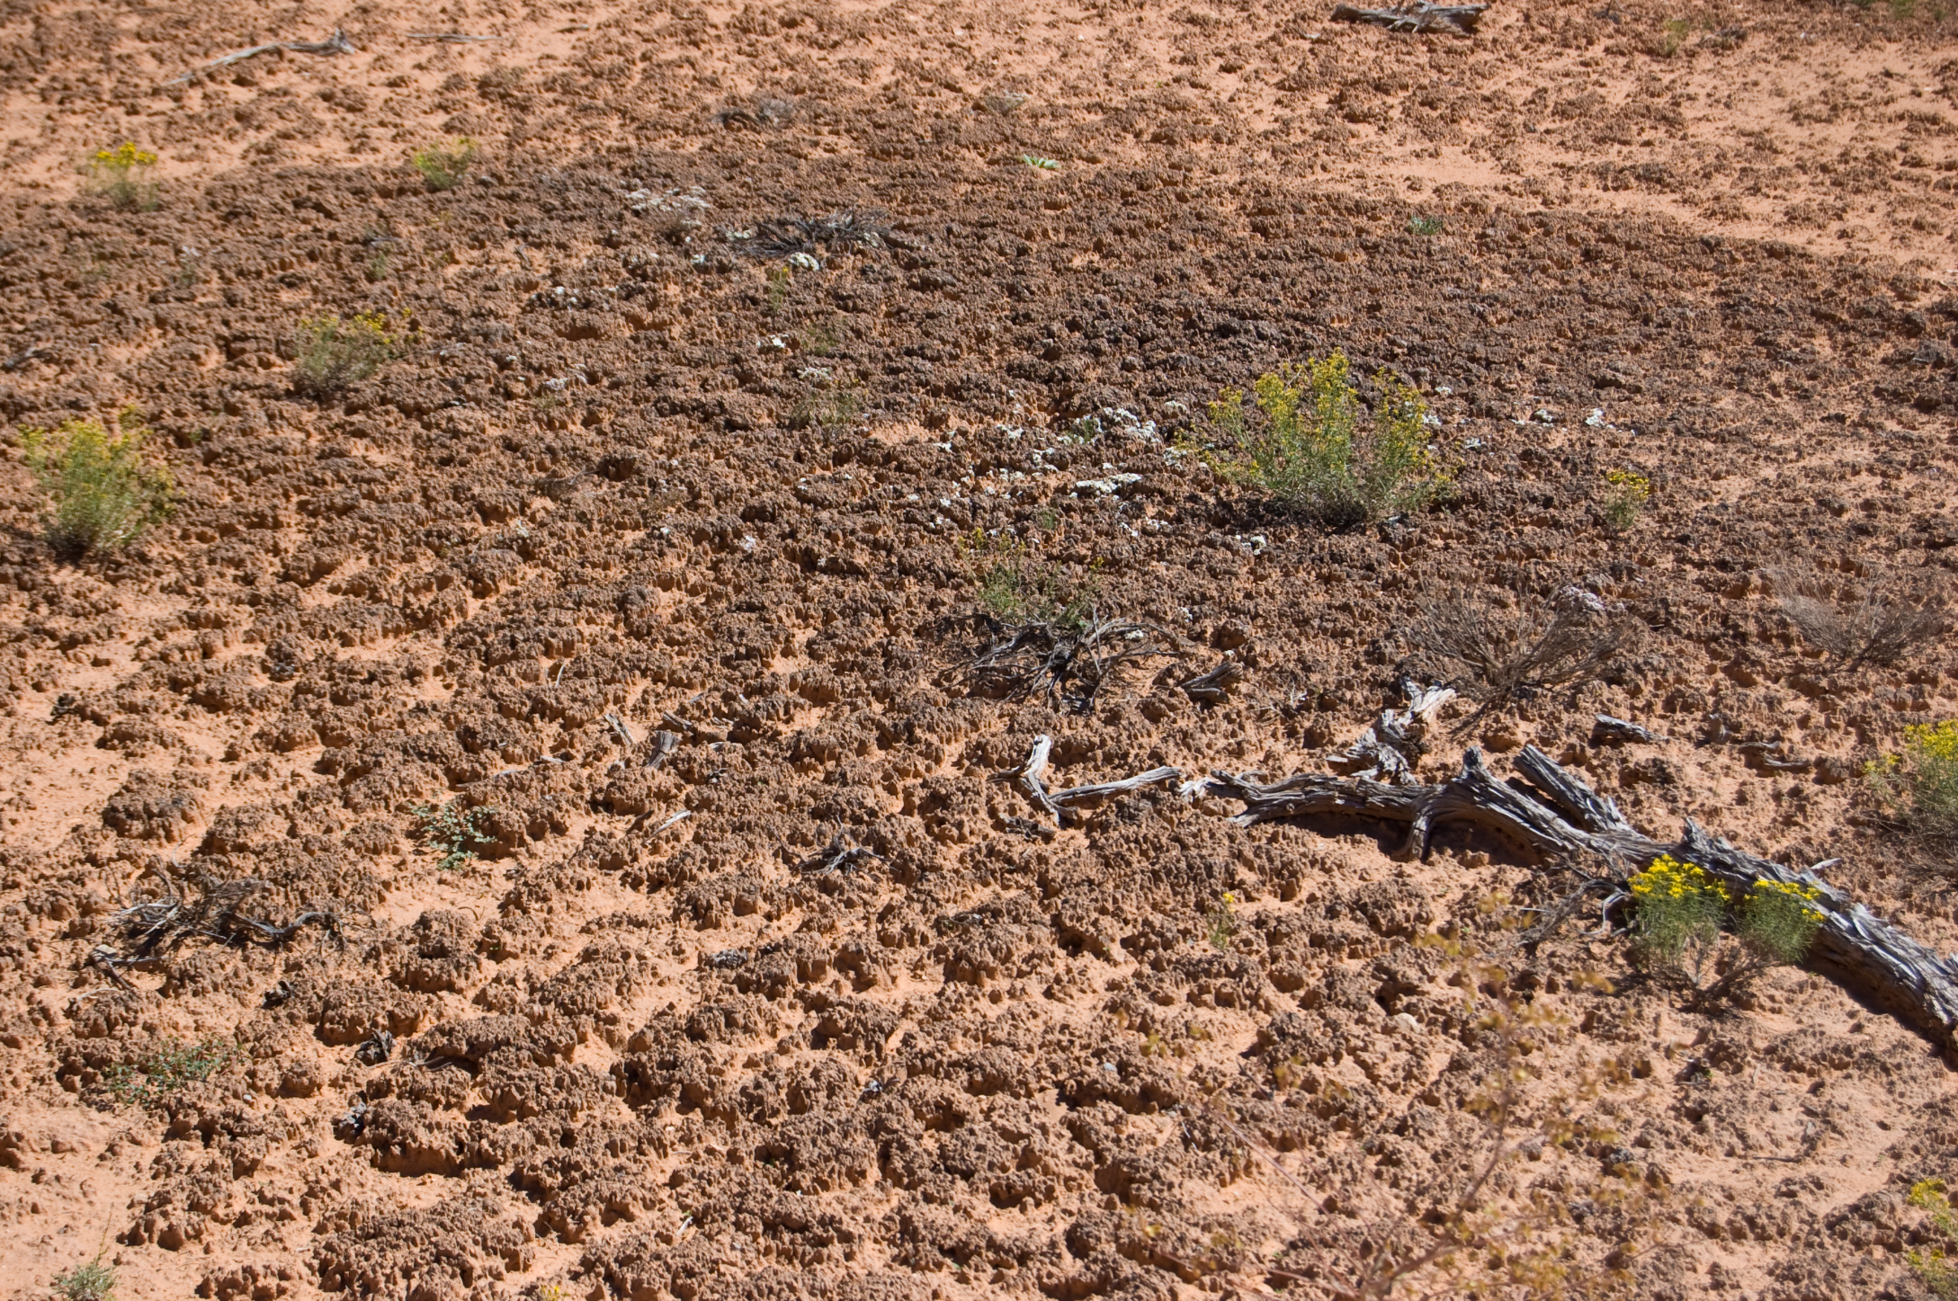

Slide 39
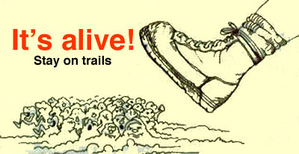
http://www.nps.gov/jotr/learn/nature/cryptocrusts.htm

Slide 40
Great Basin NP, Nevada
Basically, the top of a mountain.
Desert features. Cave system. Rock glacier. Bristlecone pines
https://www.nps.gov/grba/learn/photosmultimedia/photogallery.htm

Slide 41
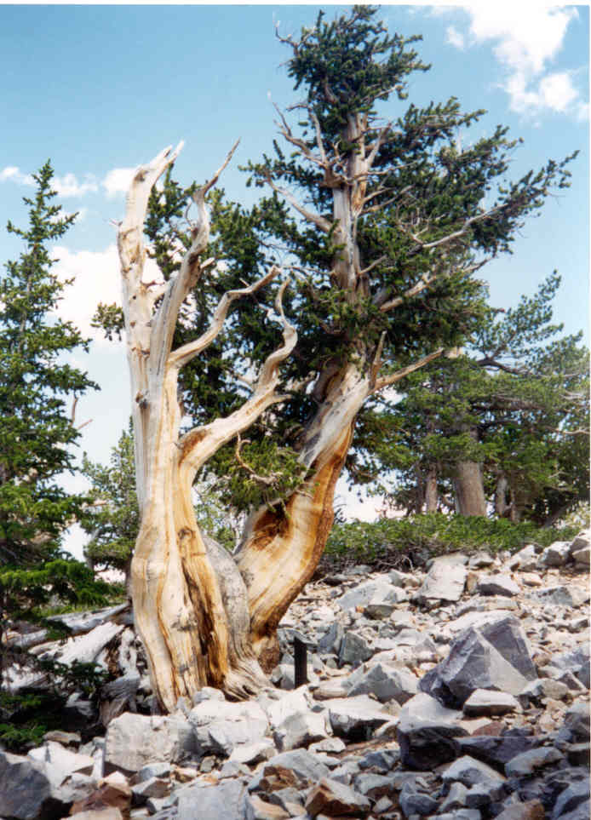

Slide 42
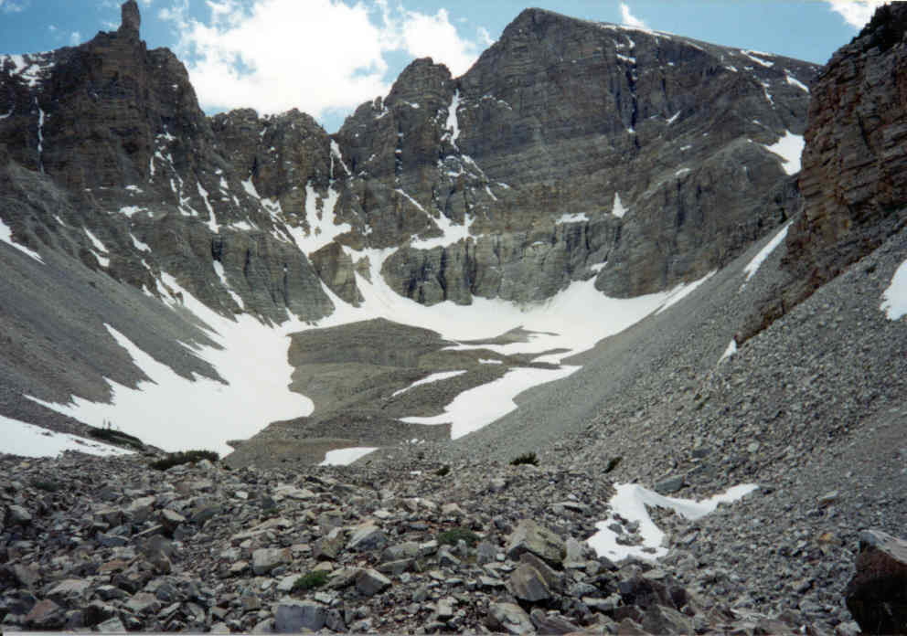

Slide 43
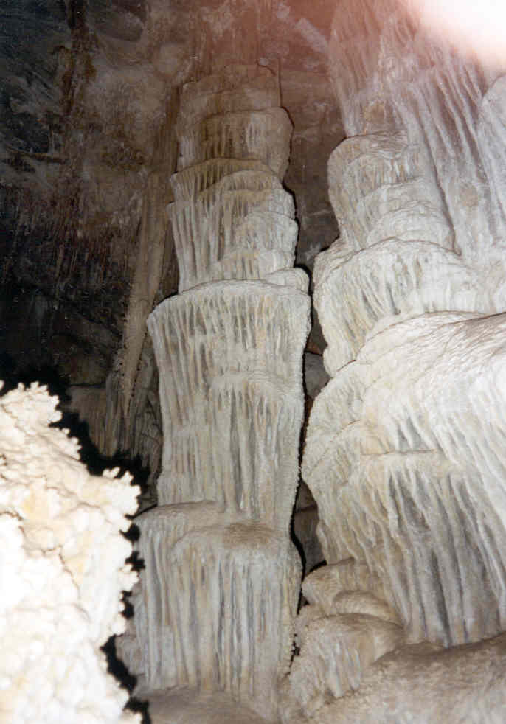

Slide 44
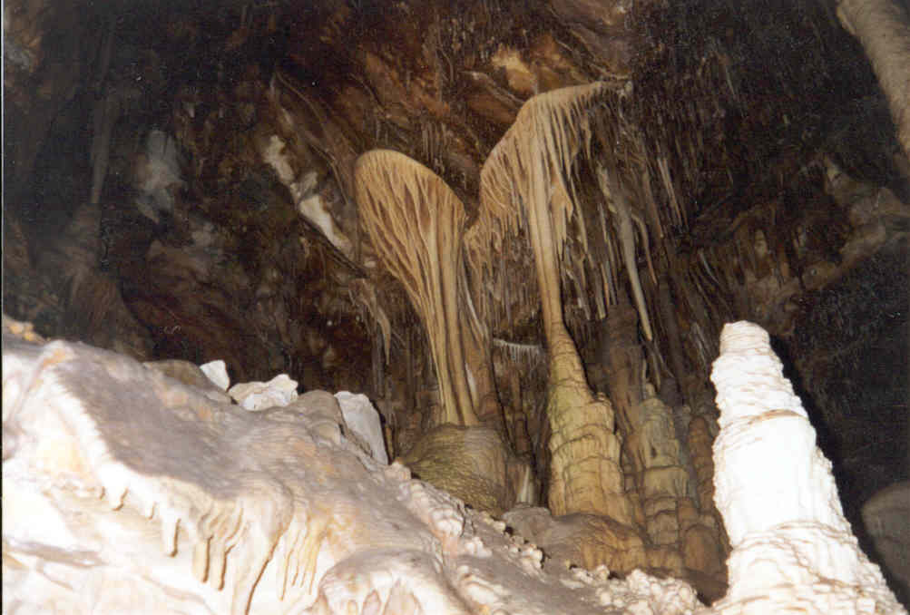

Slide 45
Grand Canyon NP, Arizona
Lotta geologic history here.
Uplift while river cuts down
https://www.nps.gov/media/photo/gallery.htm?id=F73A967F-155D-451F-67841C31296F7B05

Slide 46
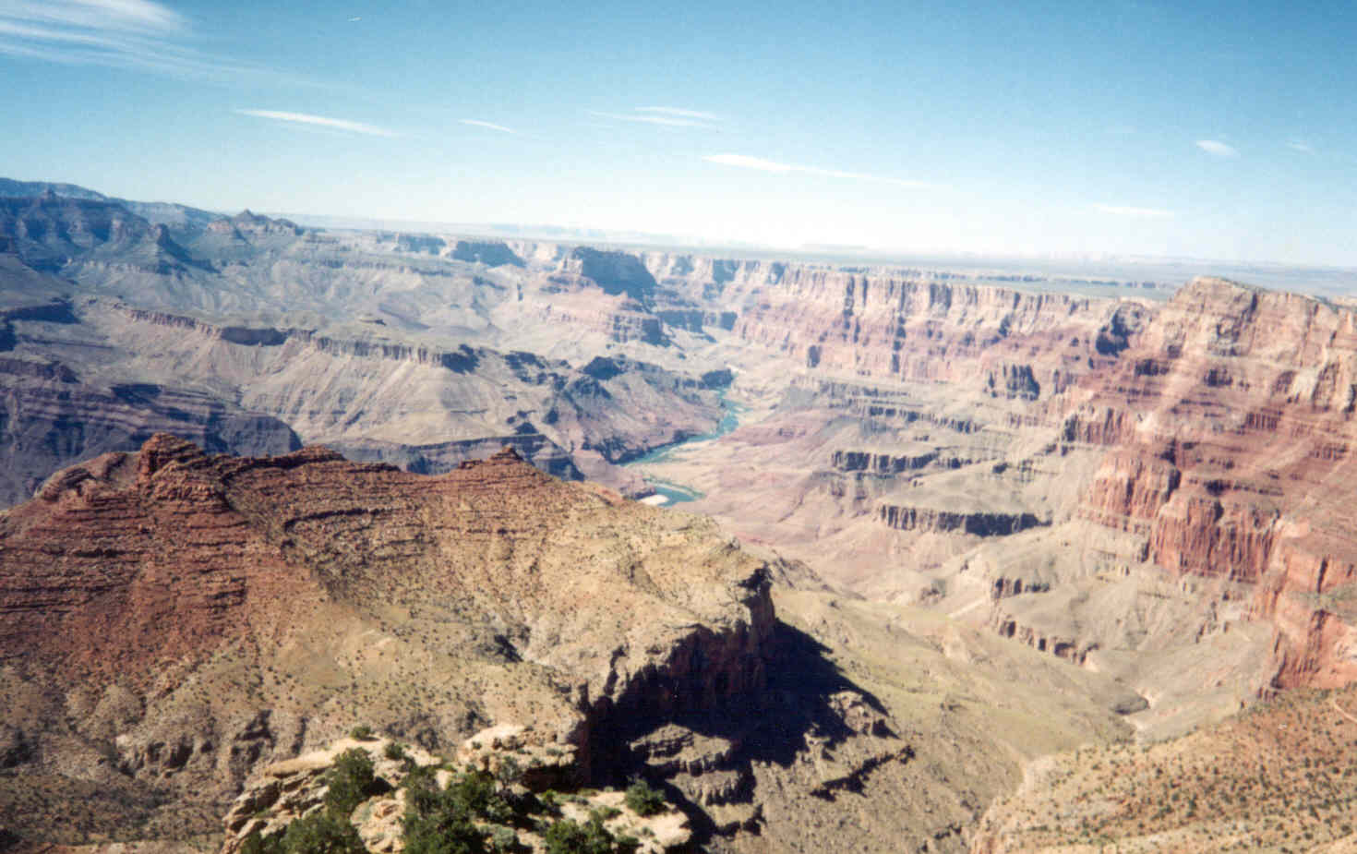

Slide 47
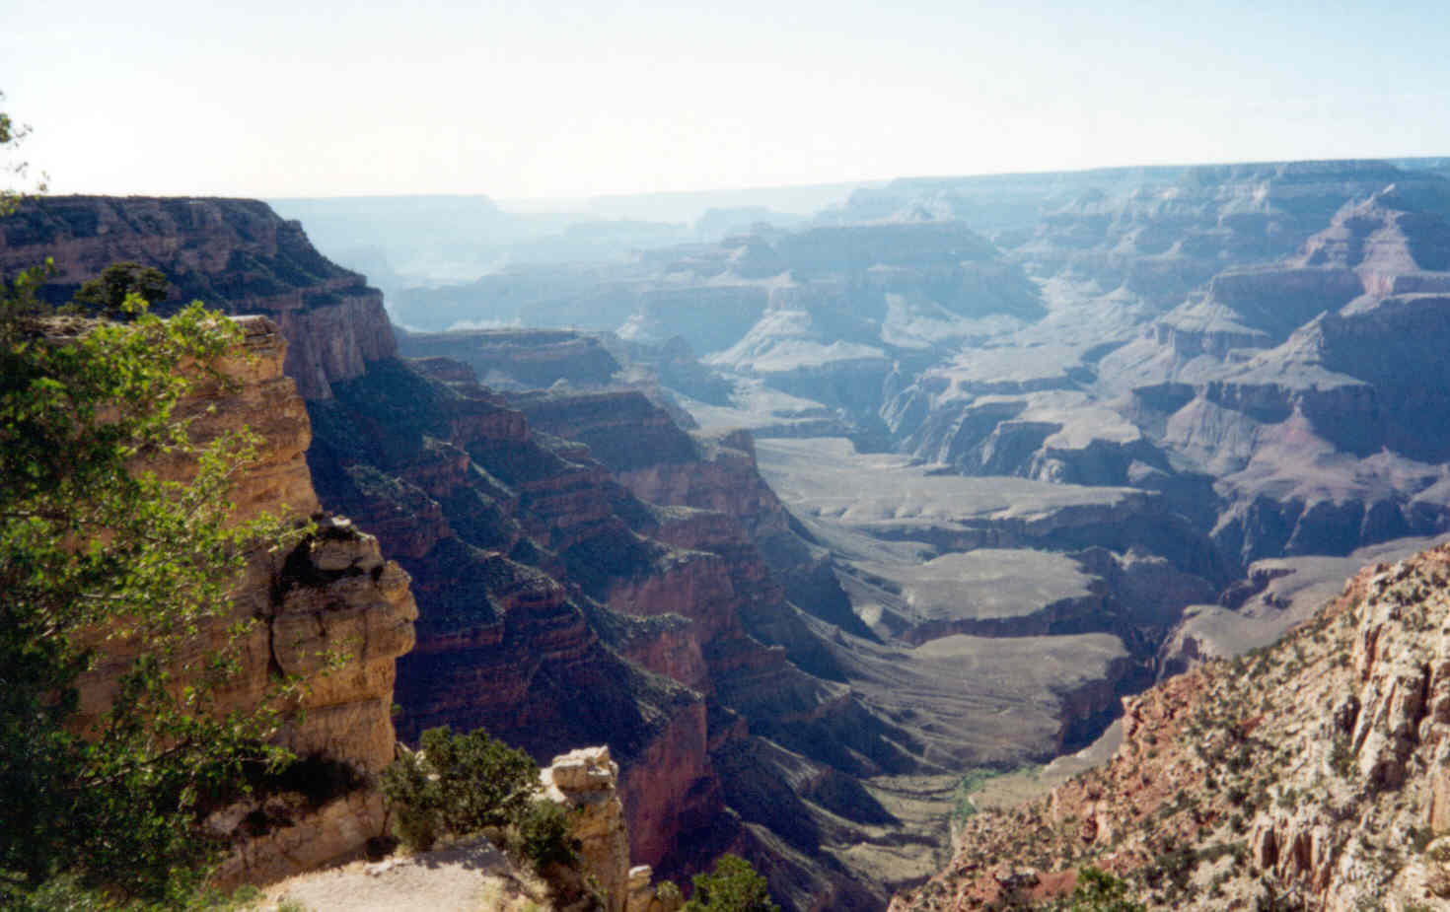

Slide 48
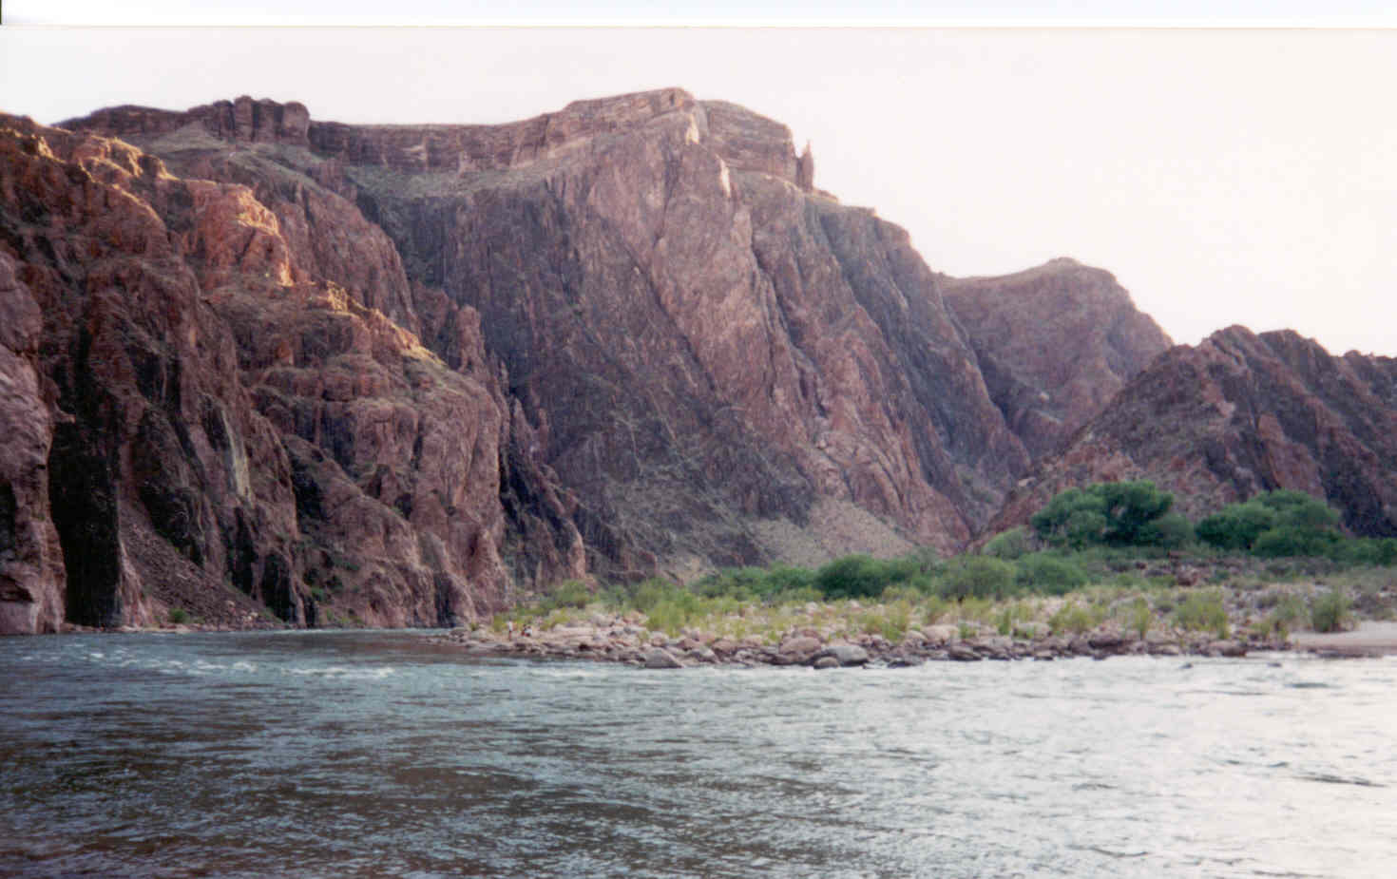

Slide 49
Almost Desert: Badlands NP, MT
Badlands… areas which don’t get quite enough rainfall for vegetation to establish itself on steep slopes.
Lots of erosion
https://www.nps.gov/media/photo/gallery.htm?id=BE498700-0690-40FD-B271-B61609D8F671

Slide 50
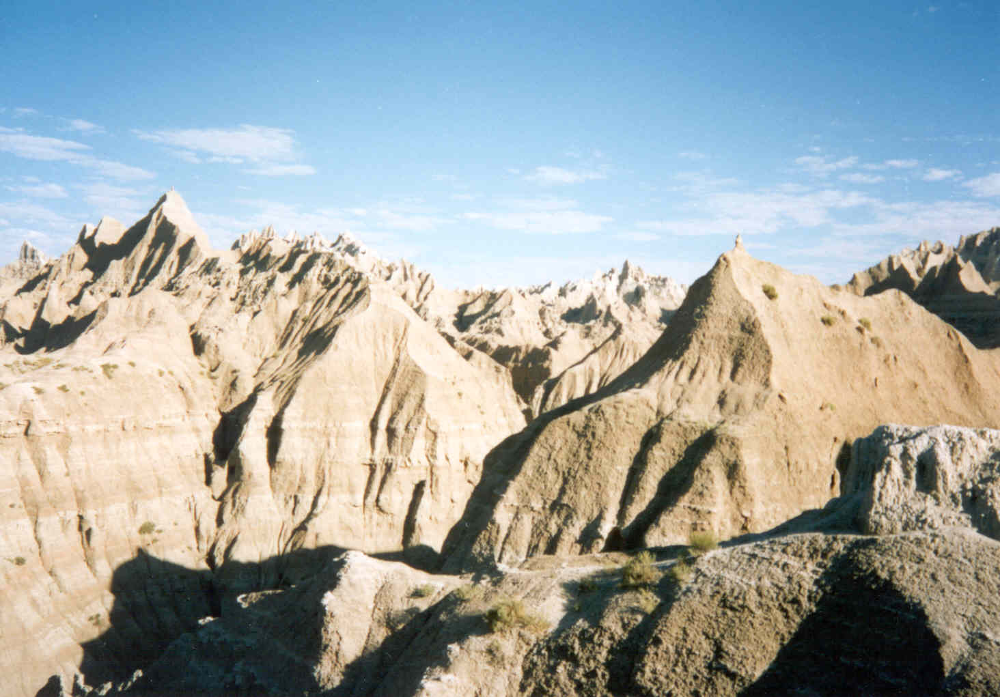

Slide 51
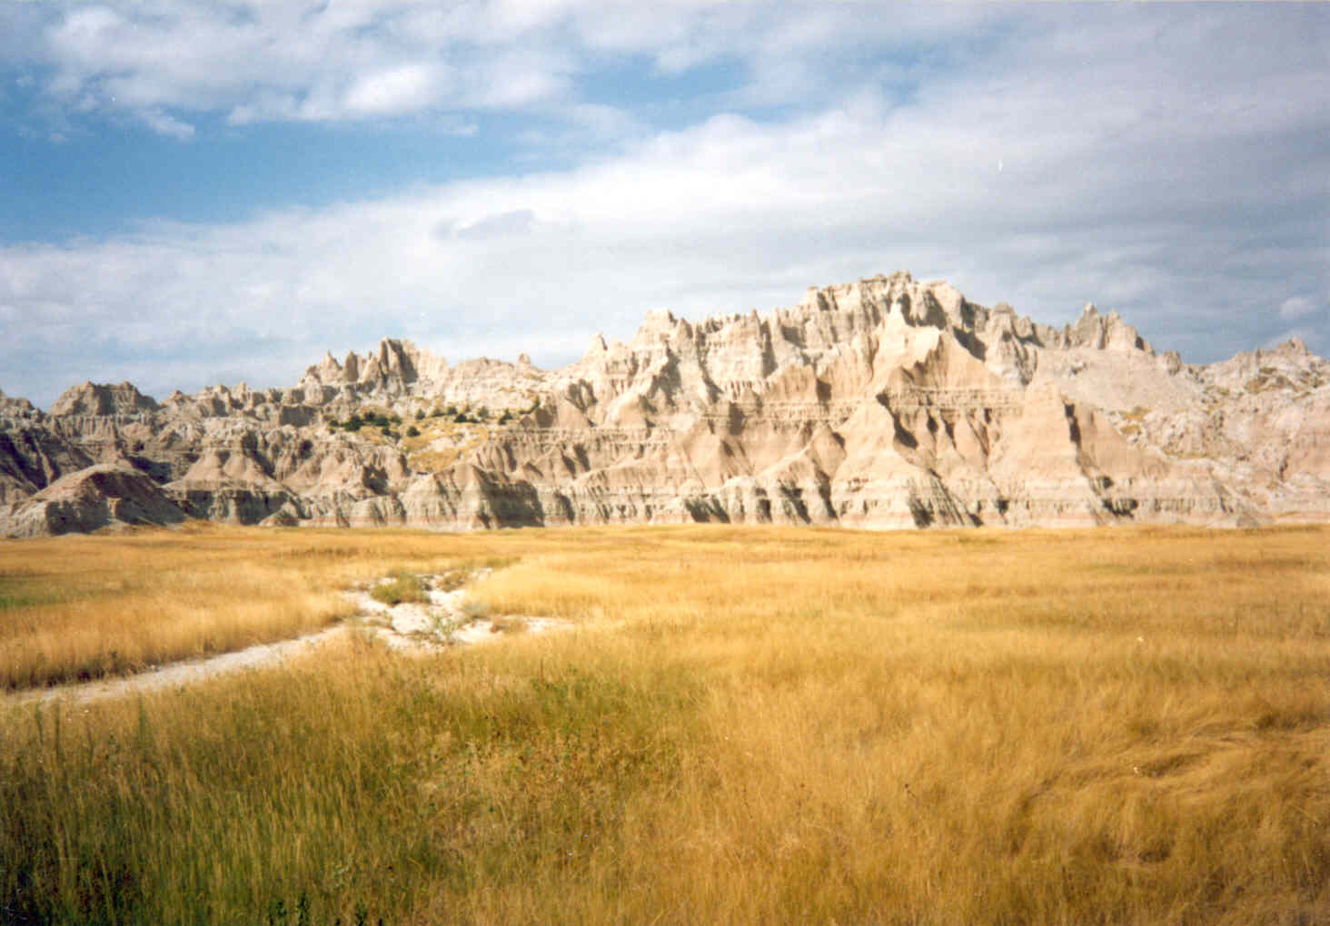

Slide 52
Death Valley NP, California
Death Valley, California, is the hottest place in the United States and the world, holding the record for the highest reliably measured air temperature on Earth at 134°F (56.7°C) set at Furnace Creek in 1913.
Death Valley, California, is the driest overall place in the United States, receiving an average of only about 2 inches (51 mm) of rain per year
https://www.nps.gov/deva/learn/photosmultimedia/photogallery.htm

Slide 53
White Sands National Park, New Mexico
https://www.nps.gov/whsa/learn/photosmultimedia/photogallery.htm
Bataan Death March Memorial Marathon

Slide 54
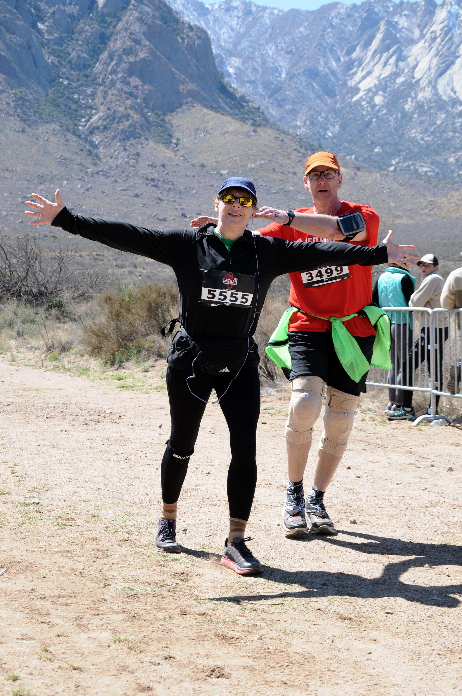

Slide 55


Slide 56
