Slide 1
Glaciated parks

Slide 2
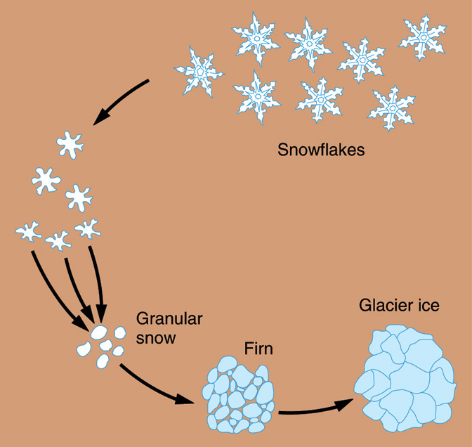
What is a glacier?
A body of ice on land which is thick enough that it flows under the influence of gravity
Bare minimum, 50 feet of ice (not snow).
Usually includes a lot of dust, rocks, and other debris.
All about pressure (basically, the weight of snow and ice that piles up)

Slide 3
Zone of ablation
Zone of accumulation
Over time, accumulation must exceed ablation for the glacier to advance.
If not, we have glacial retreat. Though it is still flowing downhill, it just doesn’t get as far

Slide 4
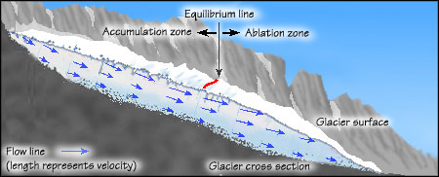

Slide 5
But… how do they actually move?
Near the surface of a glacier, ice is brittle. When the glacier moves over irregular terrain, the uppermost zone (called zone of fracture) is subjected to tension, resulting in cracks called crevasses.
Plastic flow (think thick oil)
Basal sliding – on a slick of water.
Friction is a big issue. Especially if very cold and the glacier is frozen to the ground.

Slide 6
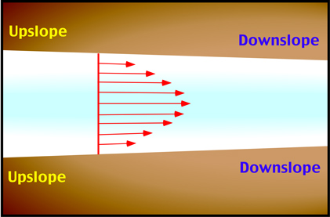
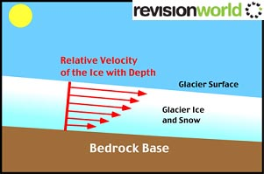

Slide 7
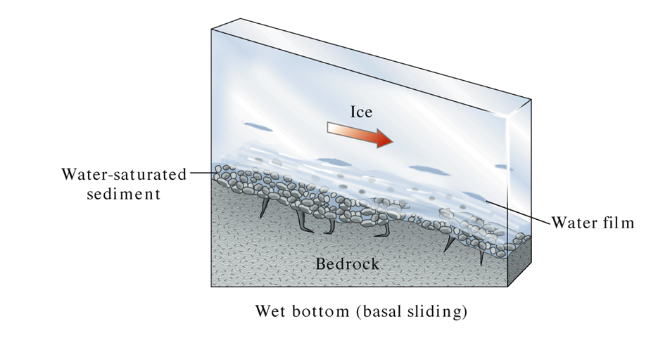

Slide 8
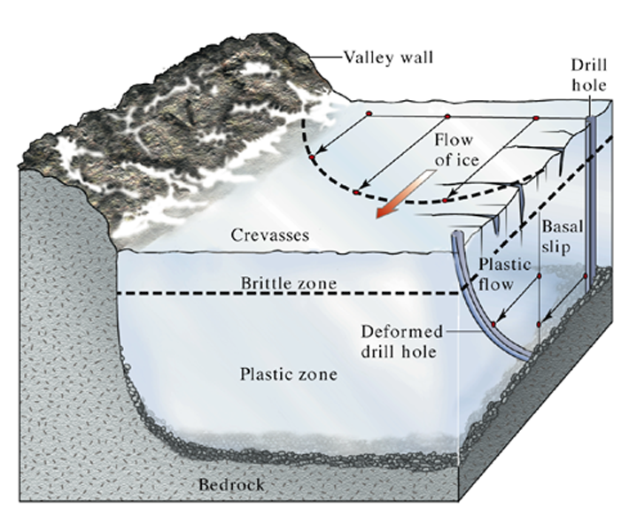
Different parts of a glacier flow at different velocities. (W.W. Norton)

Slide 9
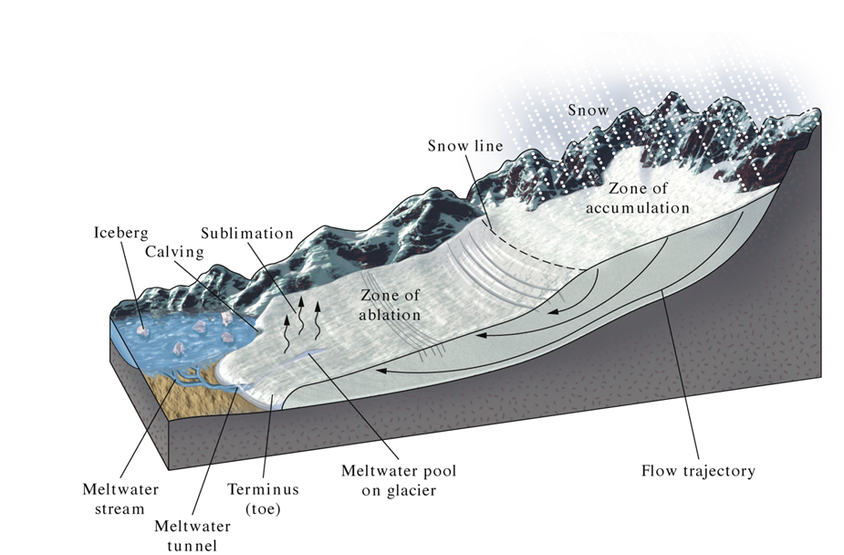
Glacial advance or retreat is determined by the balance between the accumulation of snow and the removal of ice by sublimation, melting, and calving (ablation). (W.W. Norton)

Slide 10
Type of Glaciers
Valley (alpine) glaciers: Valley glaciers are bounded by valleys. Found in the mountains!
Ice sheets (continental glaciers): Ice sheets exist on a much larger scale. Current ice sheets are found in Greenland and Antarctica.

Slide 11
How do glaciers wear down the land?
Glaciers erode land by plucking (lifting pieces of bedrock) and abrasion (grinding and scraping).
Glacial abrasion sometimes is evident in the long scratches and grooves in the bedrock (called glacial striations or polish).

Slide 12
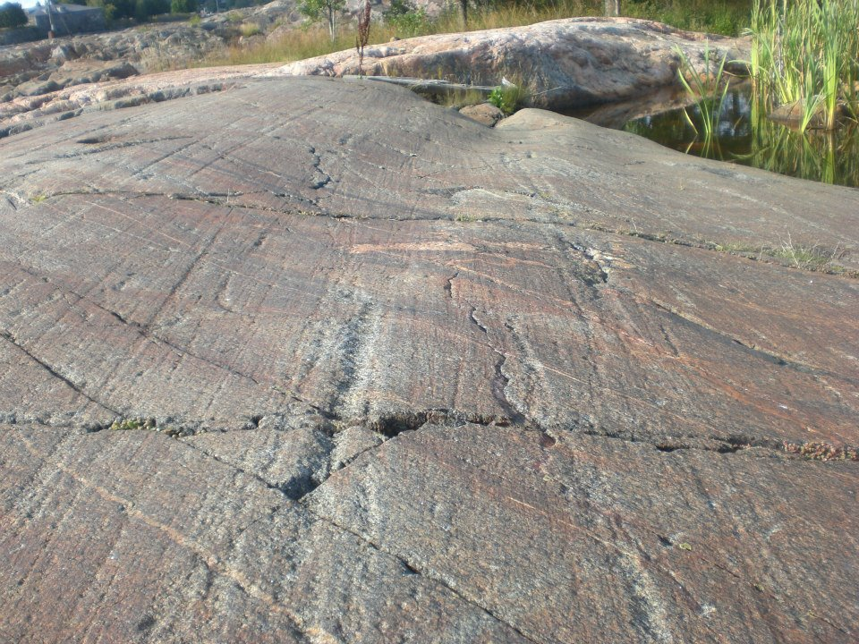

Slide 13
An outstanding example of glacial grooves can be found at the Glacial Grooves at Kelleys Island, Ohio (a National Natural Landmark), the most impressive of which is 400 feet (120 m) long, 35 feet (11 m) wide, and up to 10 feet (3.0 m) deep. These grooves cut into the Columbus Limestone. Striations cover the sides and bottoms of the grooves. https://nsidc.org/cryosphere/glaciers/gallery/grooves.html
Definitely go there on GE. NE part of the island.

Slide 14
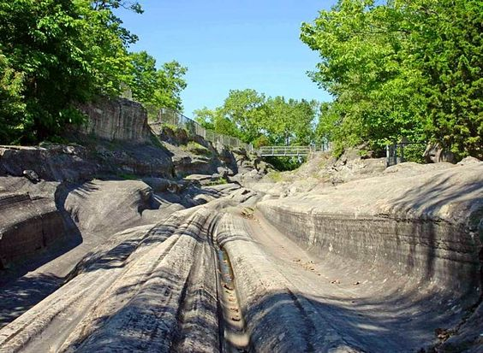

Slide 15
And now! To the Mountains!!!!
Horn
Arete
Col
Cirque
Tarn lake
U shaped valley
Hanging valley
Fjord
Glacial milk
Crevasses. They’re everywhere! Remember the brittle zone of a glacier
Terminal moraine
Medial moraine
Lateral moraine
Pater noster lakes
Ice caves

Slide 16
Decent descriptions and pics at http://www.physicalgeography.net/fundamentals/10af.html

Slide 17
Glacier NP, Montana
Overthrust belt, metasediments, and an epic sill (Purcell Sill).
My favorite.
Epic mountains, glacial features, and critters.
https://www.nps.gov/glac/learn/photosmultimedia/photogallery.htm

Slide 18
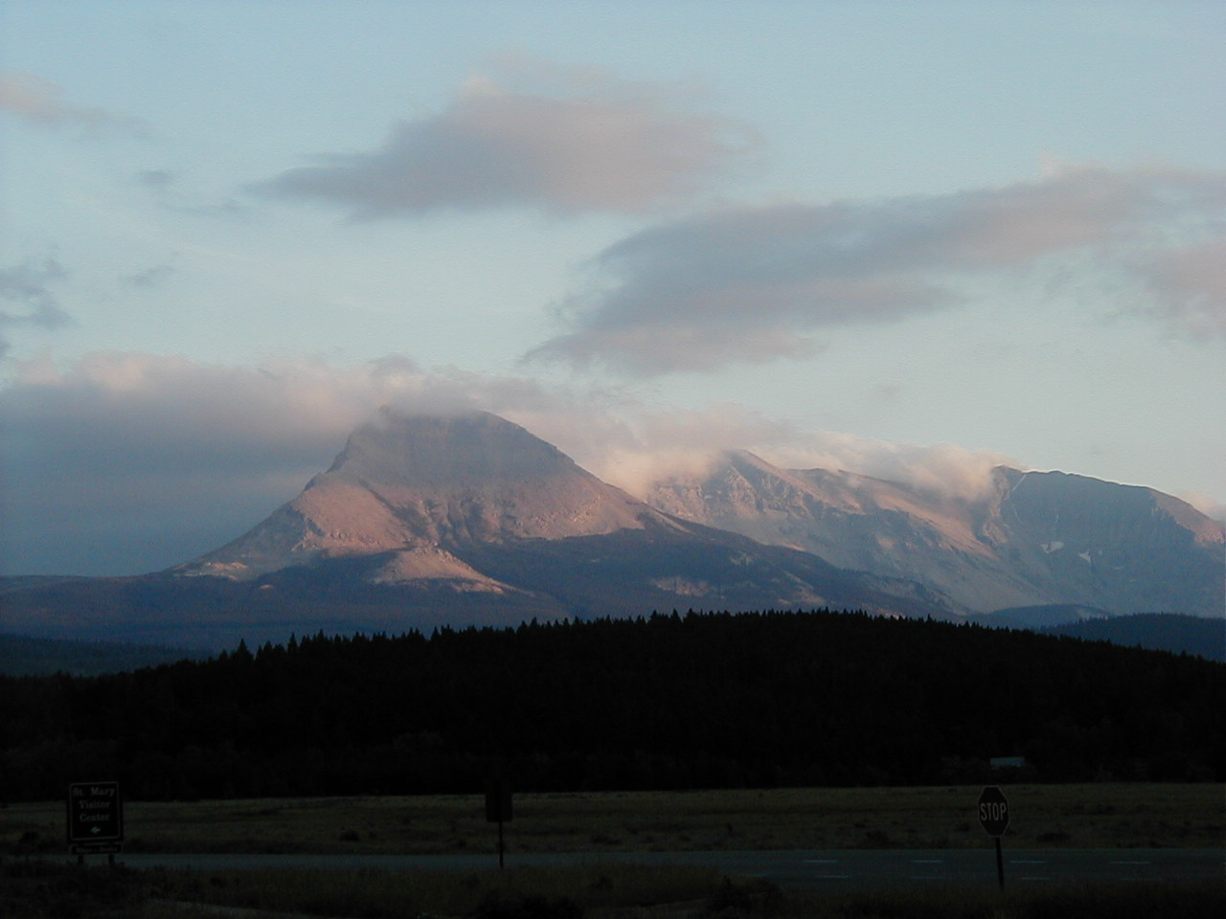

Slide 19
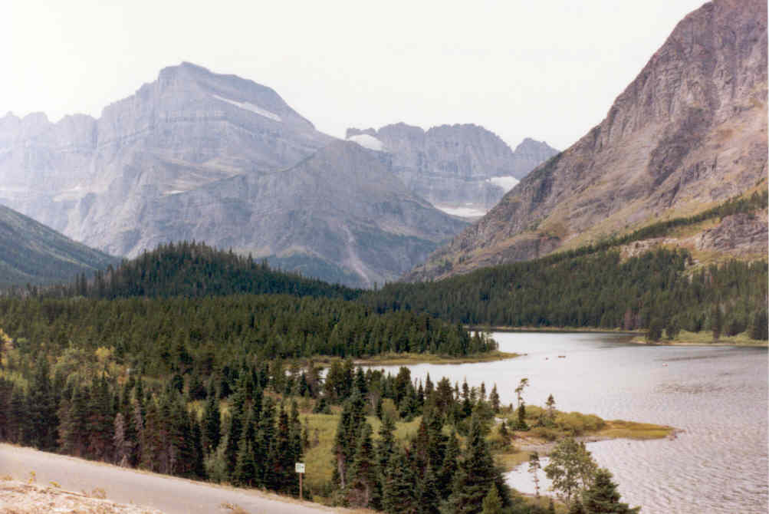

Slide 20
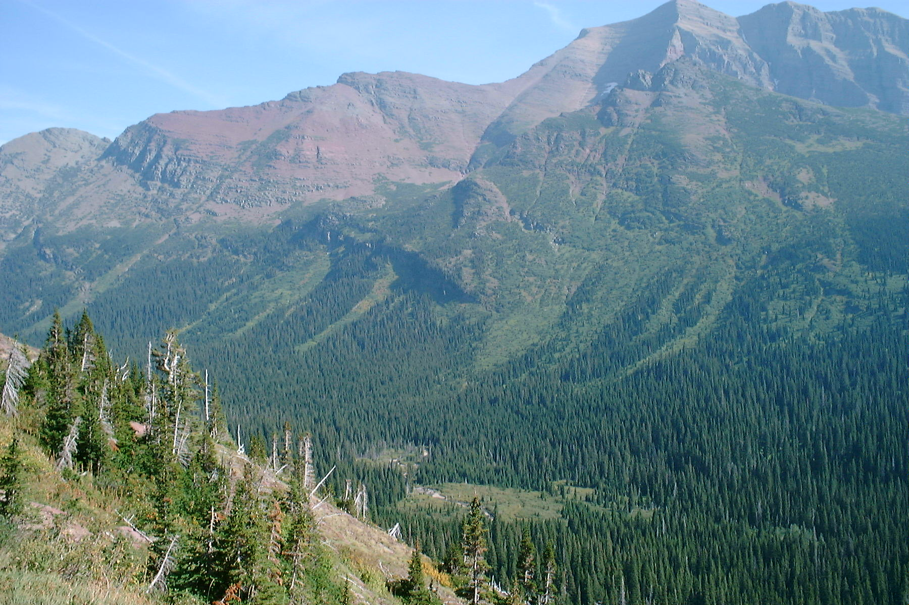

Slide 21
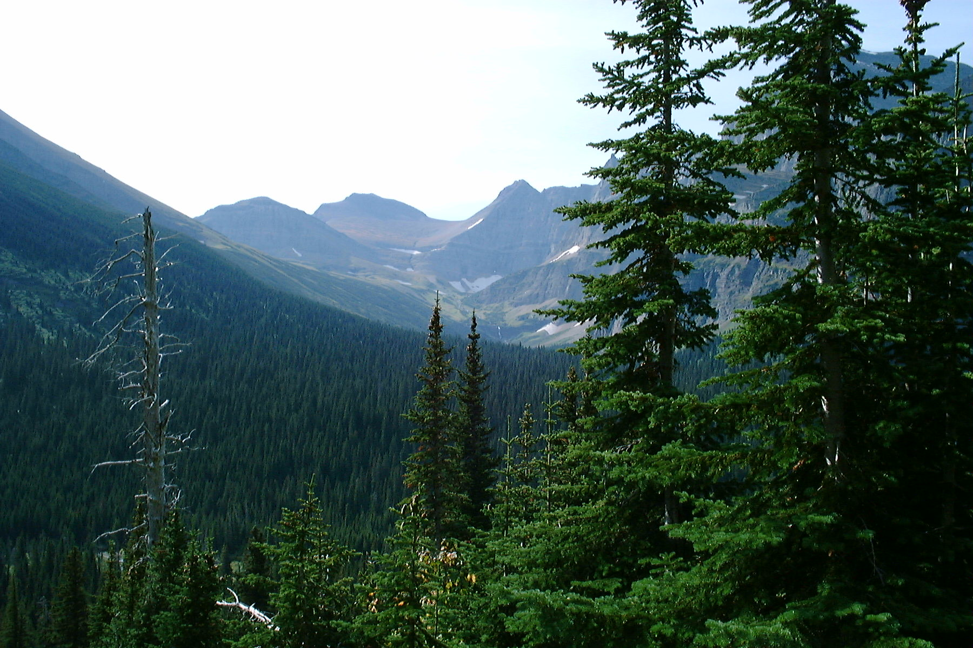

Slide 22
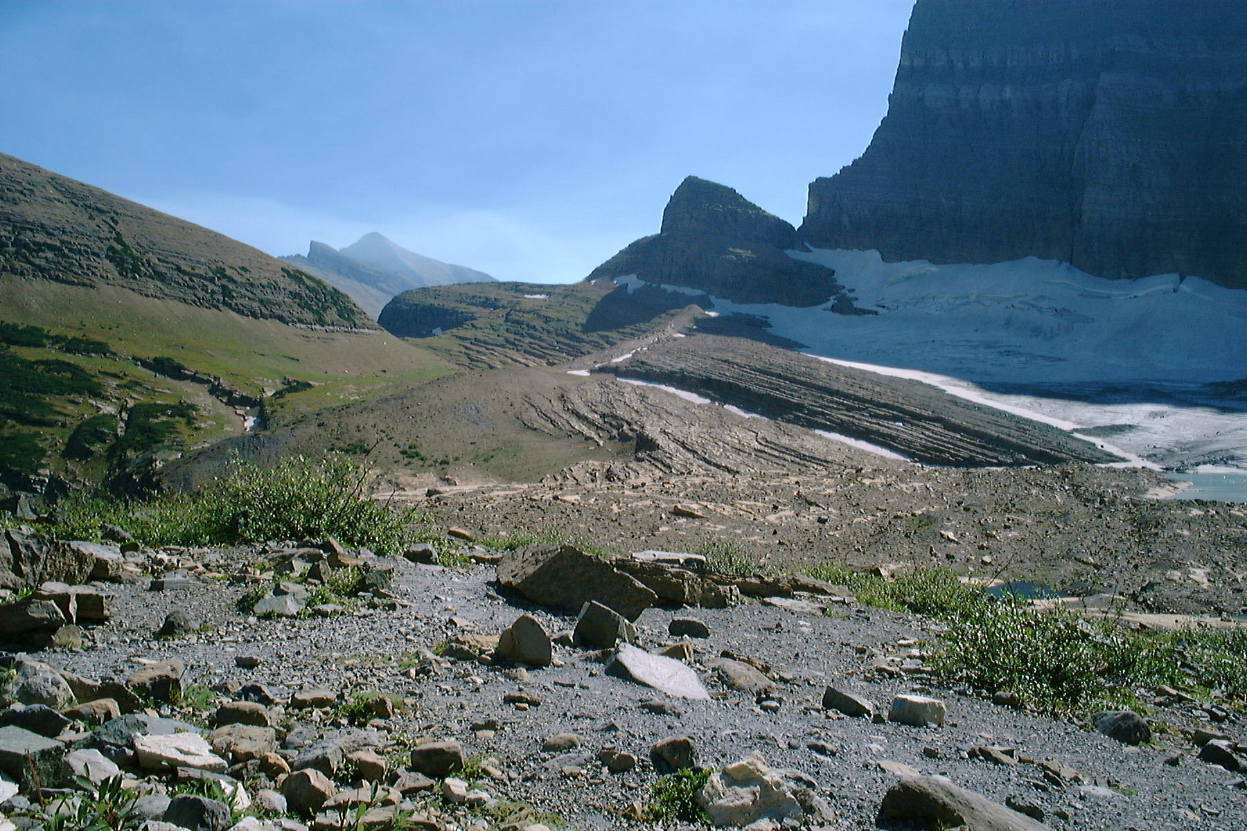

Slide 23
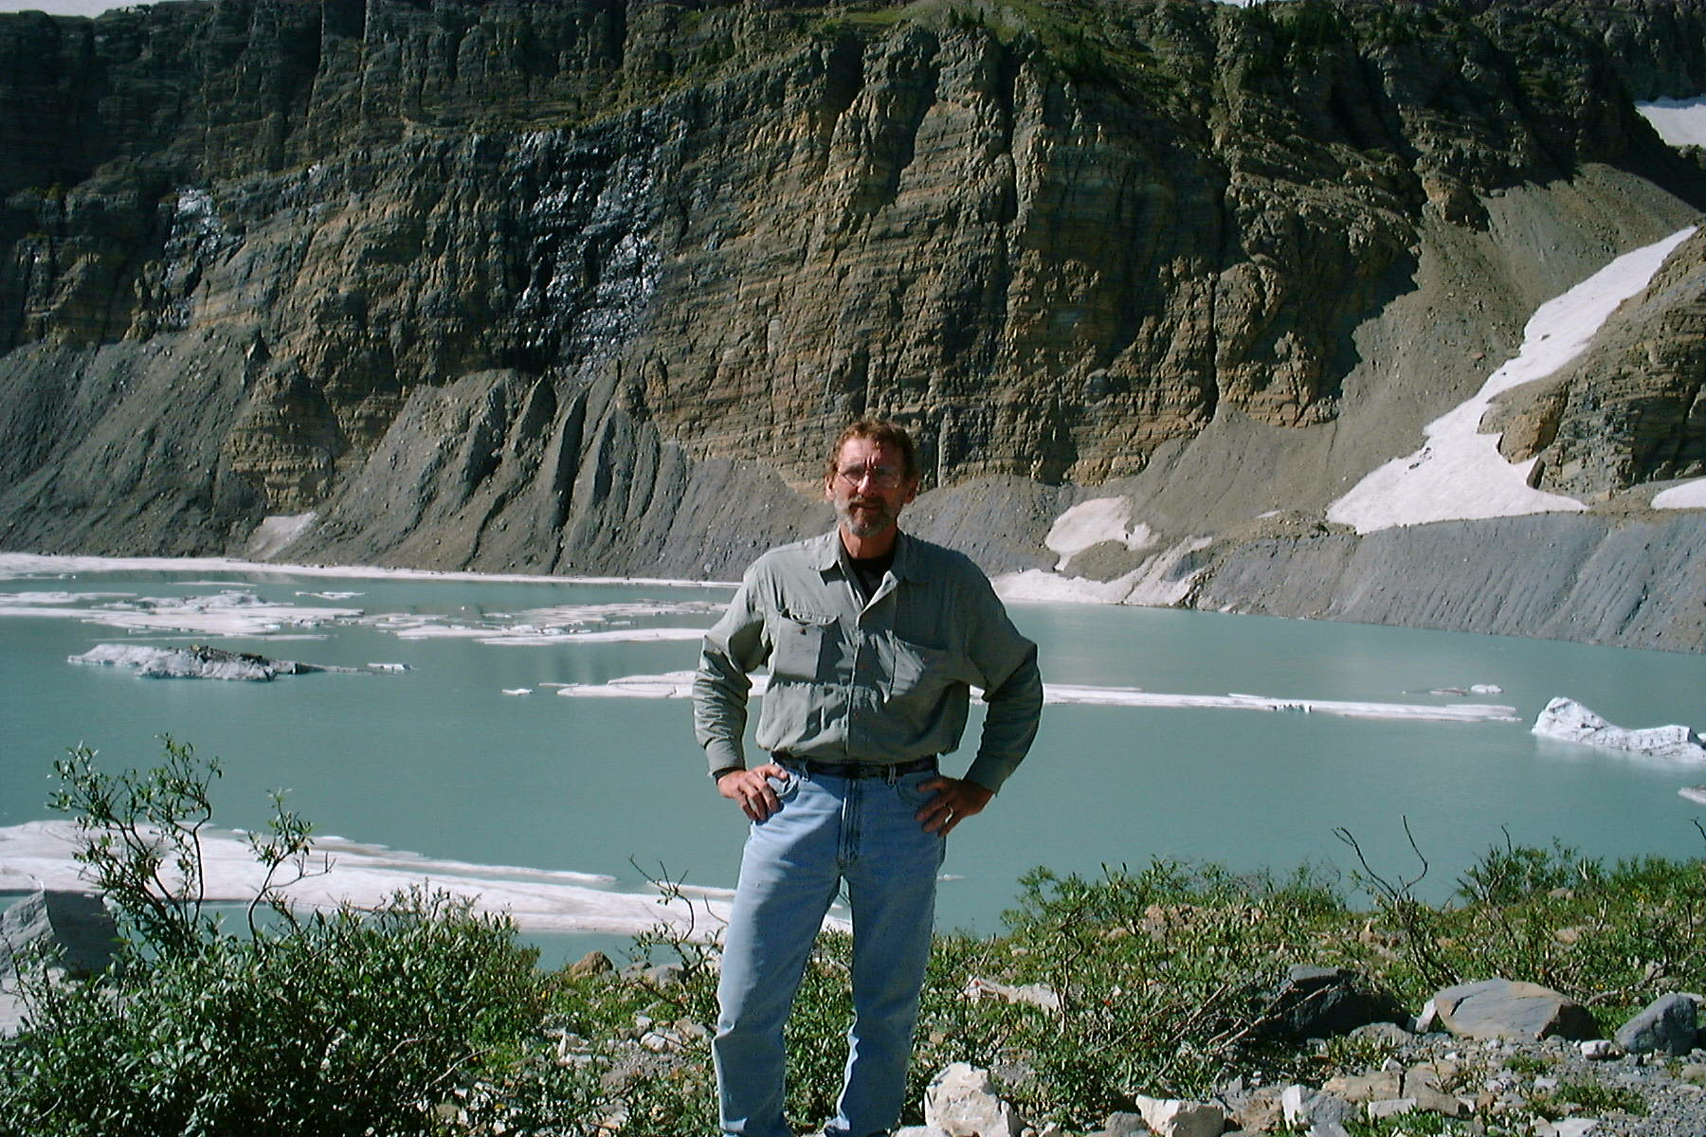

Slide 24
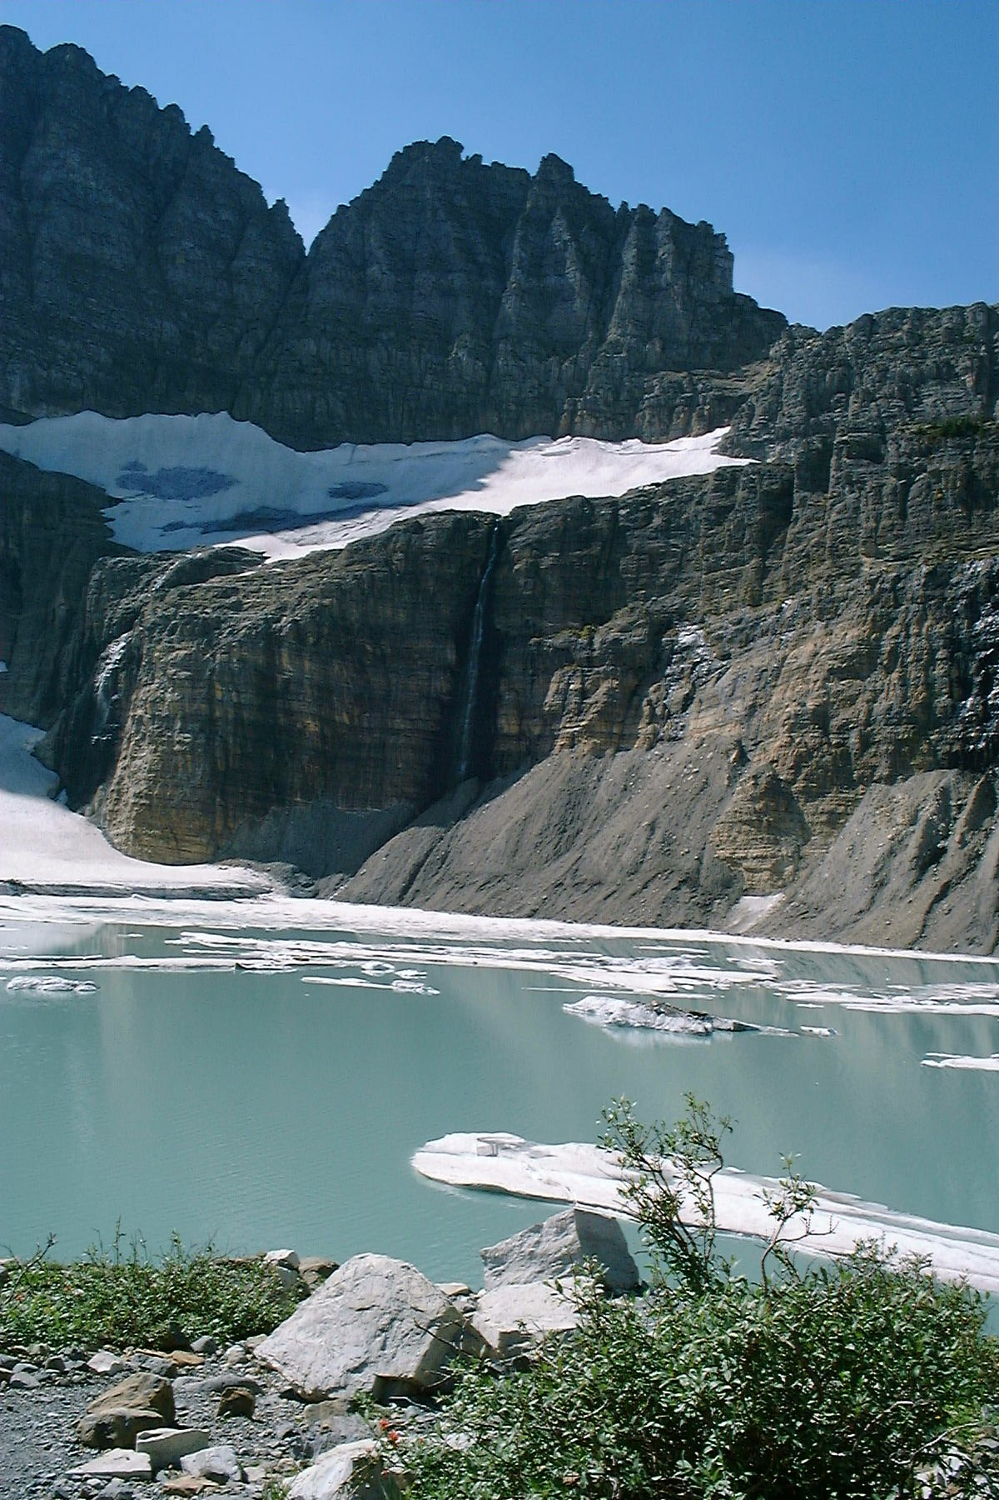

Slide 25
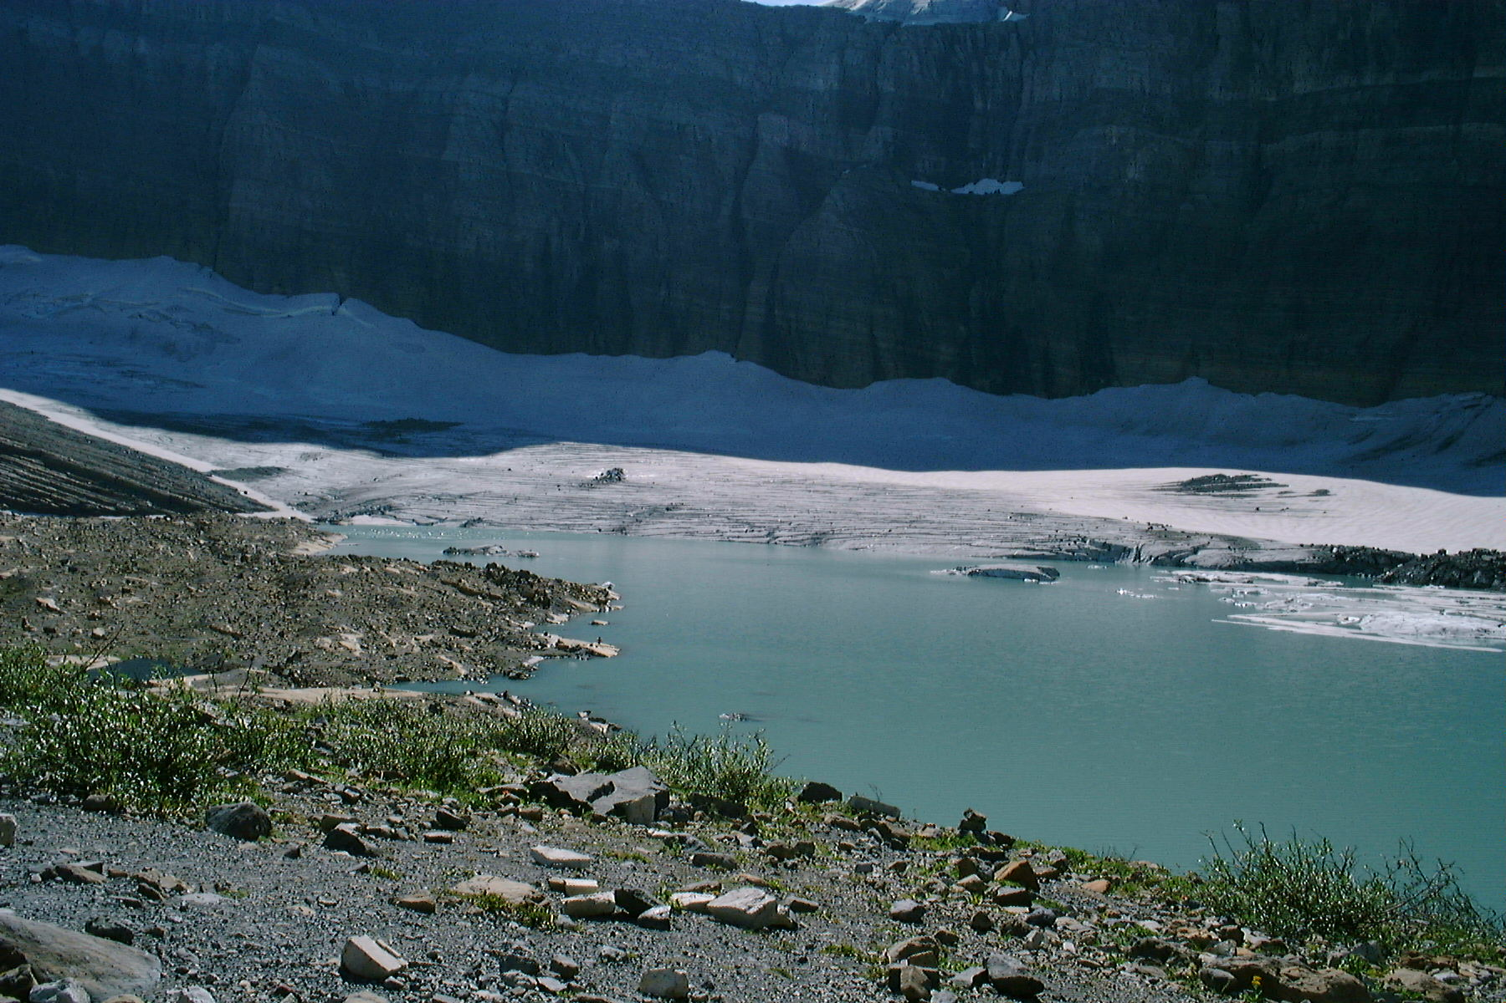

Slide 26
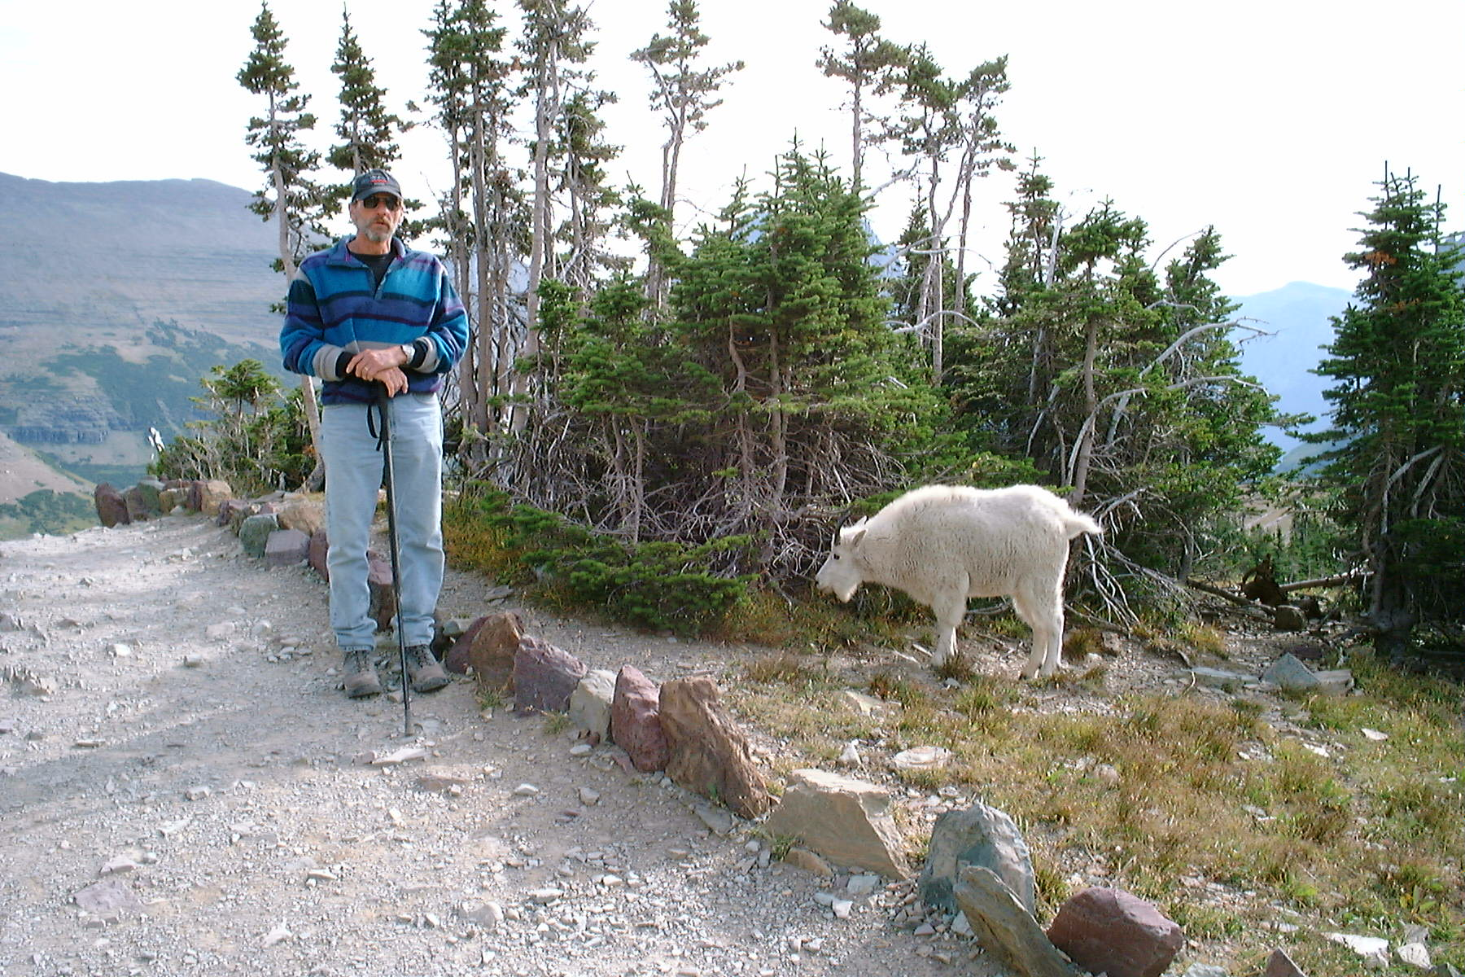

Slide 27
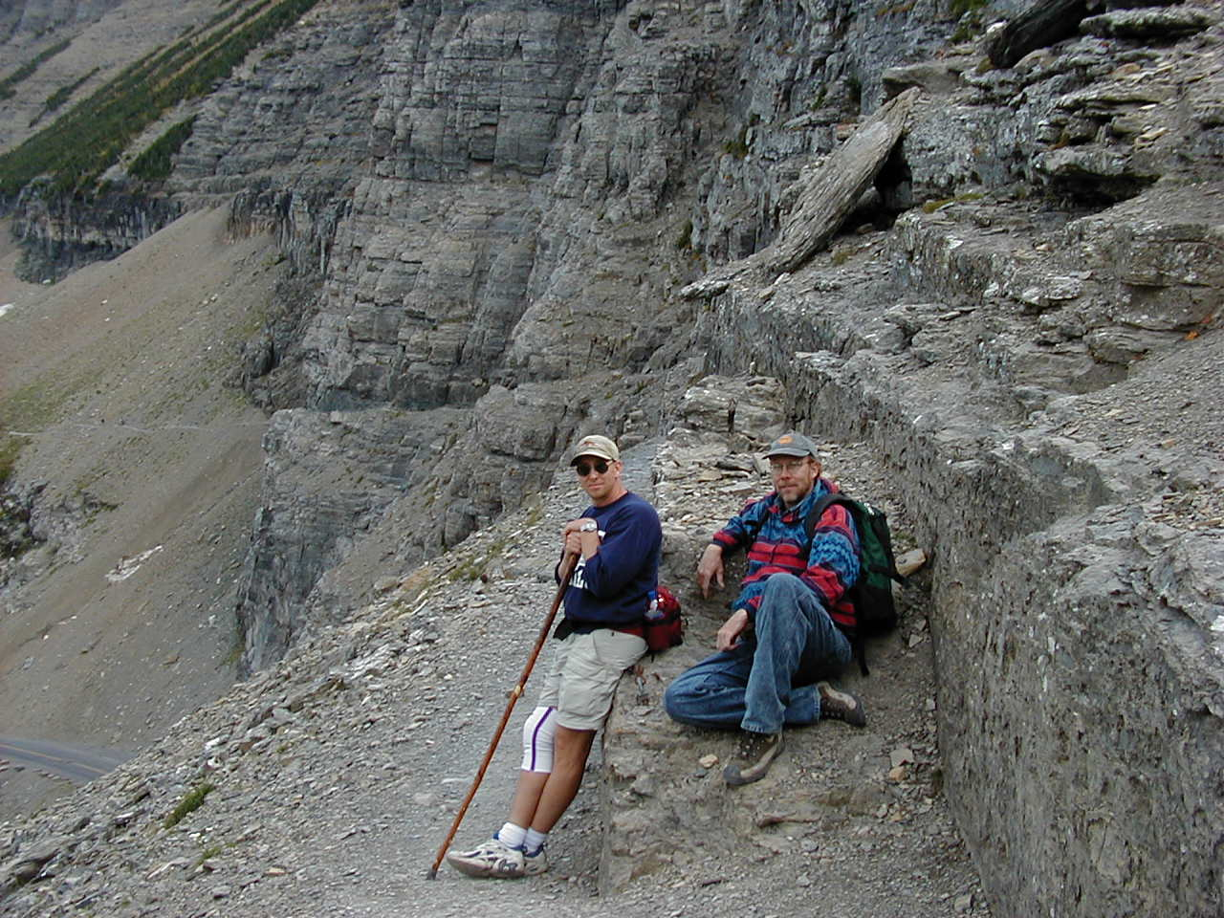

Slide 28
Denali NP, Alaska
Granitic pluton
Huge park, full of critters.
Freaking huge mountain.
https://www.nps.gov/dena/learn/photosmultimedia/index.htm

Slide 29
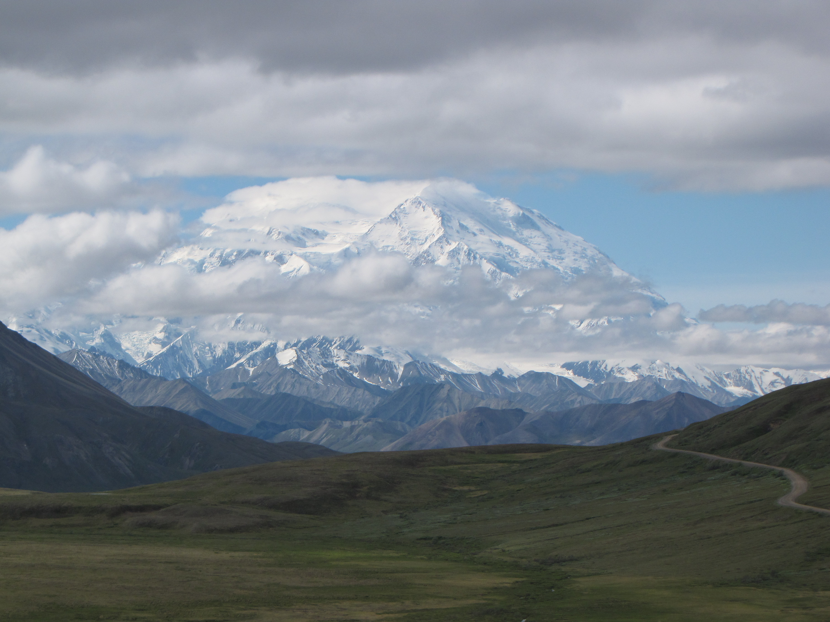

Slide 30
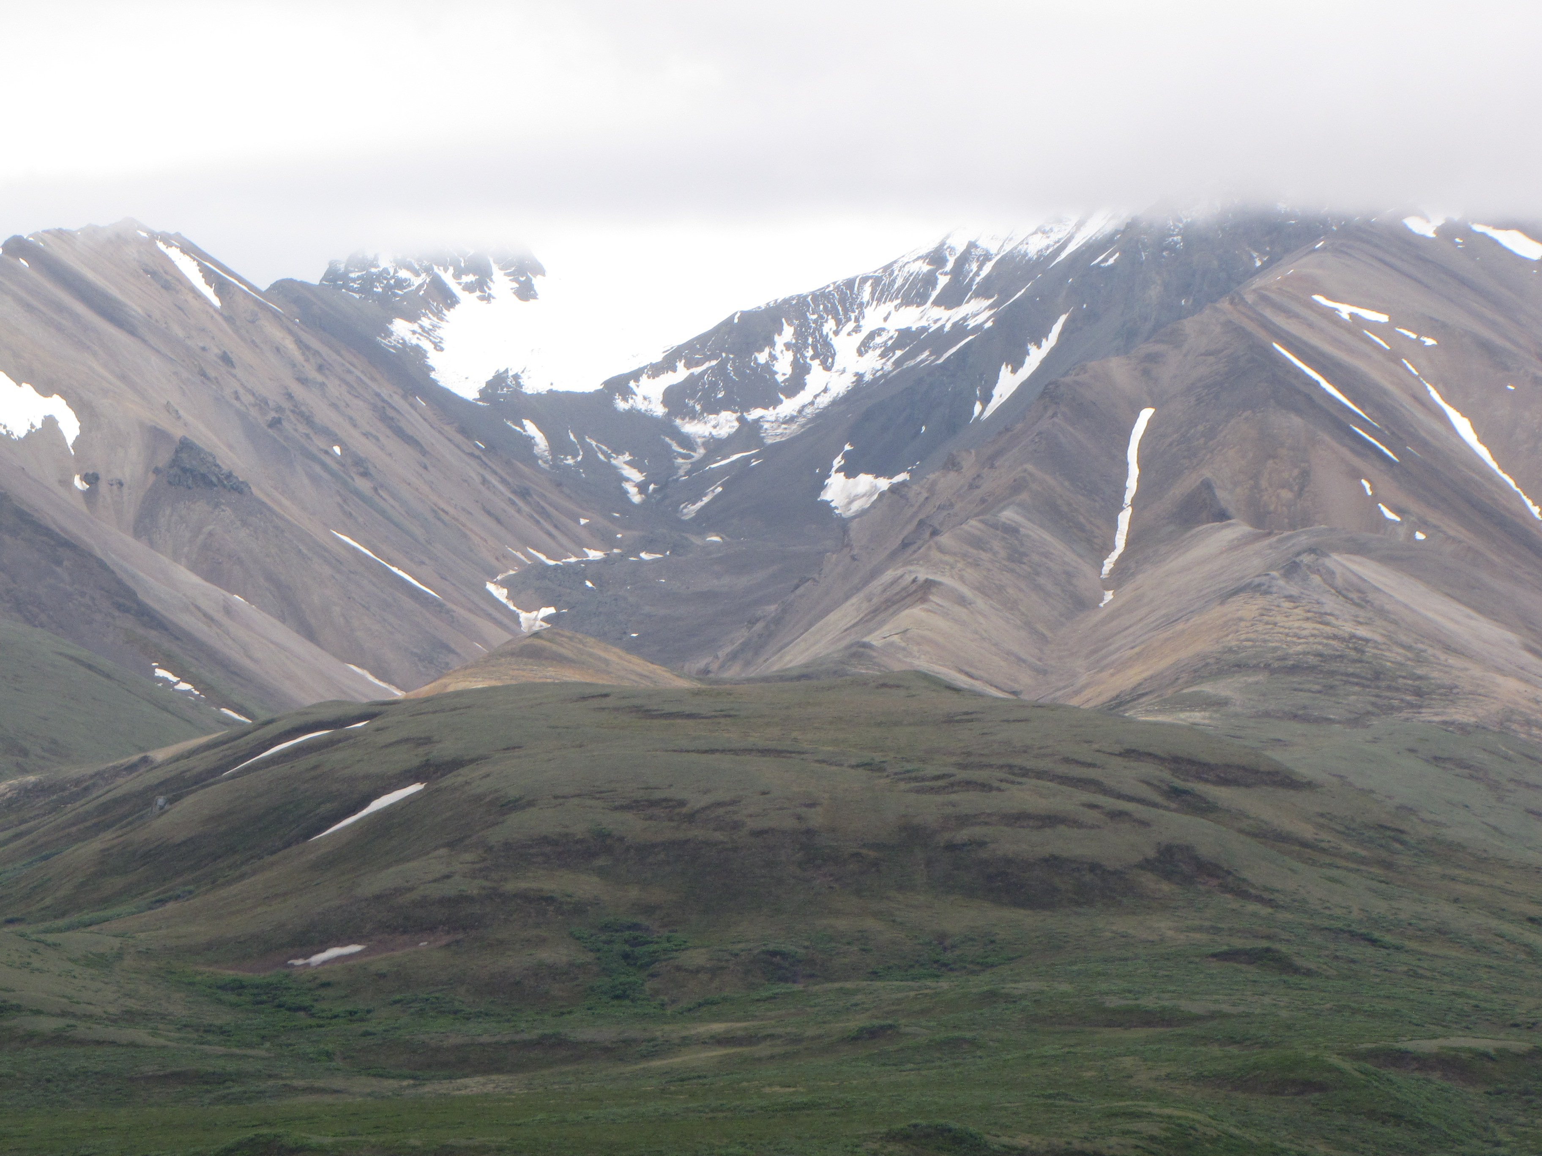

Slide 31
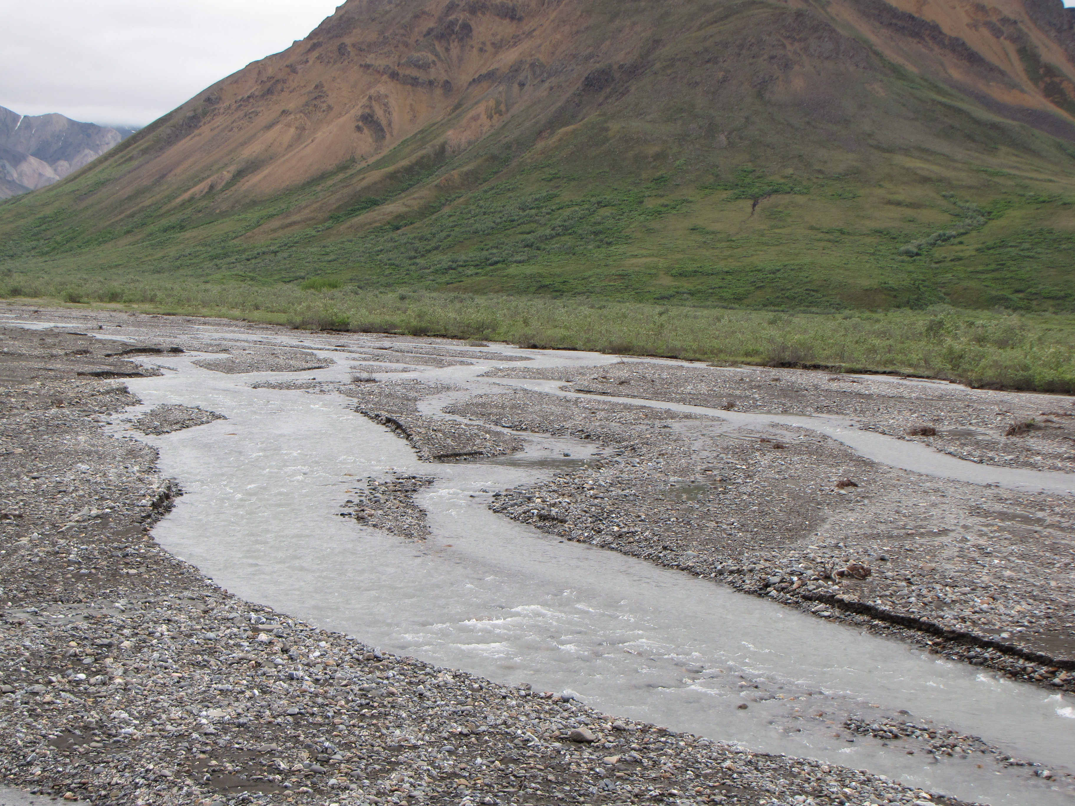

Slide 32
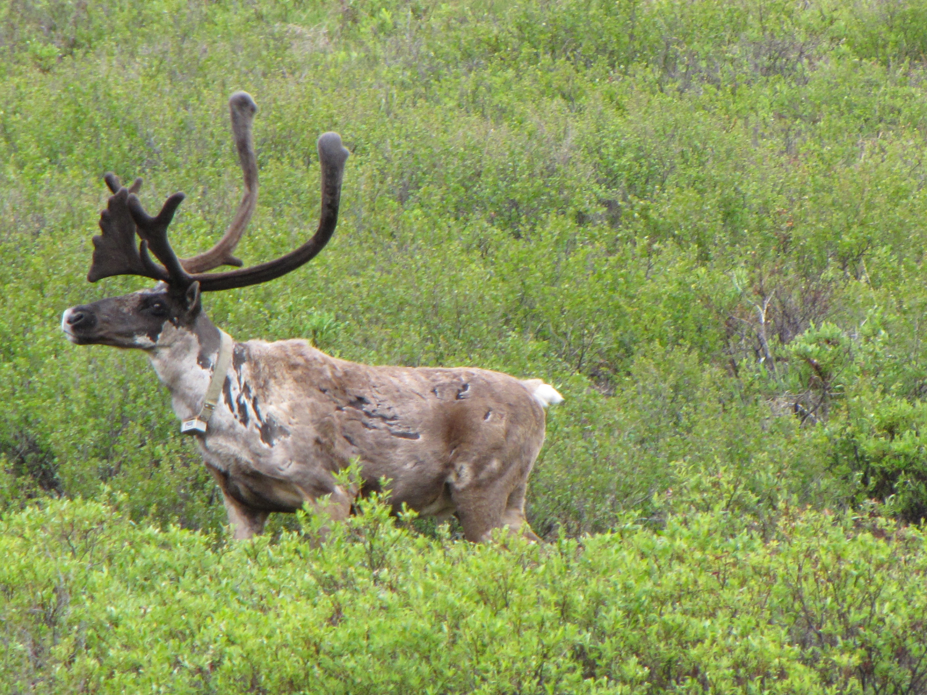

Slide 33
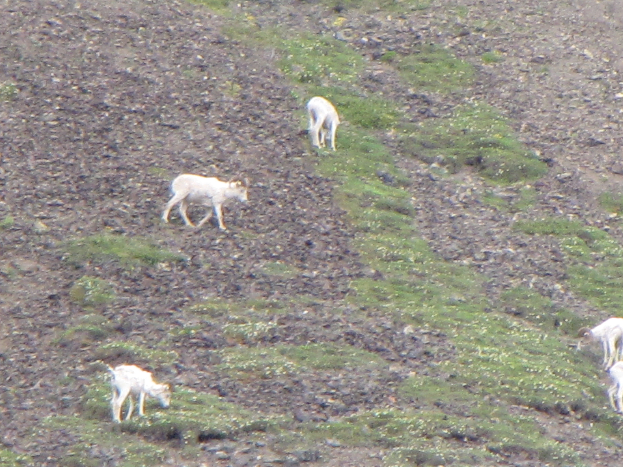

Slide 34
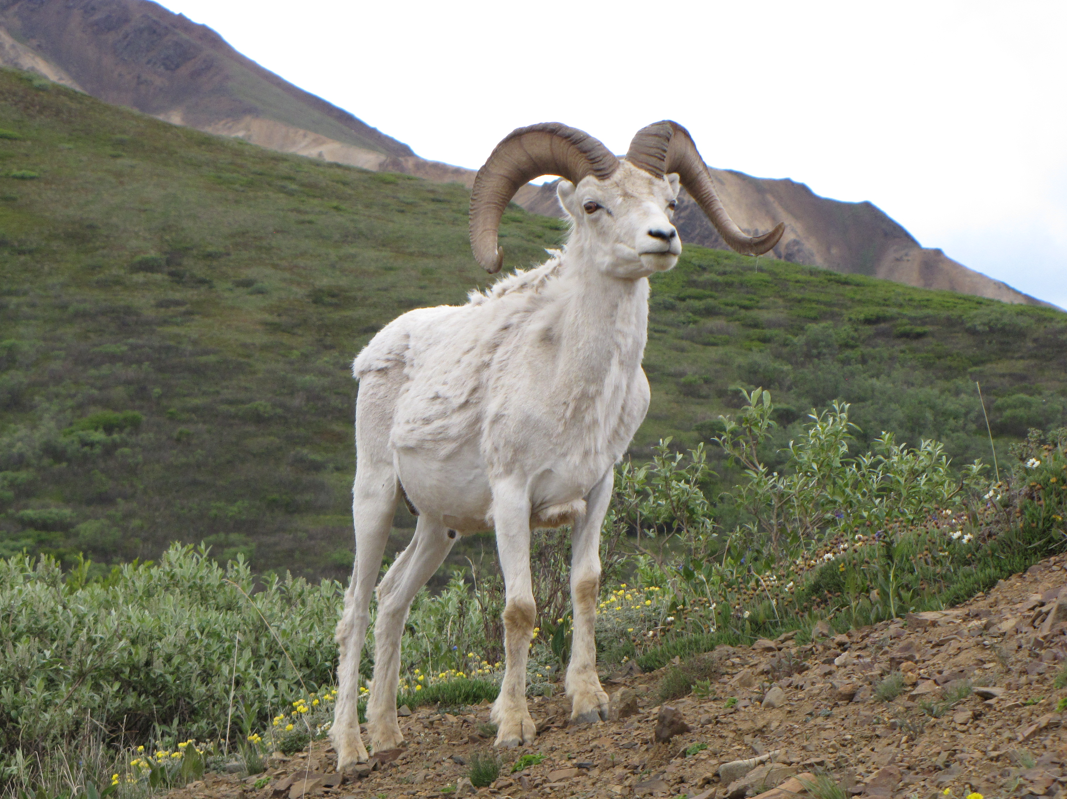

Slide 35
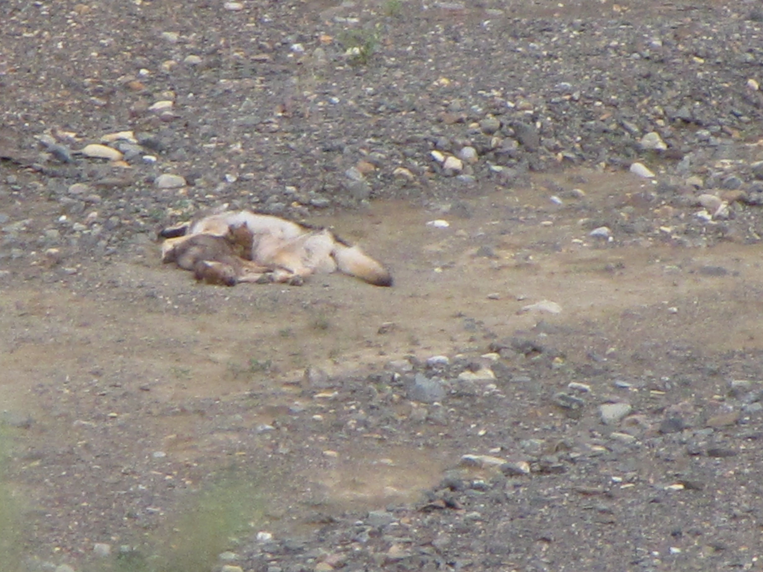

Slide 36
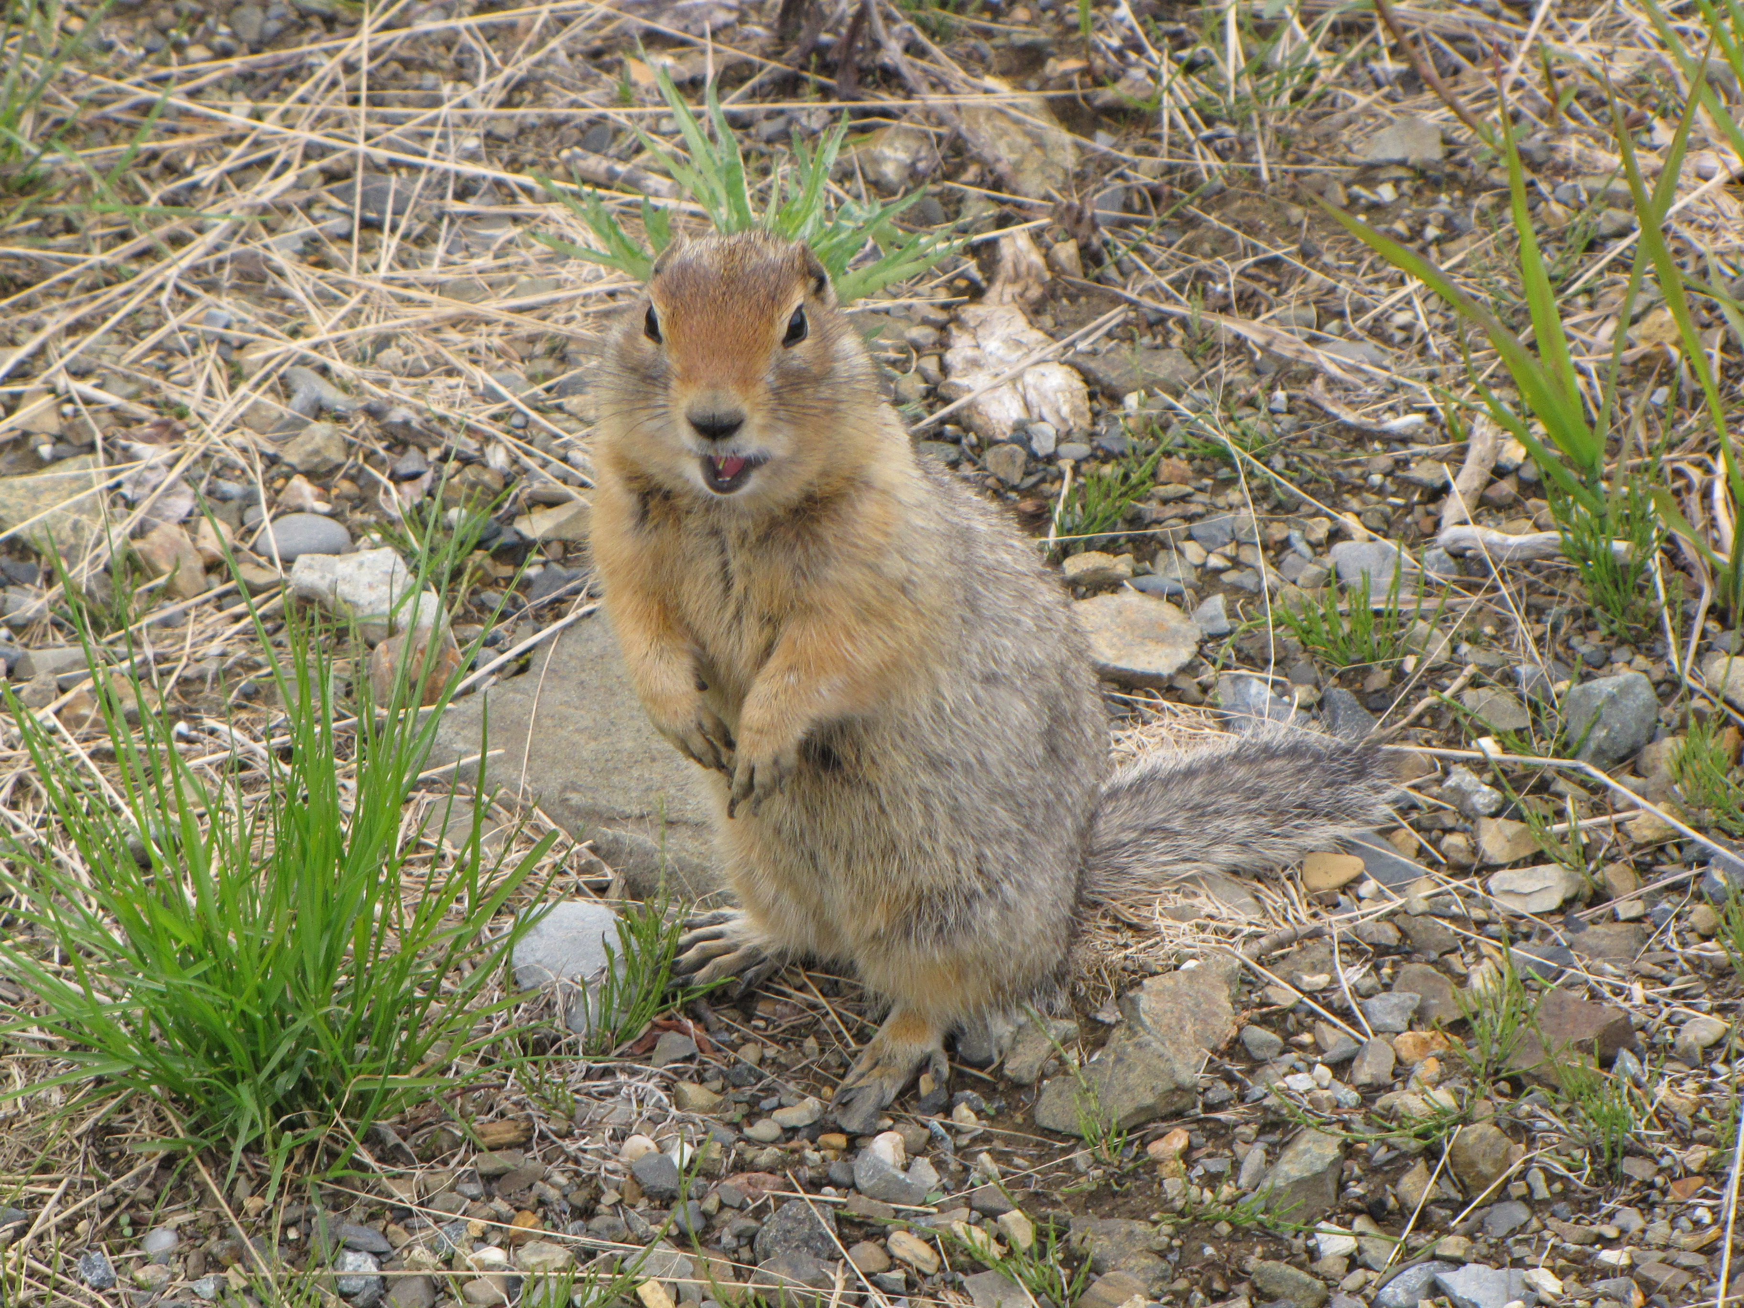

Slide 37
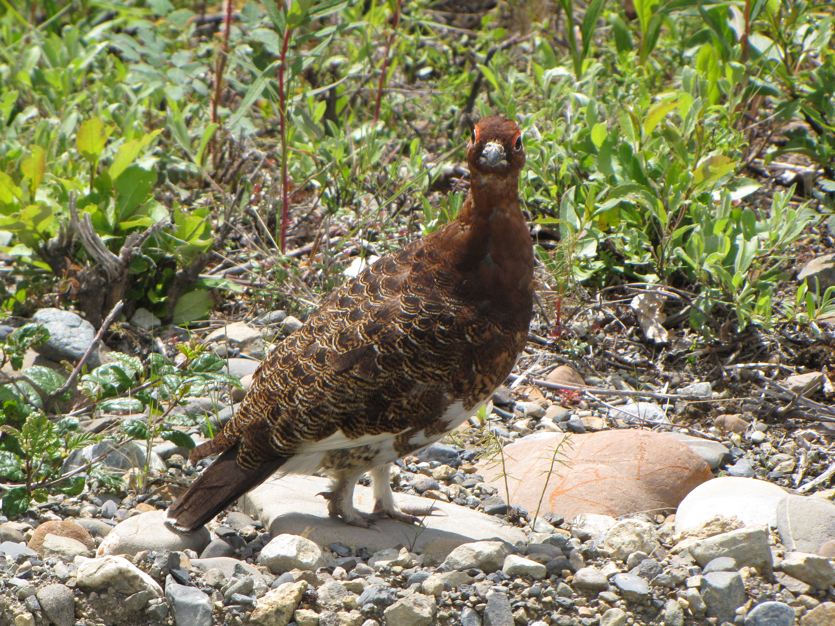

Slide 38
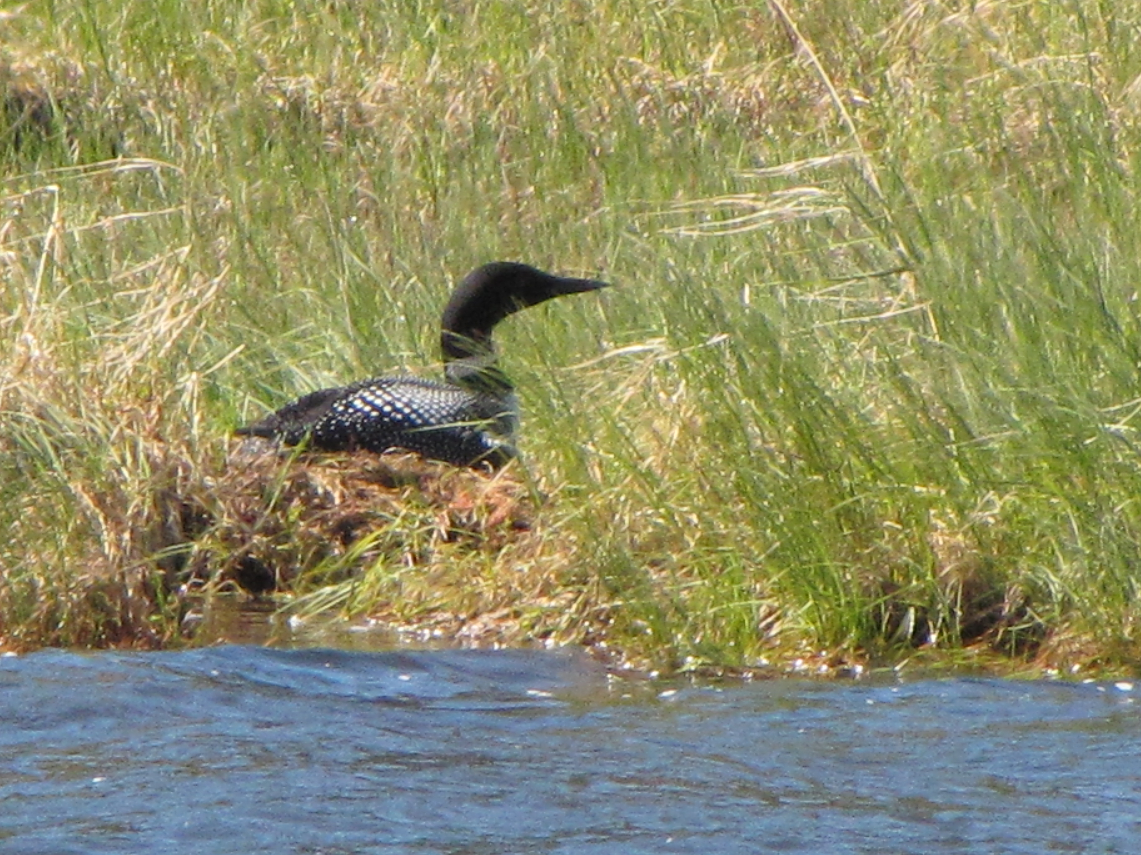

Slide 39
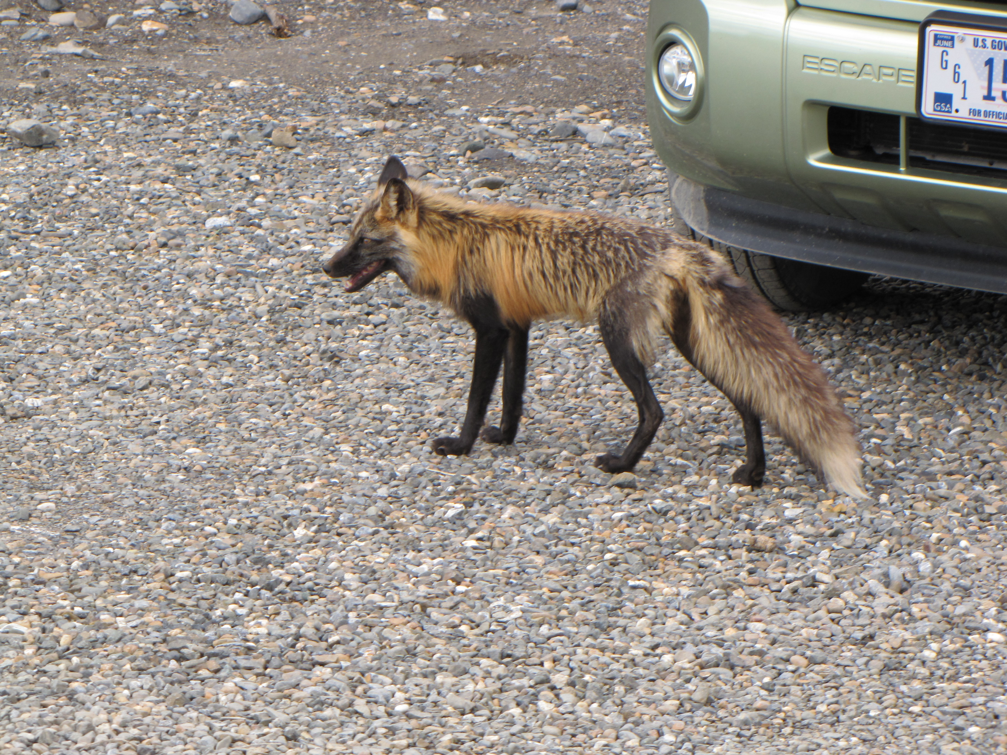

Slide 40
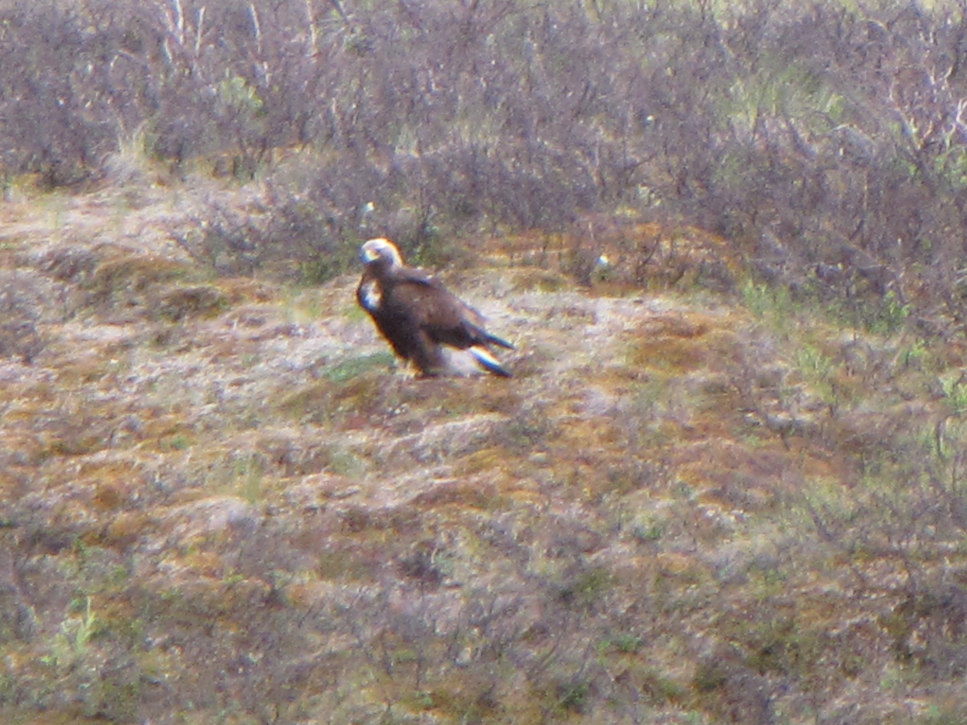

Slide 41
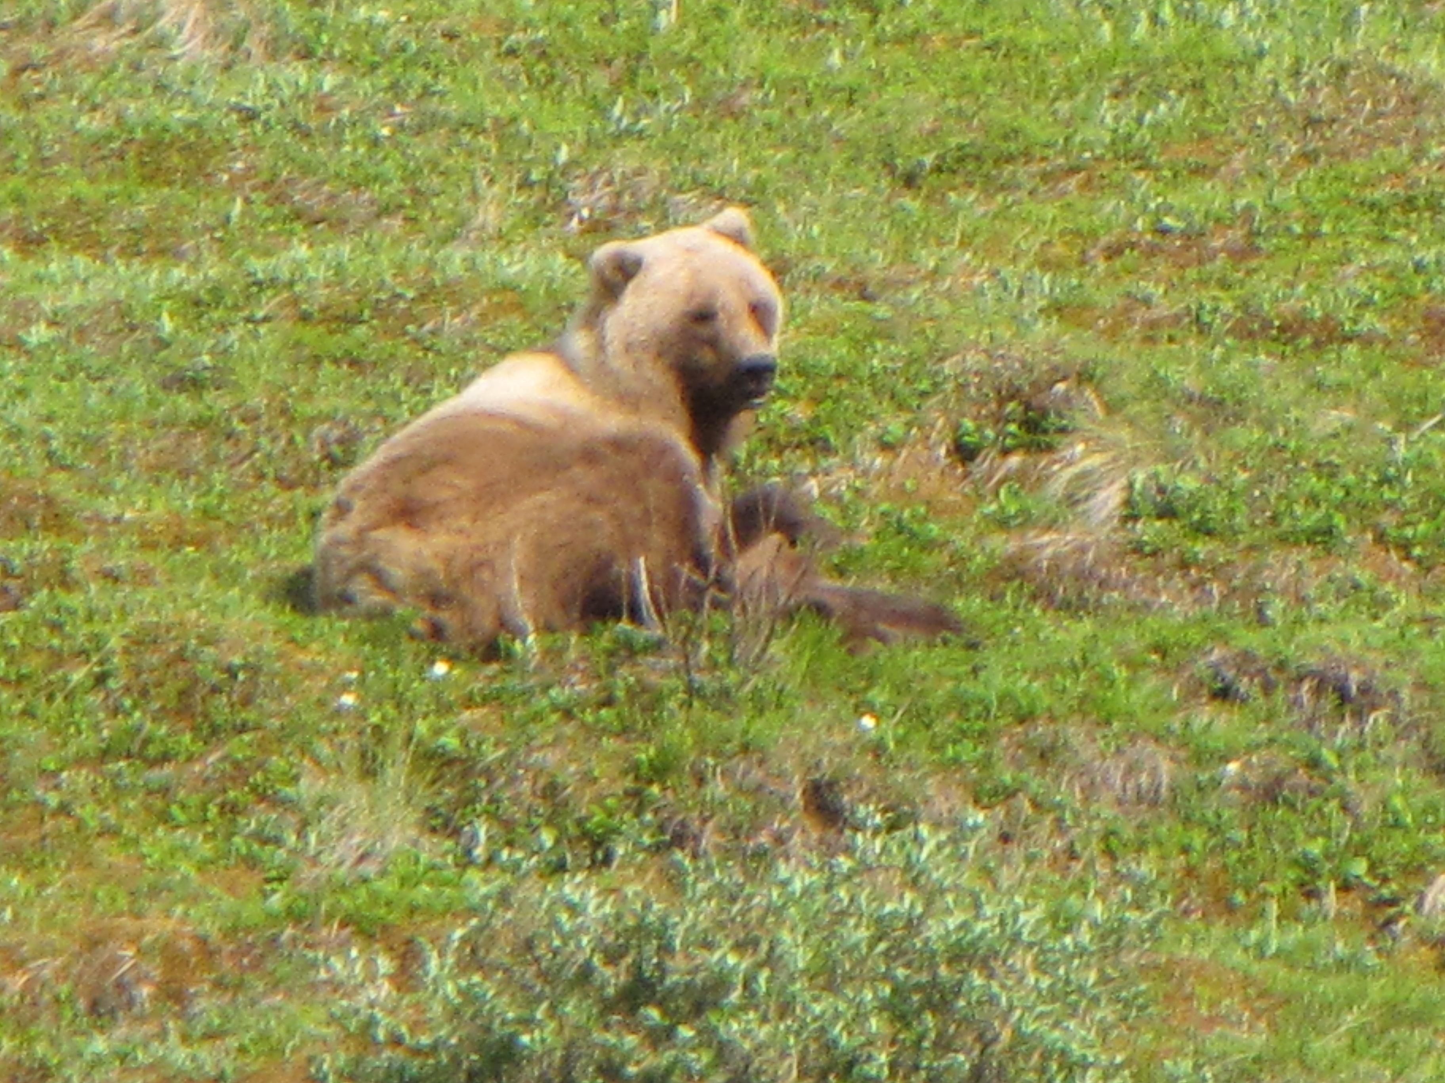

Slide 42
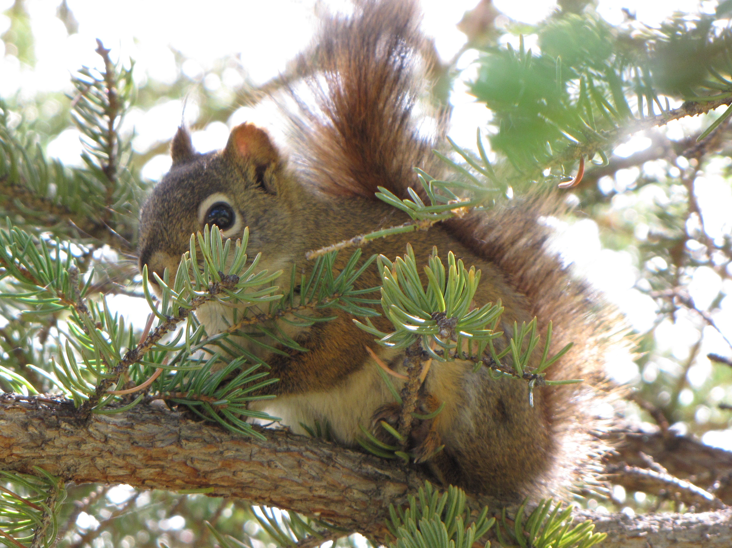

Slide 43
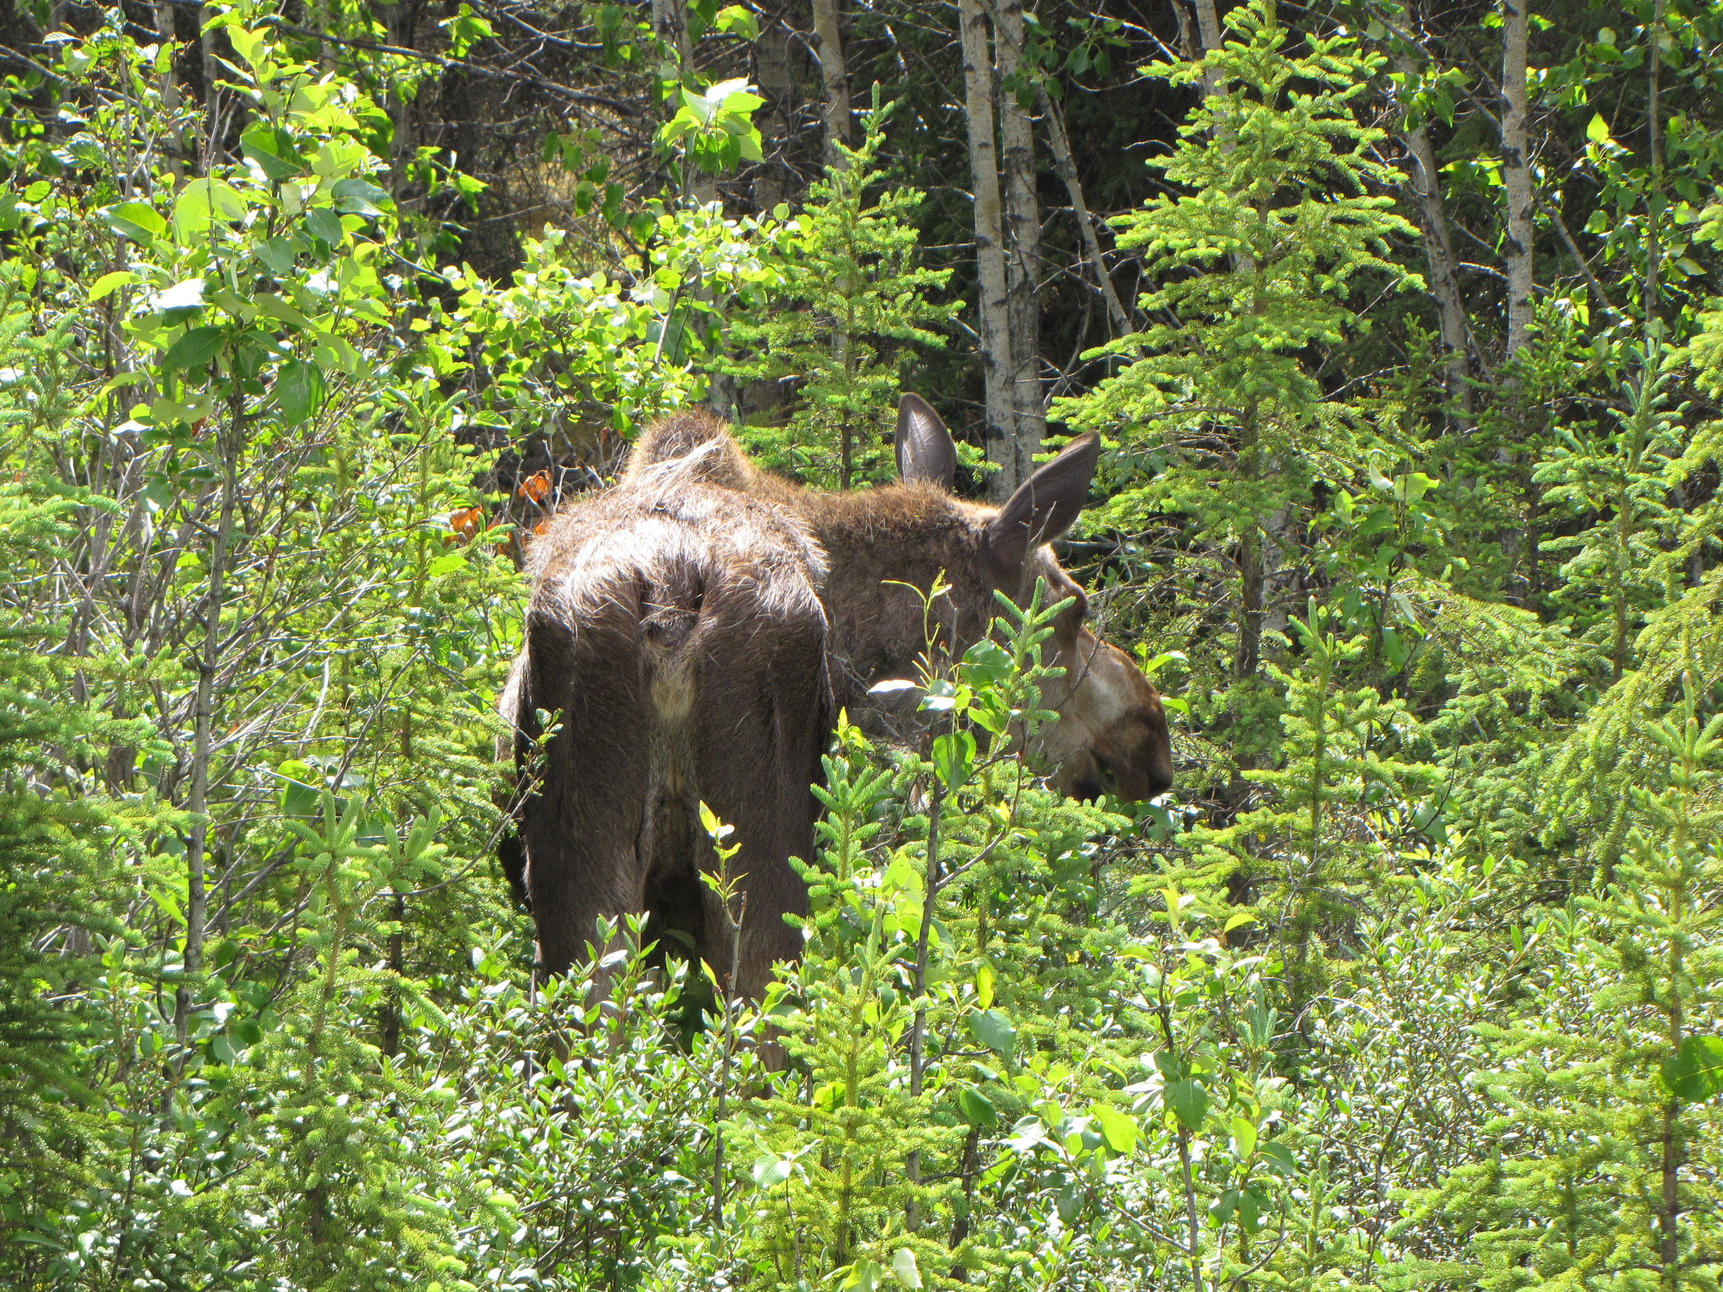

Slide 44
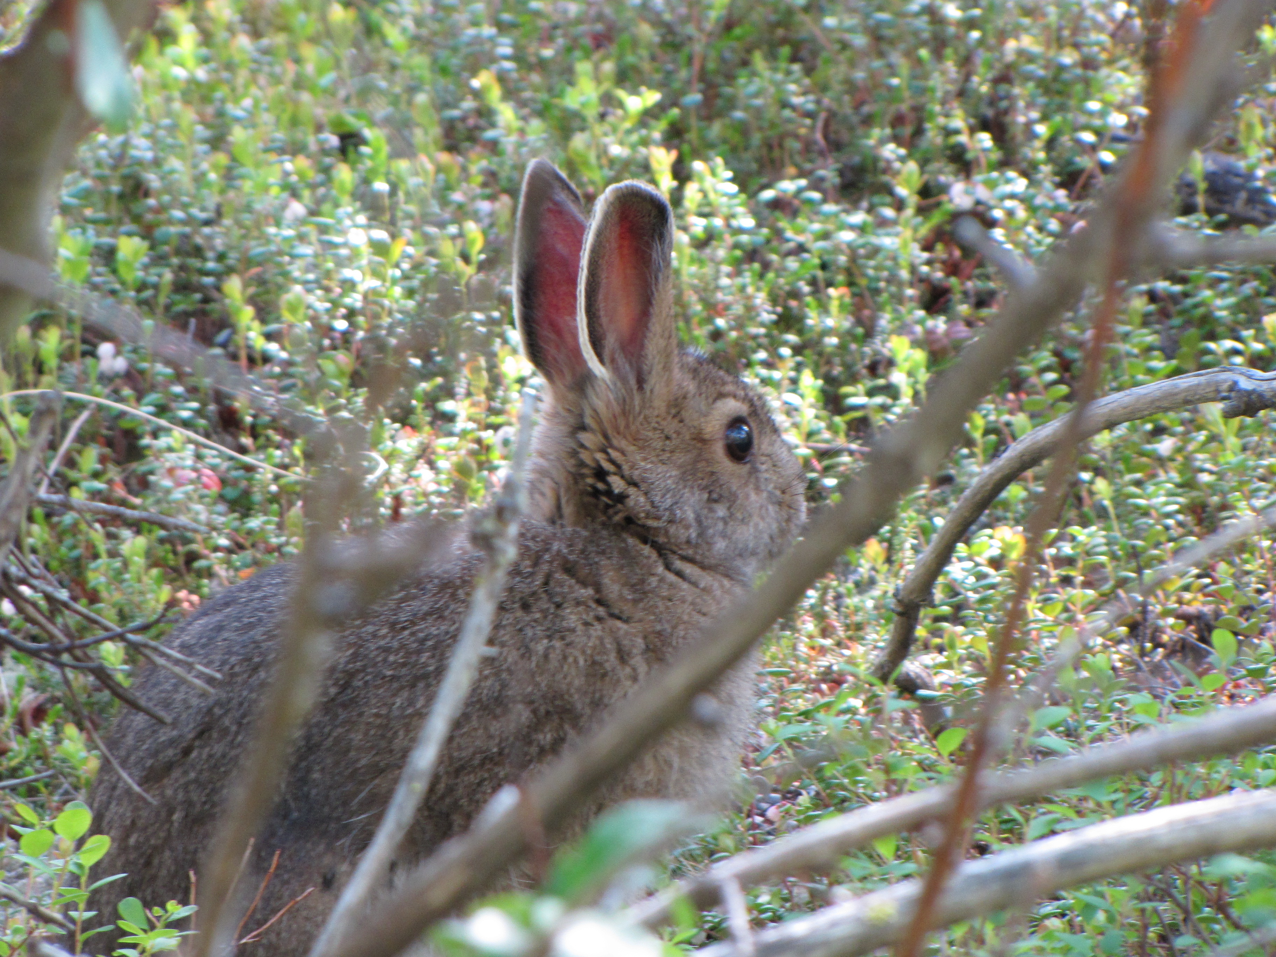

Slide 45
Tracy Arm Fjord. Like Glacier Bay NP. AK
Coastal park, glaciers heading into the water along fjords.
https://www.nps.gov/glba/learn/photosmultimedia/photogallery.htm

Slide 46
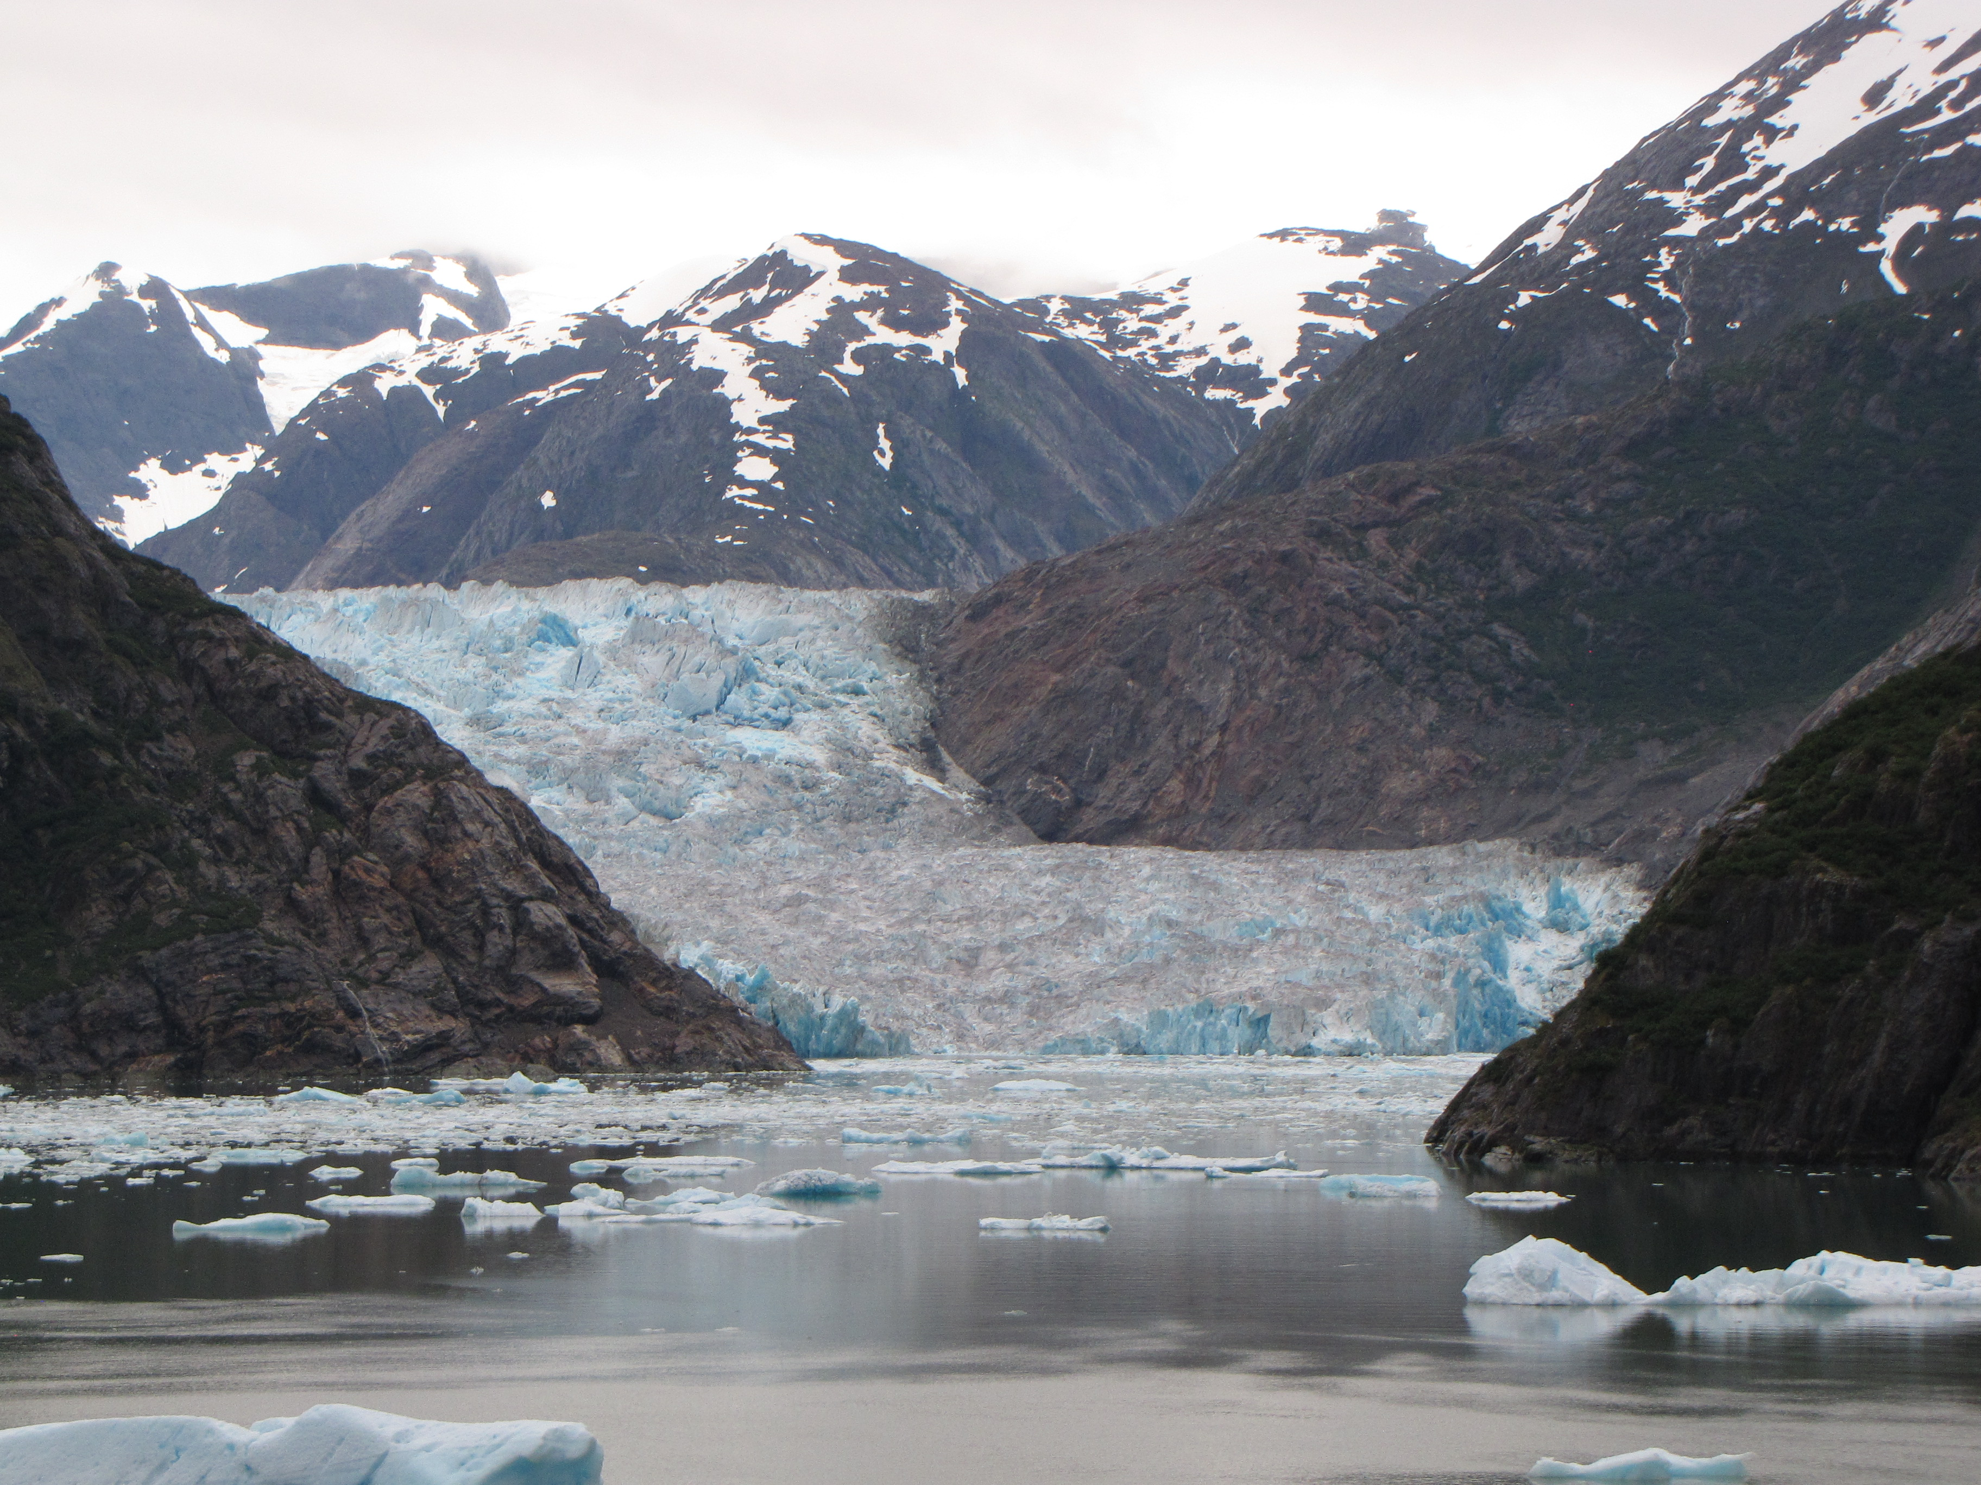

Slide 47
Great Basin NP. Nevada
Surprisingly cool. Top of a mountain in NV.
Rock glaciers, bristlecone pines, and an epic cave system.
https://www.nps.gov/grba/learn/photosmultimedia/photogallery.htm

Slide 48
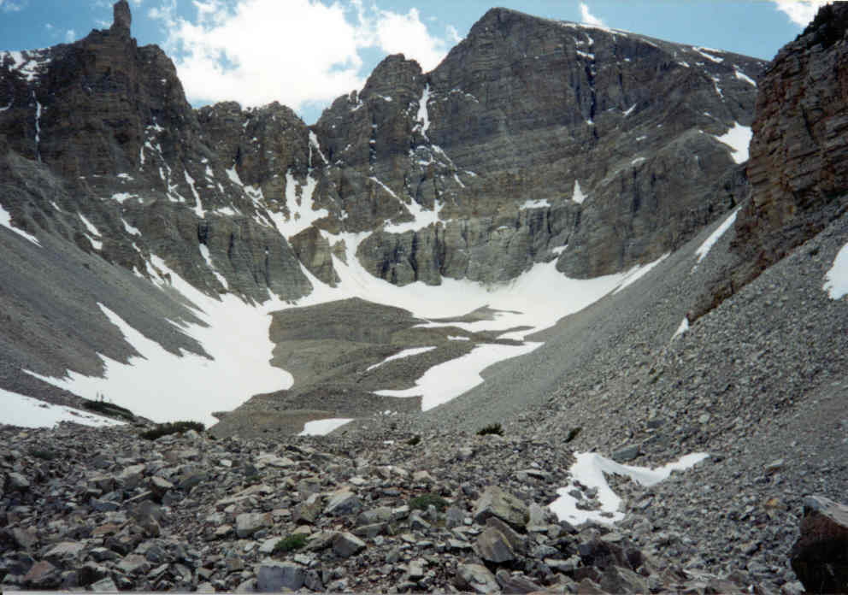

Slide 49
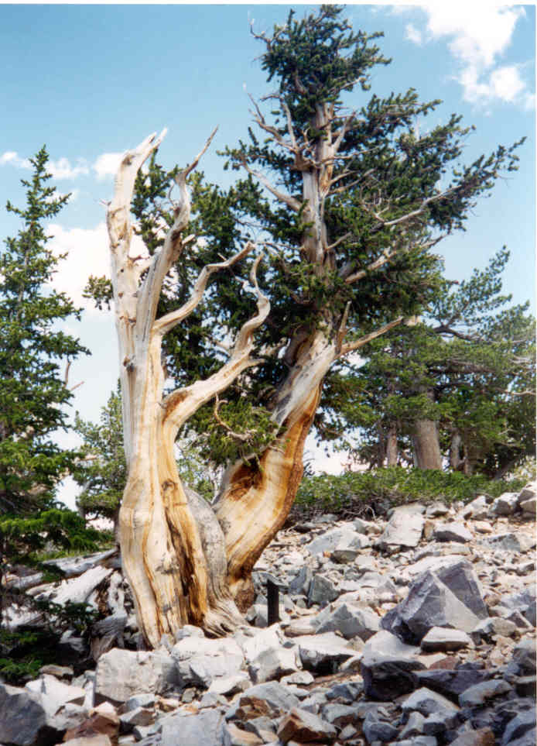

Slide 50
