Slide 1
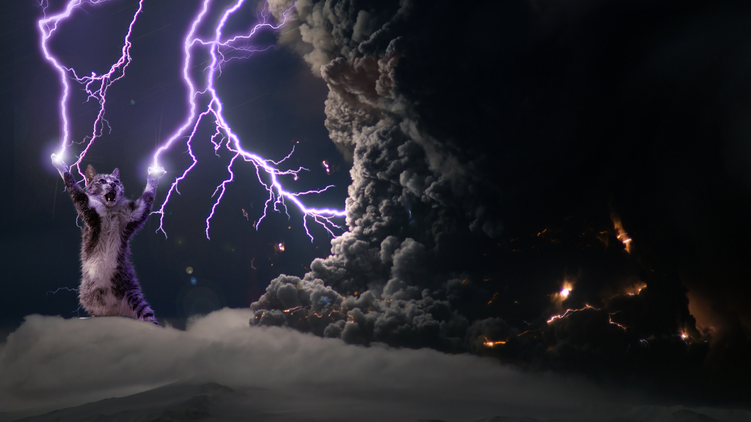
Volcanos
Eyjafjallajokull volcano, 2010

Slide 2
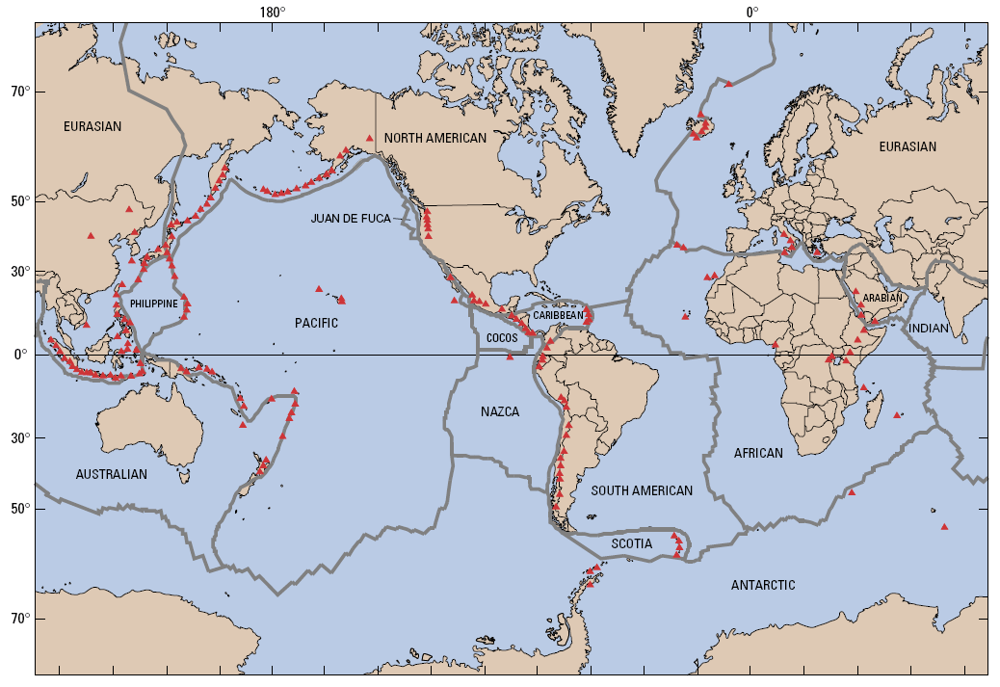

Slide 3
Types of volcanoes
Shield volcano
Fissure (flood) volcano
Composite (strato) volcano
Cinder Cones
Rhyolite caldera complex. Super volcanos. Yeah baby, yeah.

Slide 4
Onwards to photos (other slideshow)
Hawaii
Iceland
St. Helen’s
Pelee
Misc
Then on to The Big Ones

Slide 5
The big ones……
For a little context
St Helens | USA | 1980 | 0.5 km3. 15 mile vertical ash plume. Preceeded by a 5.1 mag quake

Slide 6
Tambora
http://www.newenglandhistoricalsociety.com/1816-year-without-a-summer/?fbclid=IwAR39vHvBWaGqDRWrQty88XOtY6gfX-PDxfJjrgO3DhT5sLJY6371Vz8WJFo
Tambora | Indonesia | 1815 | 100 1816 year without a summer Google earth

Slide 7
size
Volcano | Country | Year | Cubic km erupted
Tambora | Indonesia | 1815 | 100 1816 year without a summer Google earth
Taupo | New Zealand | 186 AD | 100
Kurile Lake | Kamchatka, Russia | 6640 BC | 70-80
Aniakchak | Alaska | 3450 yrs ago | 50
Crater Lake (Mazama) | USA | 6850 yrs ago | 30-40 White ash layer in soils around here from this.
Kikai-Akahoya | Japan | 6300 yrs ago | 30-40
Kuwae | Vanuatu | 1452 | 32-39
Santorini | Greece | 3600 yrs ago | 30-33 Tell atlantis/minoa story. Crete Google earth.
Ambrym | Vanuatu | 50 AD | 19-25
Krakatau | Indonesia | 1883 | 18 Massive shock wave, heard in Oz. Measured up Thames river. Def see in google Earth. Rebuilding actively.
Katmai | Alaska | 1912 | 12
Pinatubo | Philippines | 1991 | 10 big enough to mess with global Climate, at least a little.

Slide 8
The biggest eruption was at Yellowstone about 2.2 million years ago. An explosive eruption produced 2,500 cubic kilometers of ash!

Slide 9
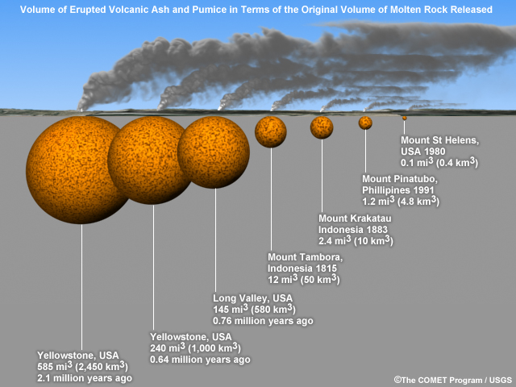

Slide 10
https://volcanoes.usgs.gov/volcanoes/yellowstone/yellowstone_sub_page_54.html

Slide 11
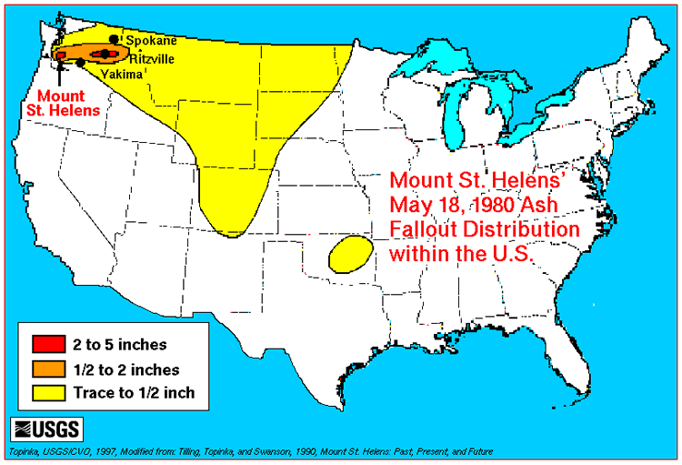

Slide 12
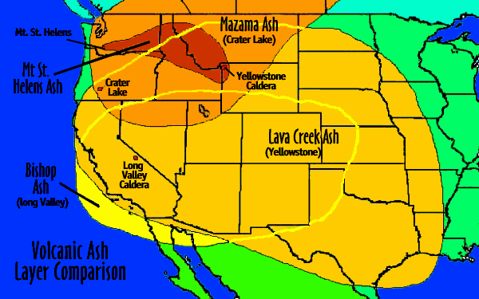

Slide 13
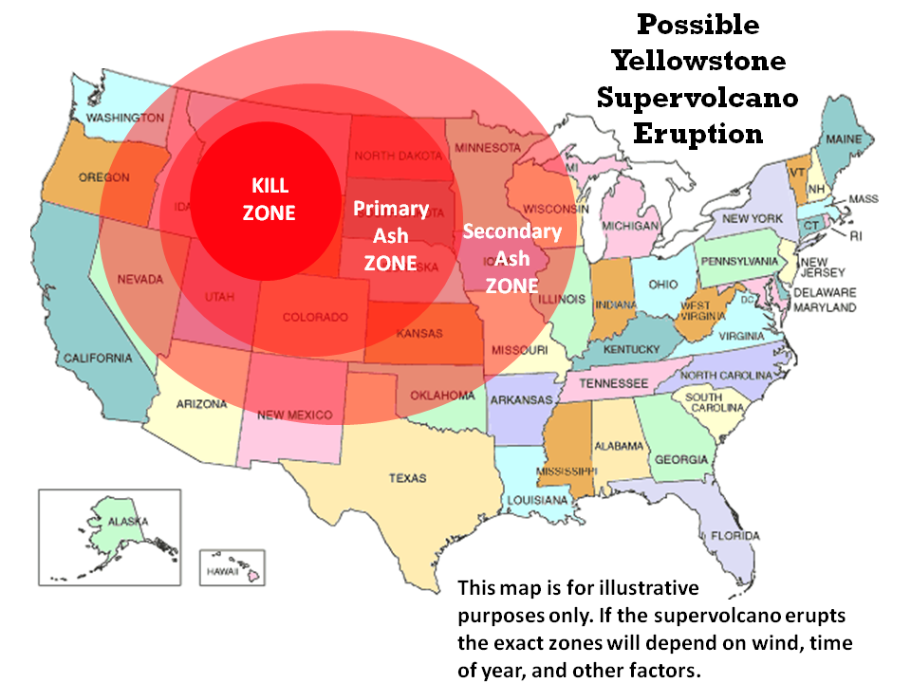

Slide 14
