Slide 1
Primary Volcanic Parks

Slide 2
https://www.nps.gov/subjects/volcanoes/primary-volcanic-parks.htm
Goto link and see list. More about ones I’ve visited.

Slide 3
Crater Lake, Oregon
Stratovolcano. Photos in previous slideshow

Slide 4
Craters of the Moon, Idaho
Fissure volcanics and cinder cones
"The surface of the moon as seen through a telescope" is how geologist Harold T. Stearns described this area in 1923. Stearns saw a place where "the dark craters and the cold lava [were] nearly destitute of vegetation." Its strangeness stirred local legends, wider public interest, and then a feature story in National Geographic magazine. In 1924, responding to growing public concern. President Calvin Coolidge used the 1906 Antiquities Act to proclaim Craters of the Moon National Monument, preserving "a weird and scenic landscape, peculiar to itself."
NASA's Apollo Astronauts Alan Shepard, Edgar Mitchell, Eugene Cernan, and Joe Engle learned basic volcanic geology here in 1969 as they prepared for their moon missions.
Goto https://www.nps.gov/crmo/learn/photosmultimedia/photogallery.htm for pics

Slide 5
Devil’s Tower, MT
Volcanic plug. Hexagonal columns. Sacred to Native Americans.
My only photos are still hardcopy, though I’ve seen it from the road more than once.
https://www.nps.gov/deto/learn/photosmultimedia/photogallery.htm

Slide 6
Hawai’i Volcanoes National Park, Hawai’i
Shield volcano
Some pics in previous slideshow
https://www.nps.gov/havo/learn/photosmultimedia/photogallery.htm

Slide 7
Mount Rainier, WA
Mount Rainier is the tallest volcano in the Cascades with an elevation of 14,410 ft (4,392 m). The most recent magmatic eruption at this composite volcano occurred approximately 1,000 years ago, and reports of historic eruptions are not considered reliable. Mount Rainier is considered to be the most dangerous volcano in the continental United States because of its propensity for unleashing catastrophic lahars and its proximity to densely populated areas. Mount Rainier is heavily glaciated, and the presence of ice, snow, and abundant surface water, along with the prevalence of weak hydrothermally-altered rock on the volcano’s slopes, make Mount Rainier especially susceptible to lahars.
https://www.nps.gov/mora/learn/photosmultimedia/photogallery.htm

Slide 8
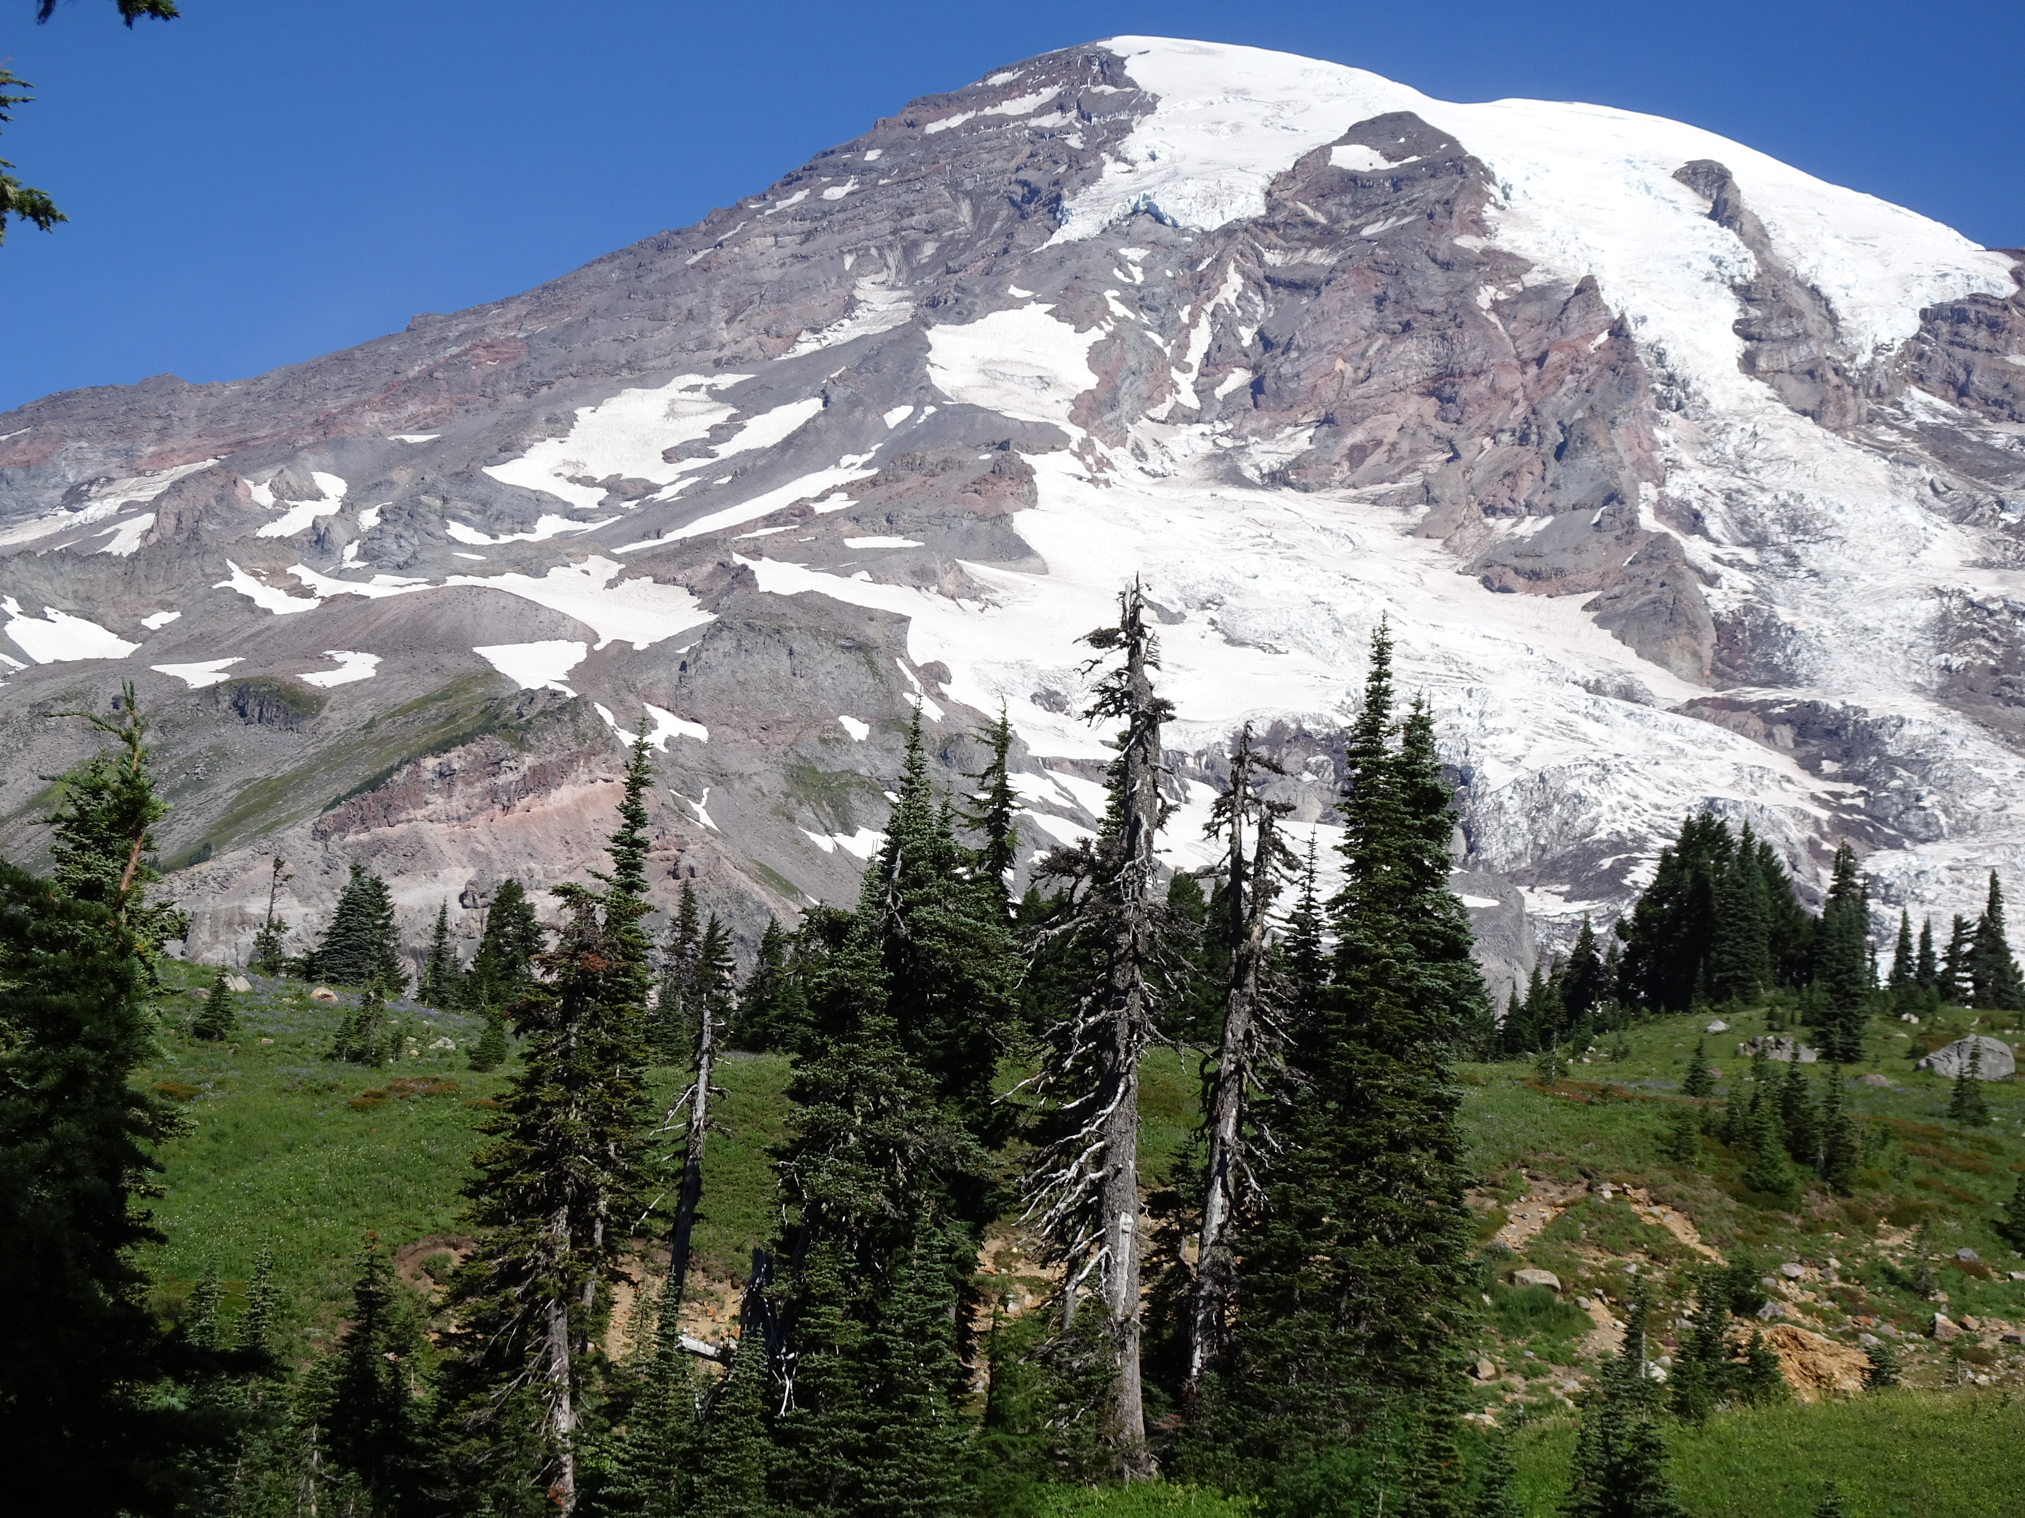

Slide 9
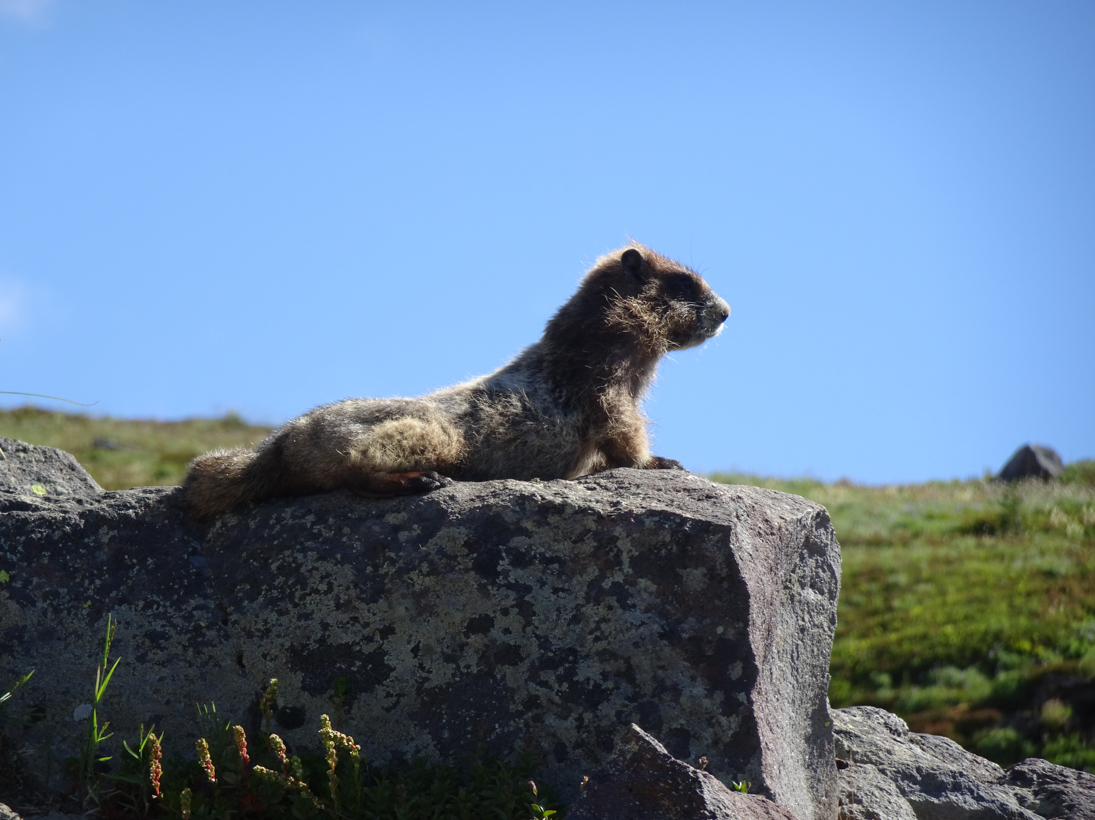

Slide 10
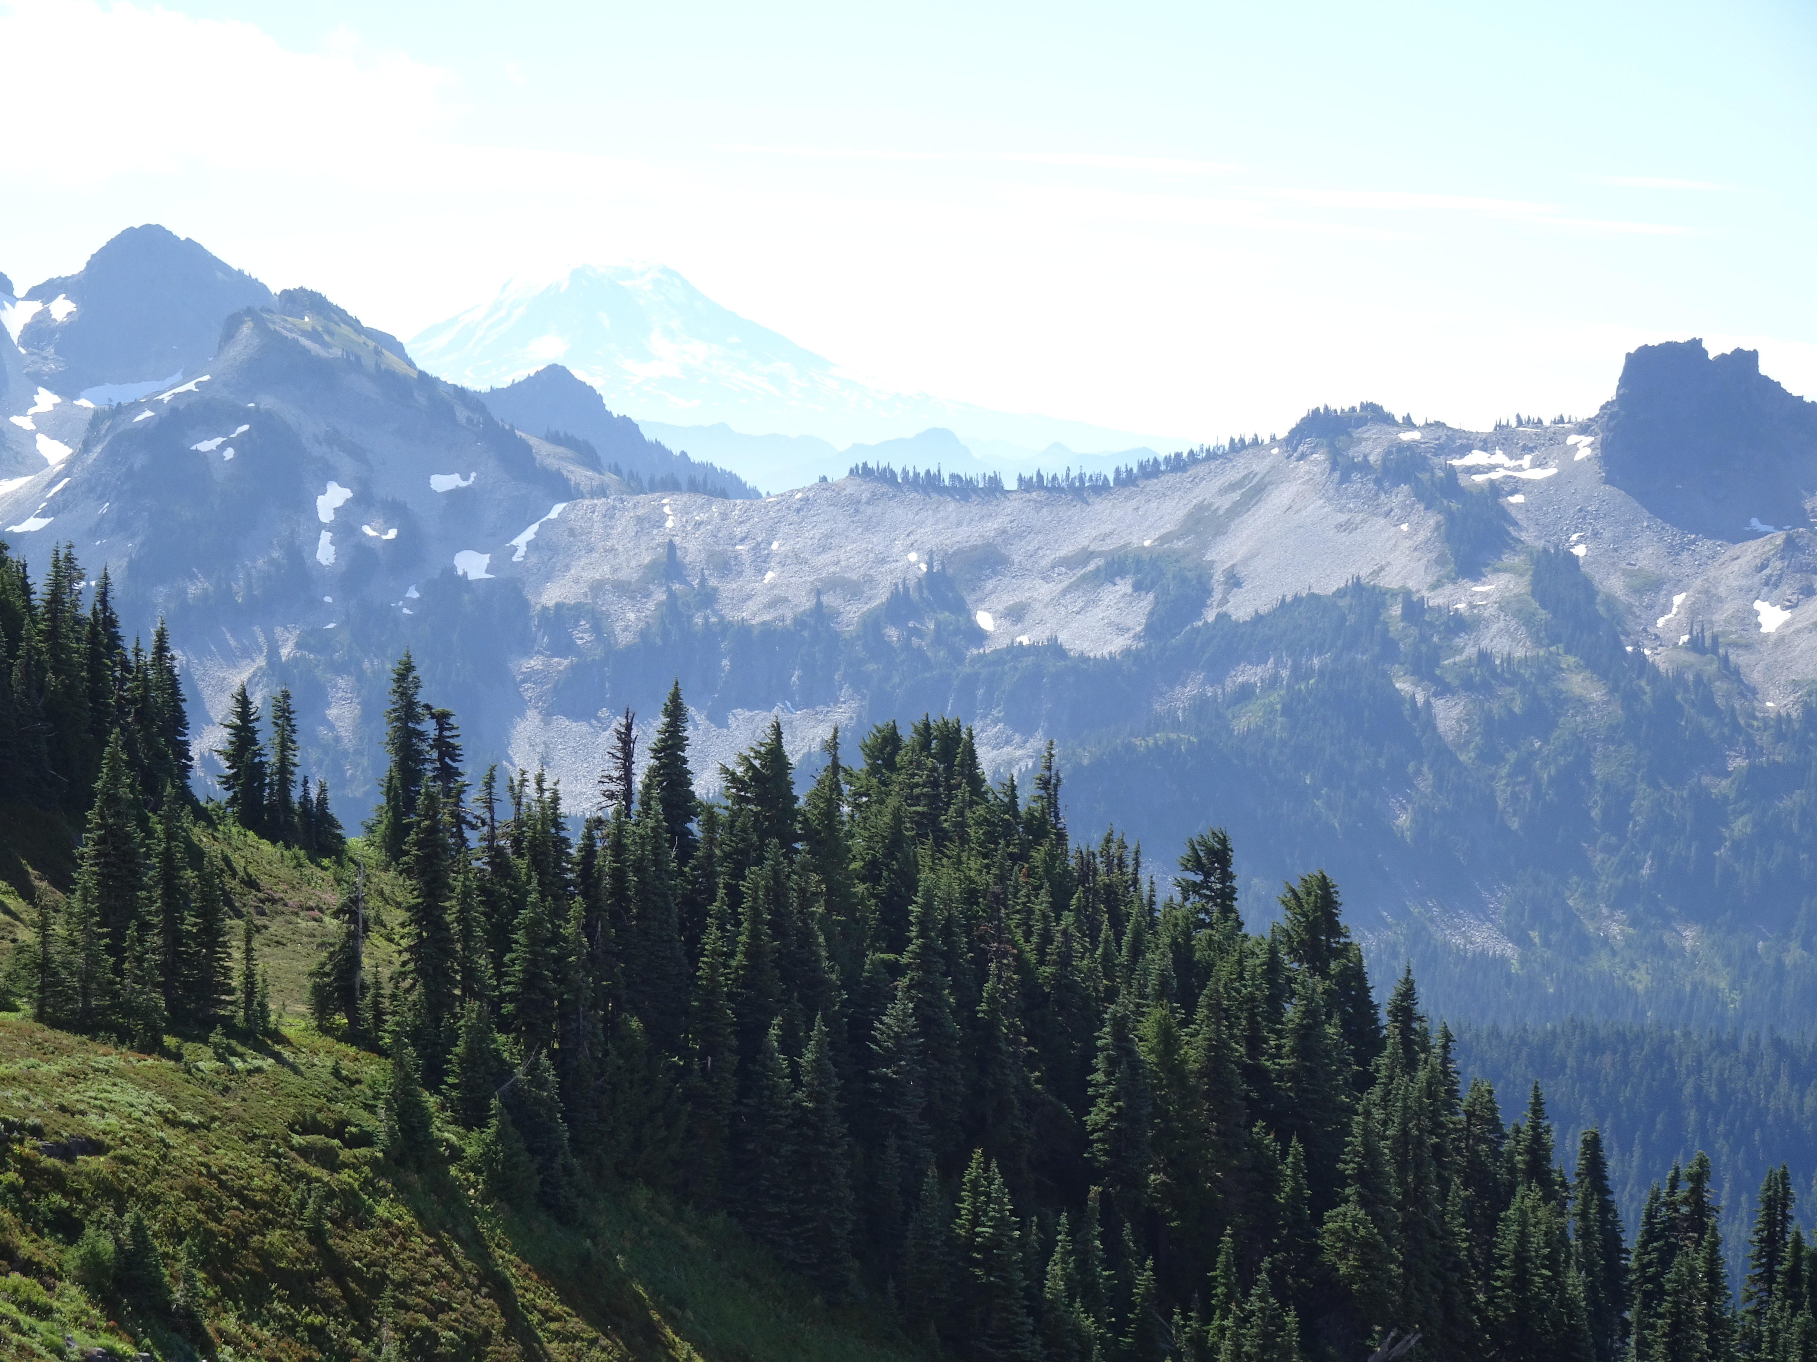

Slide 11
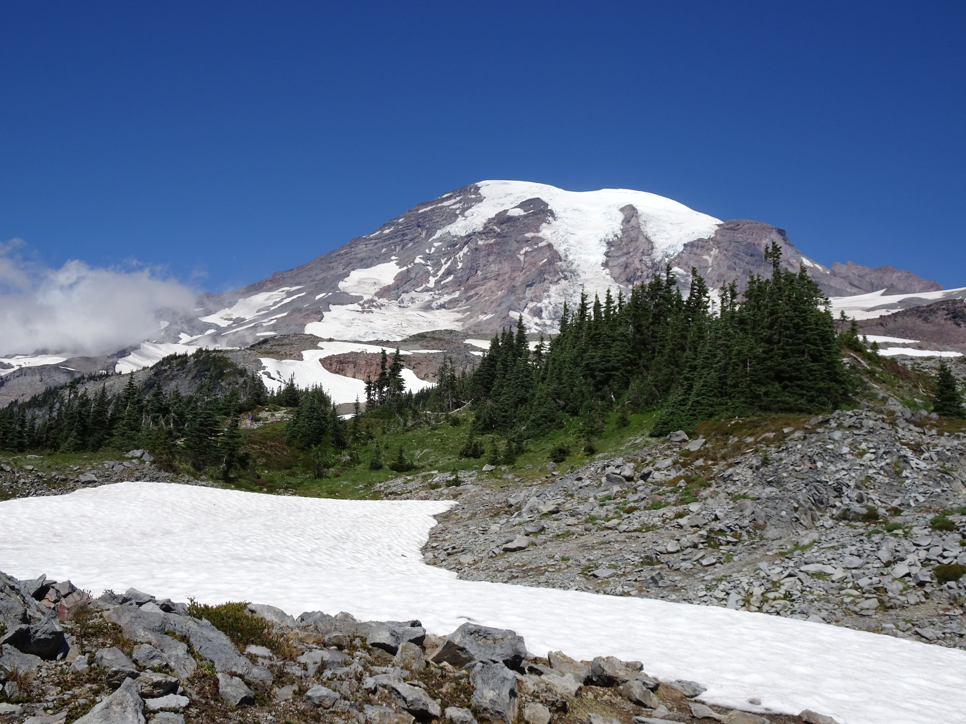

Slide 12
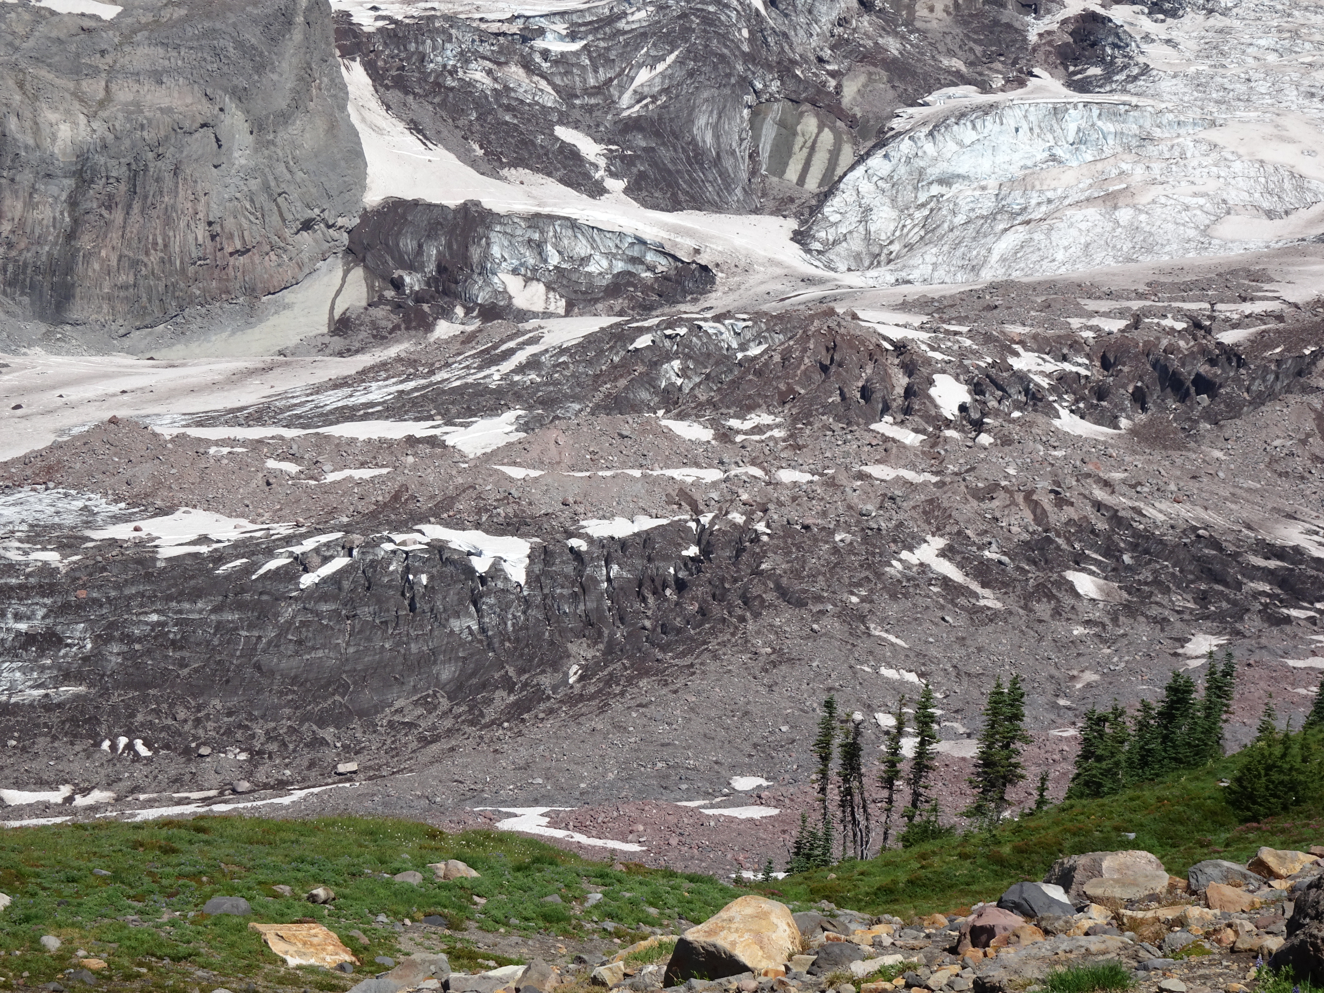

Slide 13
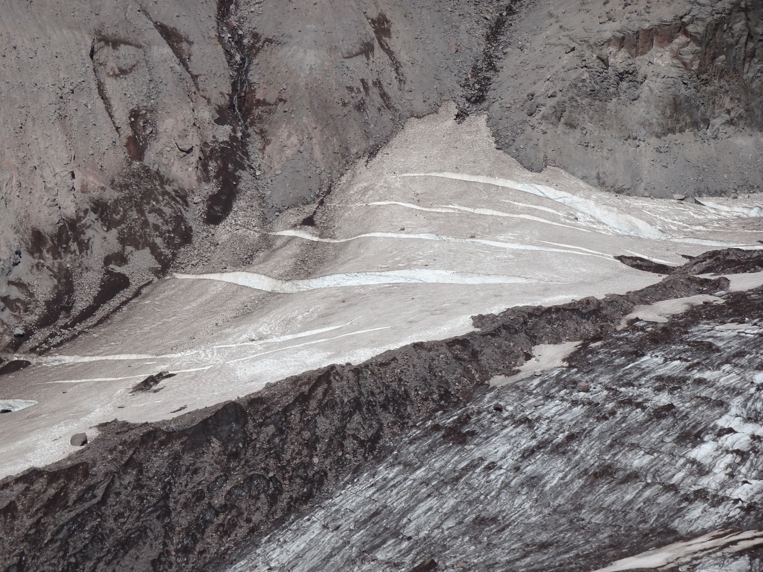

Slide 14
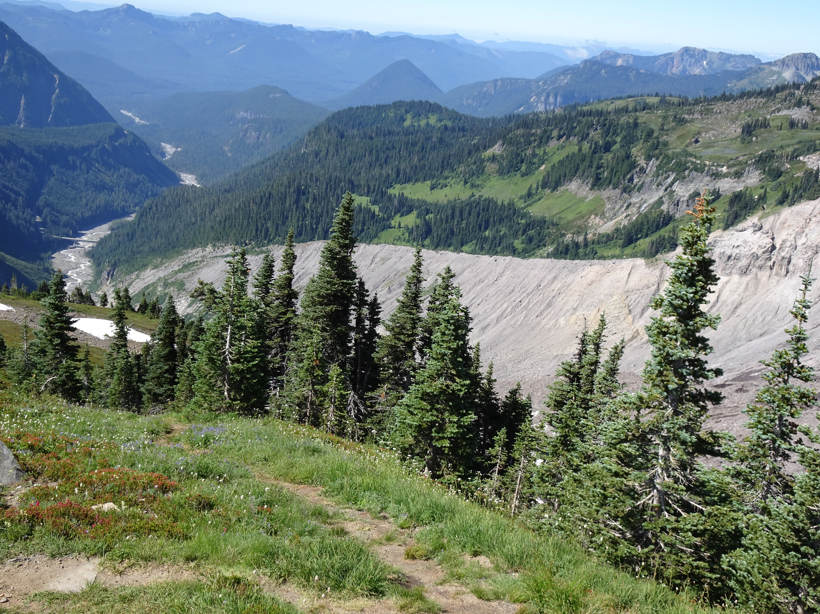

Slide 15
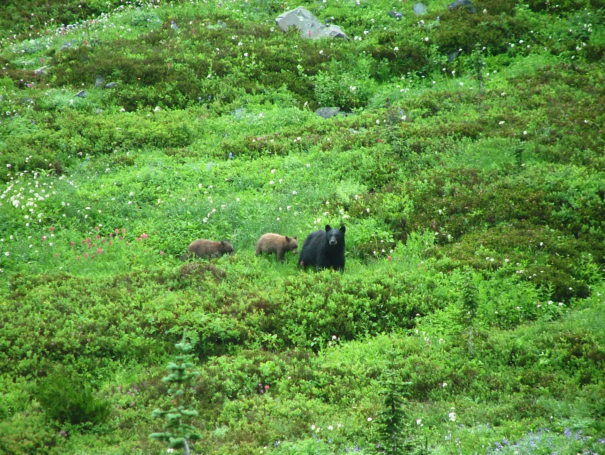

Slide 16
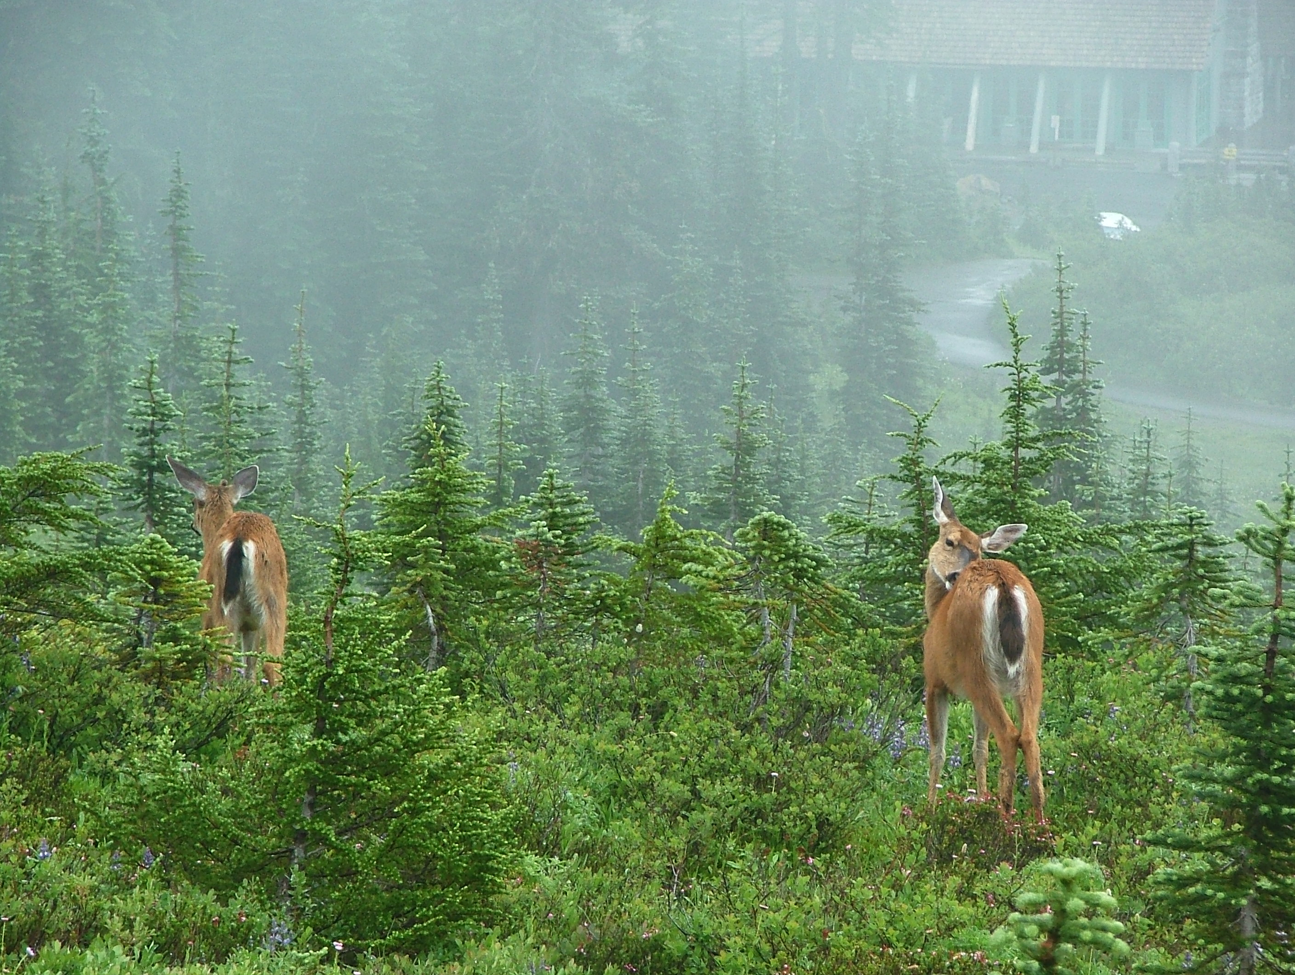

Slide 17
Yellowstone, WY, ID, MT
Supervolcano
Some pics earlier.
9000 km2, or approximately 17% of Hungary
https://www.nps.gov/yell/learn/photosmultimedia/photogallery.htm

