Slide 1
Caves!

Slide 2
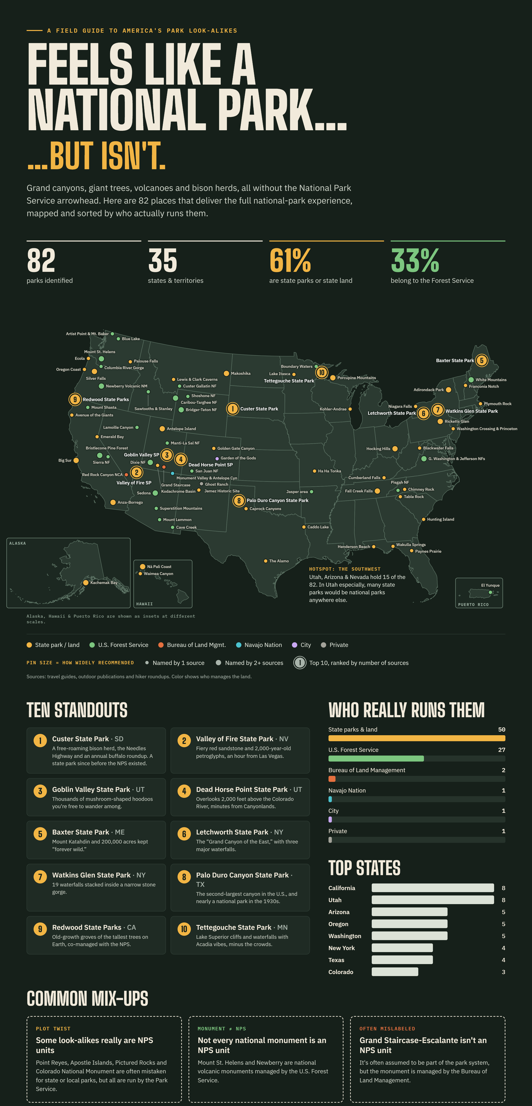
But first

Slide 3
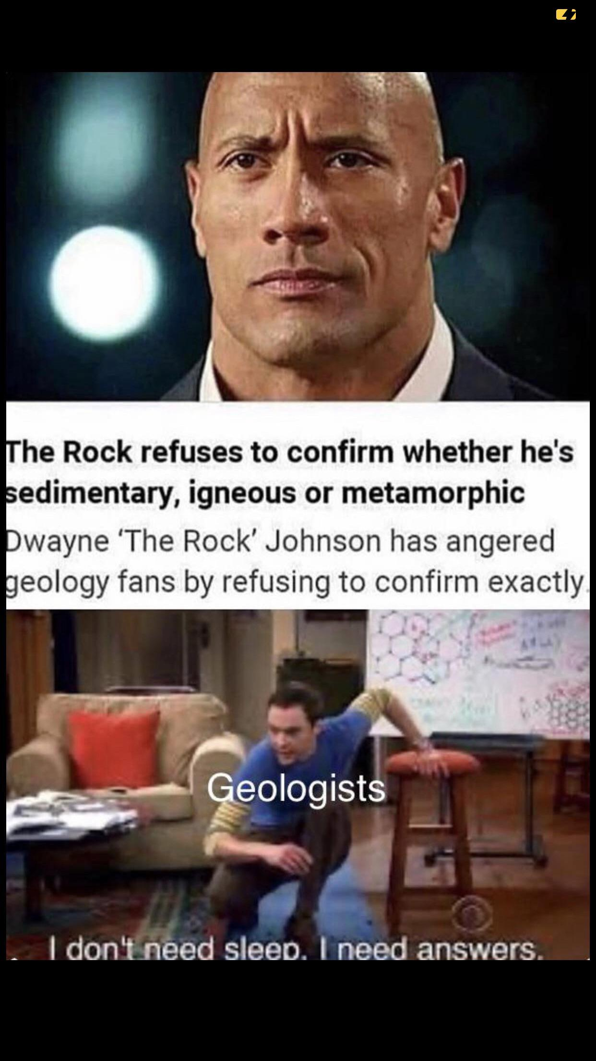
and

Slide 4
Mammoth Cave NP, Kentucky. https://www.nps.gov/maca/index.htm
Carlsbad Caverns NP, NM. https://www.nps.gov/cave/index.htm
Timpanogos Cave NM, Utah https://www.nps.gov/tica/index.htm
Russell Cave NM, Alabama. https://www.nps.gov/ruca/index.htm
Jewel Cave NM, SD. https://www.nps.gov/jeca/index.htm

Slide 5
Mammoth
https://www.nps.gov/maca/learn/photosmultimedia/photogallery.htm

Slide 6
Carlsbad
https://www.nps.gov/cave/learn/photosmultimedia/photogallery.htm

Slide 7
Jewel cave
https://www.nps.gov/jeca/learn/photosmultimedia/photogallery.htm

Slide 8
Russell Cave
https://www.nps.gov/ruca/learn/photosmultimedia/photogallery.htm

